Slide 1

The experience of the
UN-support to the International Comission against Impunitiy
in Guatemala
-Liliana Valiña

Slide 2
Fight against corruption
CLOSE RELATIONSHIP
Protection of
Human Rights
Sustainable development
Notes:
The close relationship between the fight against corruption, sustainable development and the protection of human rights is indisputable

Slide 3
Rule of Law
FUNDAMENTAL
PRINCIPLES
Equality
and non-discrimination
Dignity
Notes:
The close relationship between the fight against corruption, sustainable development and the protection of human rights is indisputable

Slide 4
In Guatemala, the fight against impunity and corruption has an innovating component
The International Comission against Impunitiy
Better known as: CICIG

Slide 5
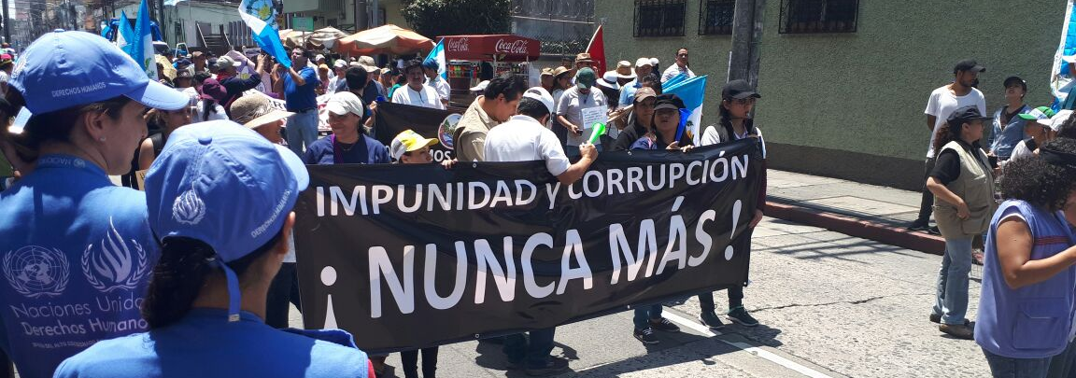
Corruption has a negative impact on the enjoyment and exercise of human rights

Slide 6
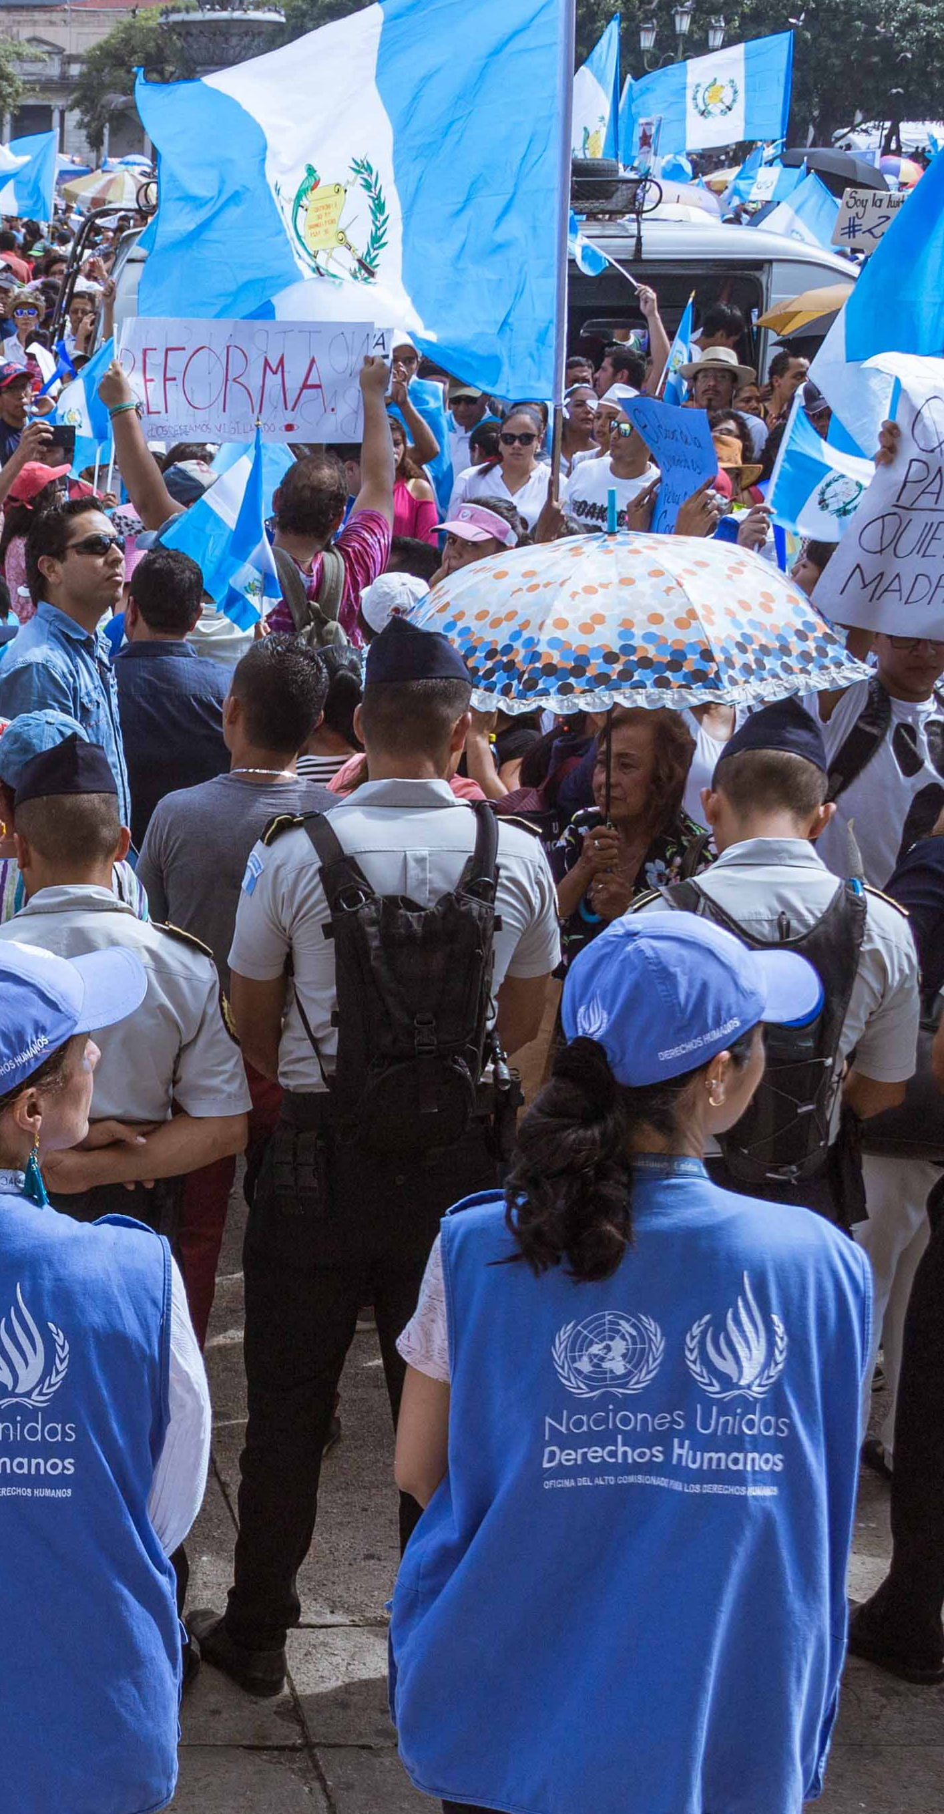
Corruption undermines the ability of States to comply with their international human rights obligations

Slide 7
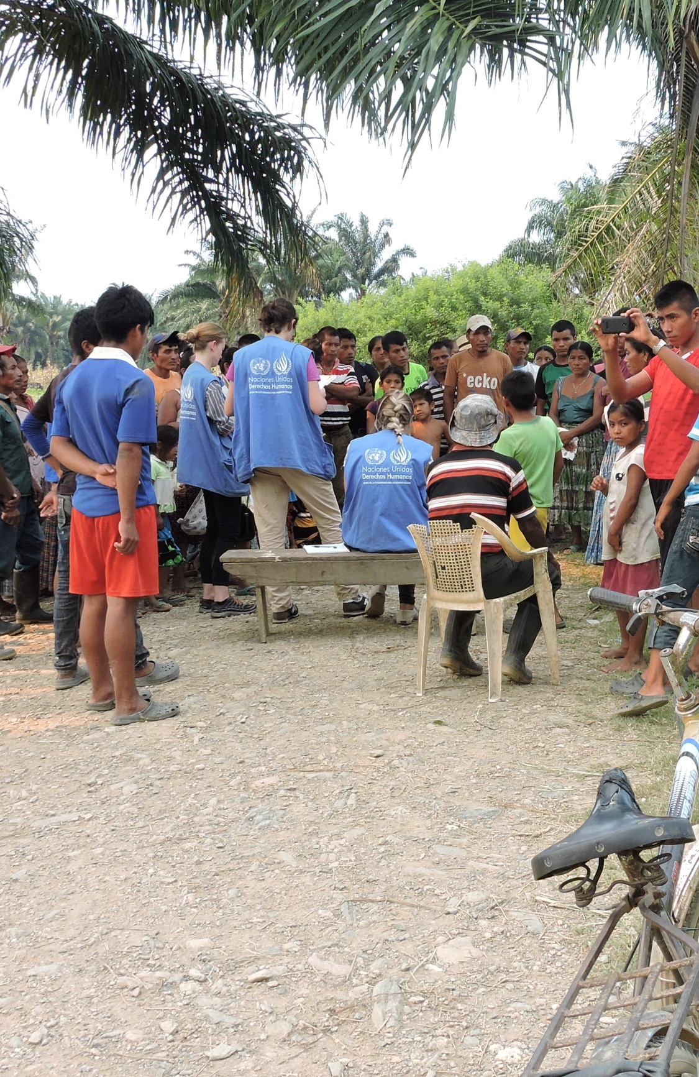
In Latin America and Guatemala, inequality is a structural scourge
In this context, corruption affects the situation of the most vulnerable groups

Slide 8




POVERTY
60% of the country’s population lives in poverty
76.1% rural areas
79.2% indigenous peoples
69.2% children under 15
Guatemala is affected by deep inequality and discrimination
-Annual Report of the UN High Commissioner on the activities of his Office in Guatemala

Slide 9
OHCHR
CICIG
STRATEGIC ALLIANCE
Contribute to the consolidation of the rule of law
Fight against corruption and impunity
Strengthening of the justice system
Notes:
The close relationship between the fight against corruption, sustainable development and the protection of human rights is indisputable

Slide 10

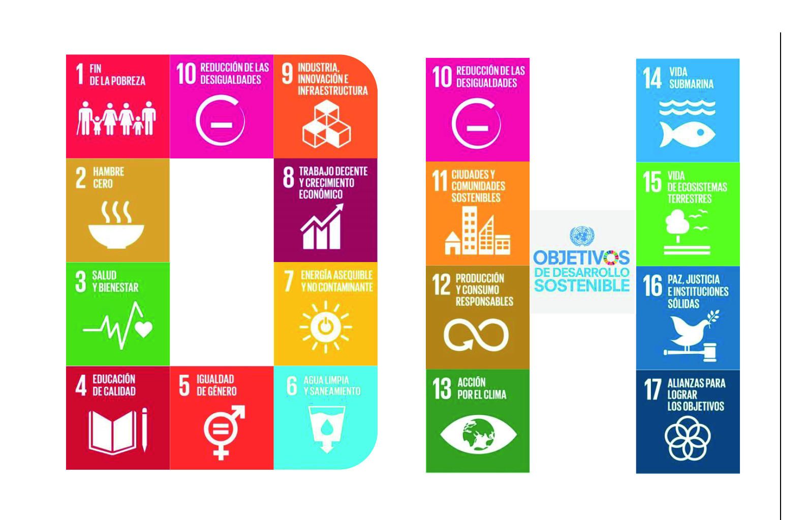
Corruption is a significant obstacle
for the 2030 agenda that seeks to leave no one behind

Slide 11
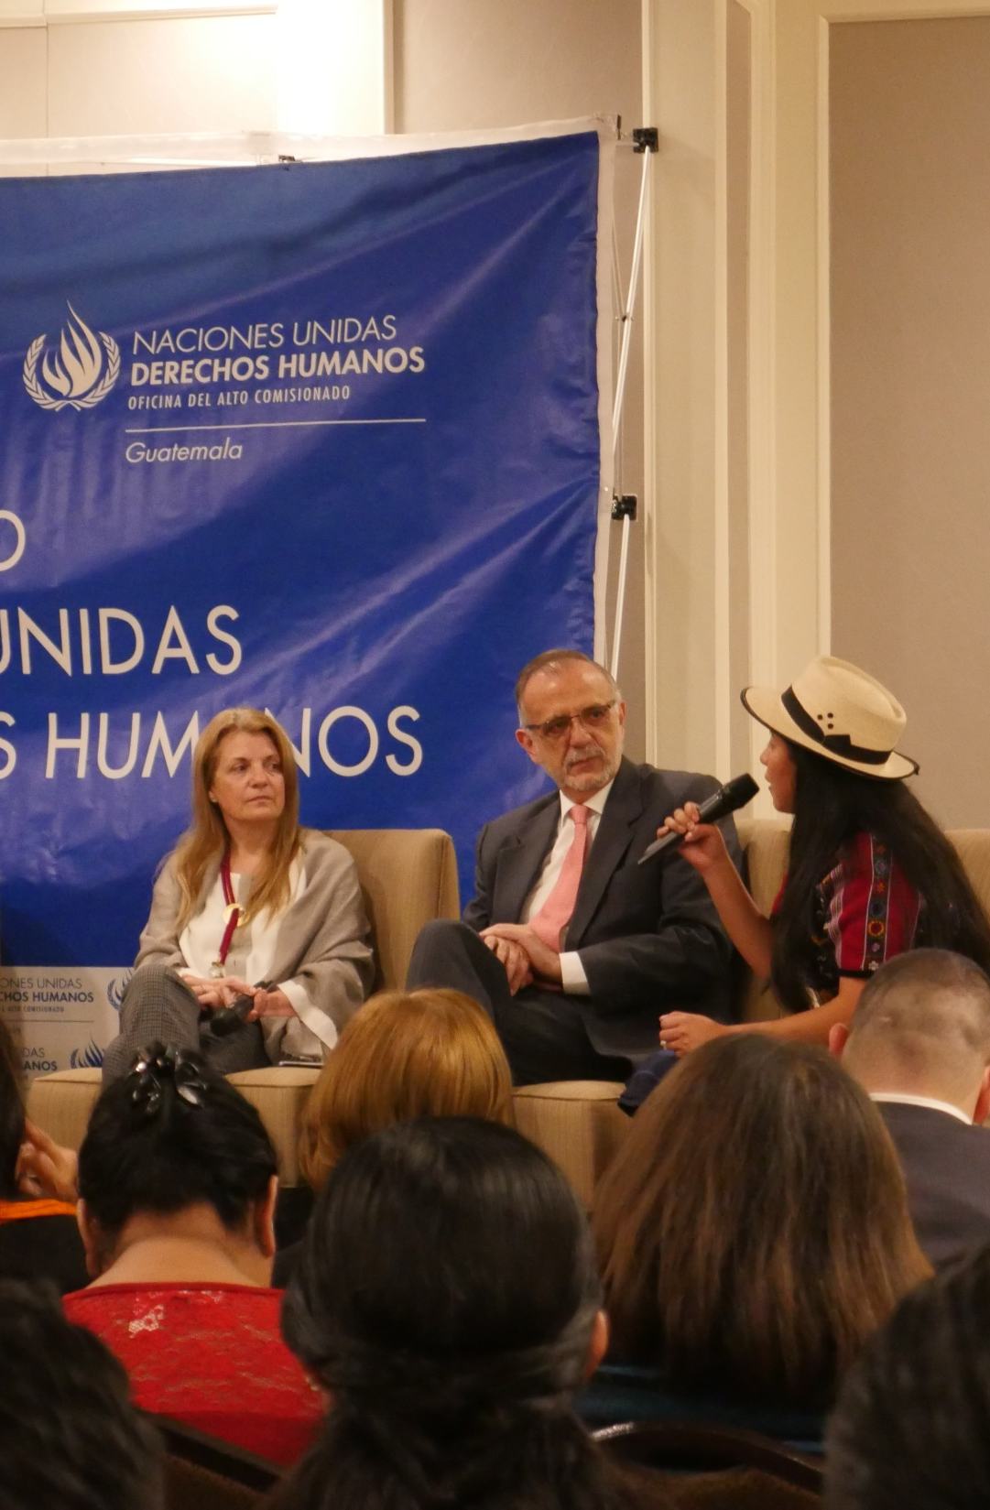
Both institutions have a mandate to advise on legislation and public policy
We have joined efforts aimed at the fight against impunity, rule of law and judicial independence

Slide 12
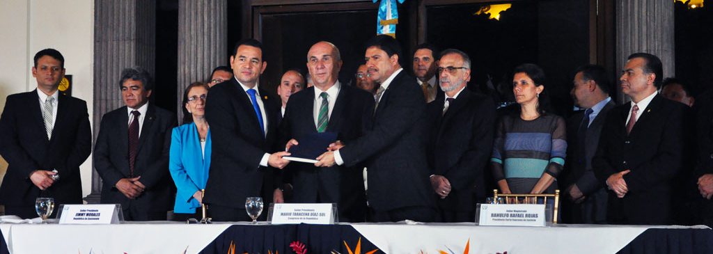
Promotion of a Constitutional reform in the area of justice
Joint effort with Attorney General Office, the HR Ombusdman, OHCHR, CICIG, the UN Resident Coordinator, Civil Society and State Institutions
OHCHR promoted recognition of indigenous jurisdiction and other issues related to judicial independence

Slide 13

Fight against corruption
Justice system
Human Rights approach
Rights of the Victim
Criminal prosecution
OHCHR provides HR international standards to legislative proposals

Slide 14
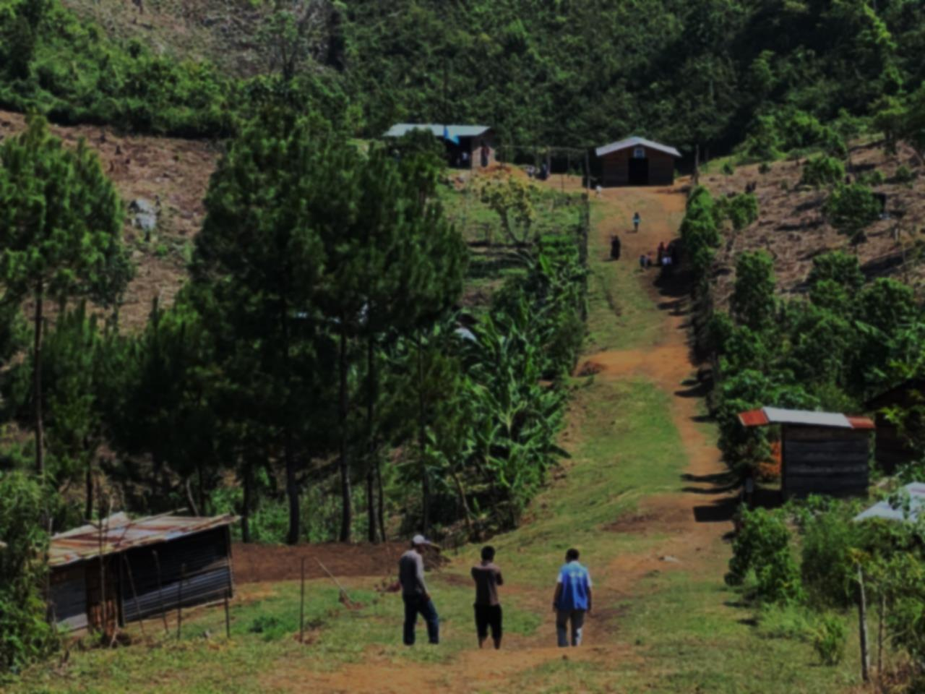
Monitoring human rights violations allows OHCHR to formulate strategies and recommendations as parameters for the fight against impunity and corruption

Slide 15
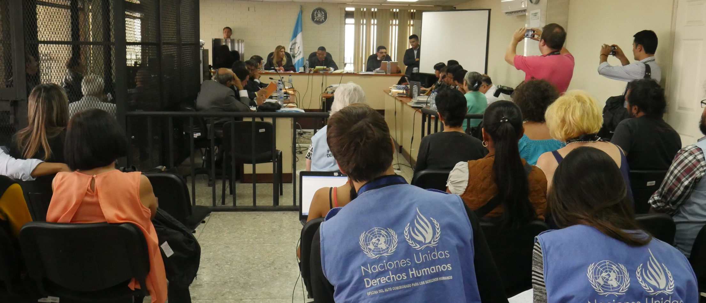
Frequently the same actors are involved in different processes, some related to corruption, other to HR violations

Slide 16

OHCHR monitors situation of actors involved in investigations that are threatened and in a situation of risk

Slide 17
Many cases of corruption have a direct impact on the human rights of the population
Illicit electoral founding
Health
System
Civil & Political rights
ESCR

Slide 18
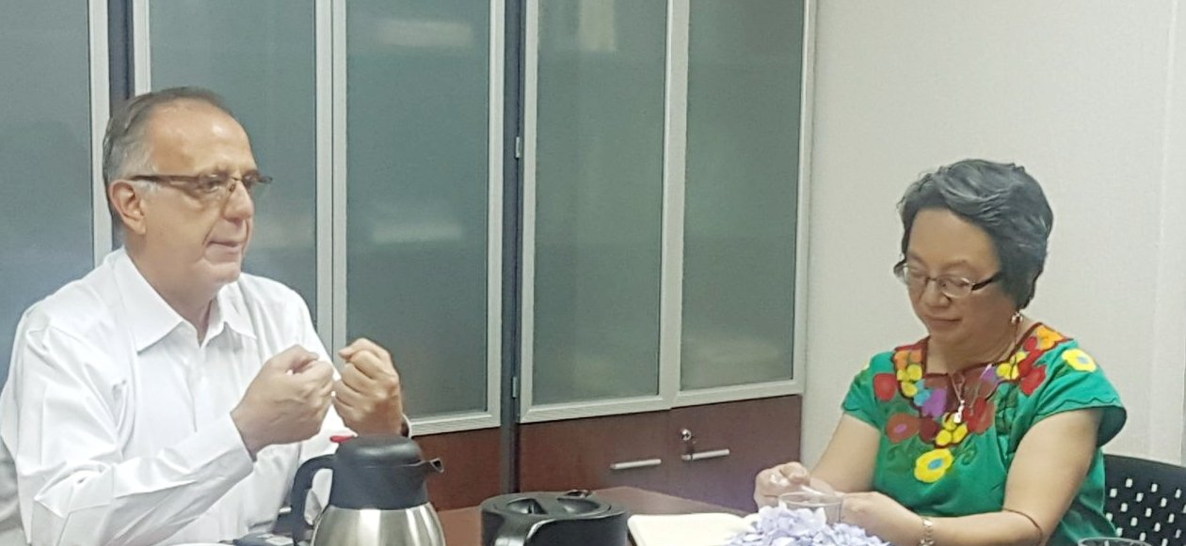
Our cooperation includes the work that associates the international mechanisms for the protection of human rights

Slide 19
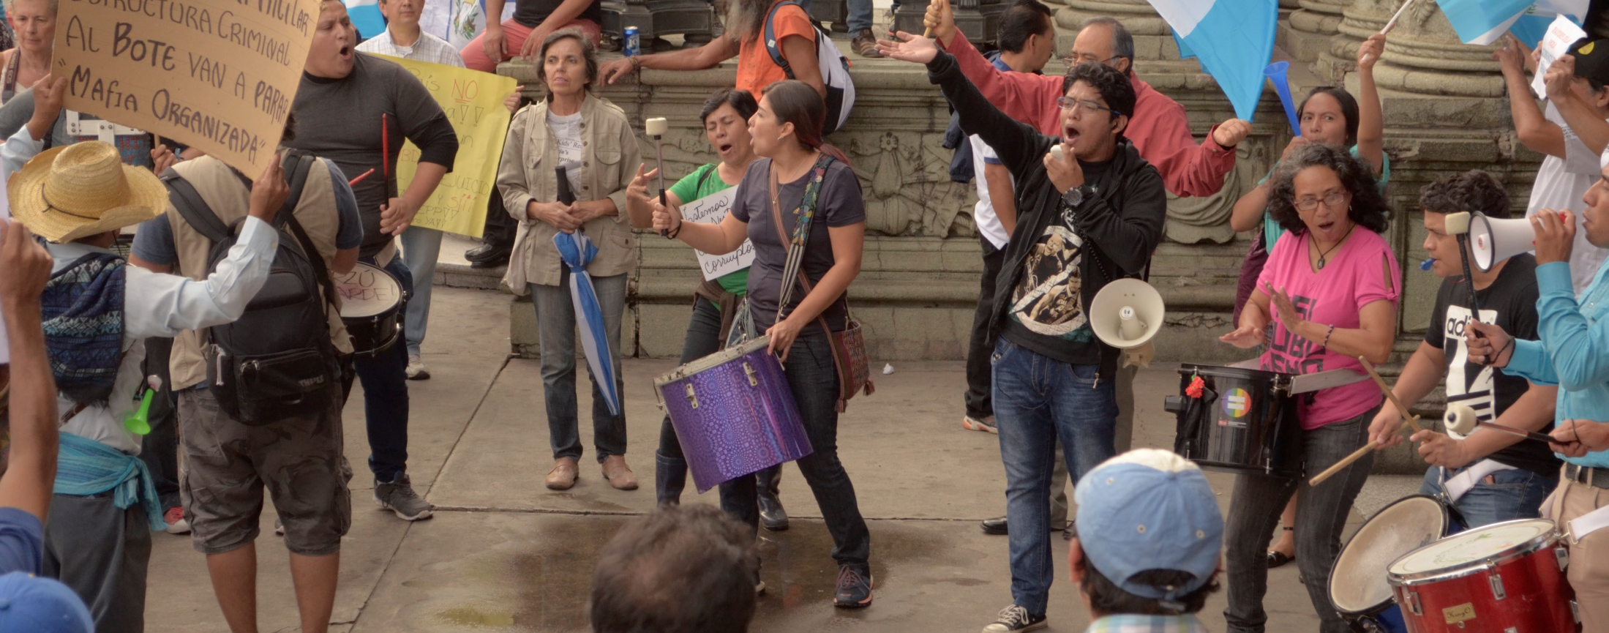
The fight against corruption must be based on the fundamental principles of human rights
-UN High Commissioner

Slide 20

This perspective shows that the State has the responsibility to react to the negative consequences of corruption

Slide 21
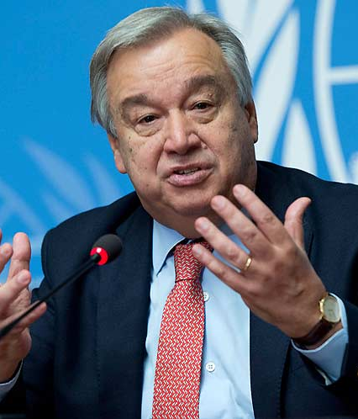
“Within the good practices and mechanisms that have made progress in the fight against impunity and corruption is the CICIG”
-António Guterres, General Secretary on the
15th anniversary of the adoption of the United Nations Convention against Corruption

Slide 22
A response to the responsibility of the State is to consolidate the efforts in the investigation, prosecution and punishment of those responsible for acts of corruption
Another response is to advance simultaneously in structural reforms that address the causes of exclusion, inequality and discrimination that affect vulnerable groups.

Slide 23
the full participation of these groups is key to guarantee that no one is left behind

Slide 24

Ending with corruption represents an opportunity for the State to deepen and strengthen its response to the human rights of the population

Slide 25

The disappearance of corruption does not automatically lead to better opportunities for vulnerable groups
Structural patterns of
inequality, racism and discrimination
must be transformed

Slide 26

Only a policy consistent with
human rights and the principles of
equality, inclusion and dignity,
will effectively ensure that
no one is left behind

