Slide 1
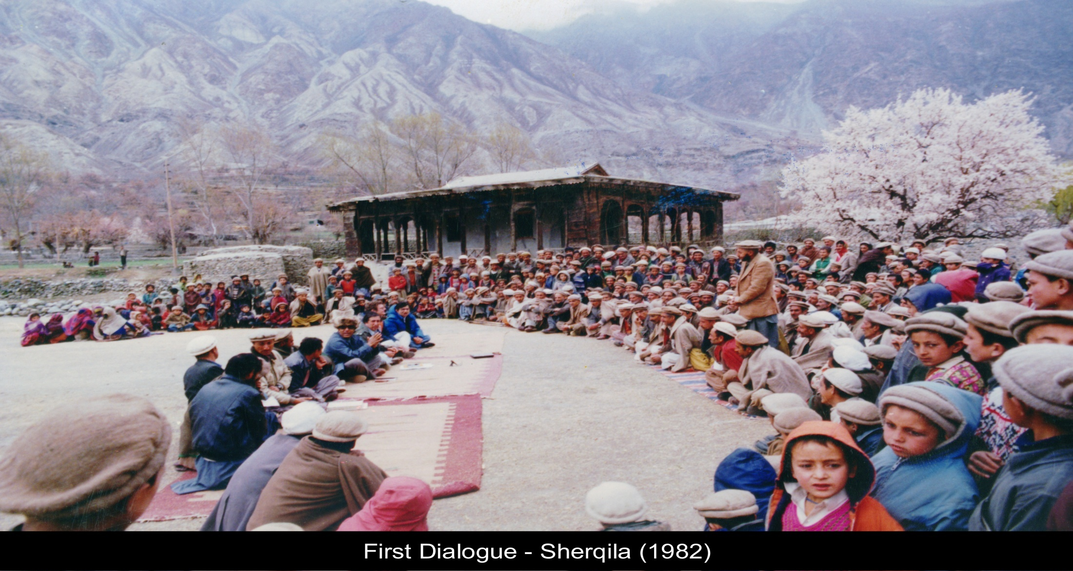
EXPERIENCE OF THE RURAL SUPPORT PROGRAMMES NETWORK OF PAKISTAN
WITH IMPLEMENTING THE RIGHT TO DEVELOPMENT
First Dialogue – Sherqilla, Gilgit (Pakistan) 1982
Presentation by: Shoaib Sultan Khan
December 2018

Slide 2

Context WHOSE RIGHT?
20% of the world population consumes 80% of global resources. The poorest 20% only account for 1.3% of global consumption.
Source: D+C Journal

Slide 3
Context
The centre-piece of a policy framework for poverty alleviation has to be the mobilisation of the poor in order to enable them to participate directly in the decisions that affect their lives and prospects.
*Main Recommendations of ISACPA* - 1991
Independent South Asian Commission on Poverty Alleviation (ISACPA)

Slide 4


Two Pillars of State
    Administrative Pillar
    Political Pillar

Slide 5

The Missing Link: The Socio-Economic Pillar
  None of the Federal Ministries,
  Provincial & District Departments or Elected Bodies have the capacity to engage all or overwhelming majority of people especially the vulnerable and the poor in planning, implementing and monitoring their own development agenda
Notes:
Image improve

Slide 6

Characteristics of Socio-economic Pillar
Fostering of Socio-Economic Pillar through social guidance cannot be undertaken by government departments or NGOs. It requires an institutional mechanism which has the resources of the government and flexibility of an NGO, such as Rural Support Programme (RSP).

Slide 7
Solution Recommended by ISACPA
Implementation Strategy and Institution Building by Governments of South Asia:
Support financially and administratively the establishment of independent, non-governmental and national level support mechanisms to catalyse formation of organisations
  * ISACPA – 1993 SAARC Summit

Slide 8
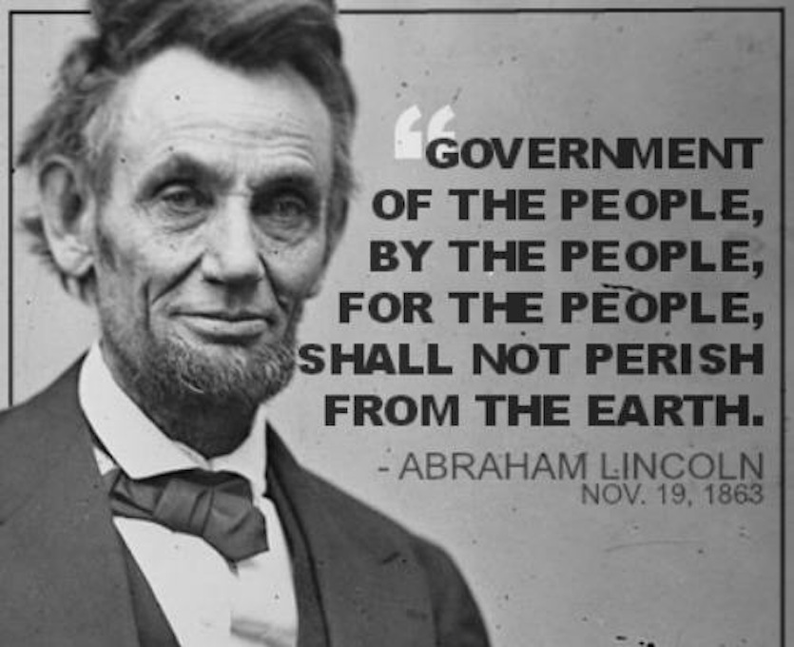
OF Institutions
of the people
BY Elected Institutions
by the people
FOR Administrative Institutions
for the people

Slide 9
Core Function of RSPs: Fostering a Three-Tiered Social Mobilization Network
1,497
(LSOs)
7.12 million
households organized
President
LSO
466
Women Only (LSOs)
Manager
48%
52%
VO
President
VO
20,814
(VOs)
Manager
48%
48%
4%
Manager
HH Member
President
CO
CO
CO
409,883
(COs)

Slide 10






The Holistic Approach to Social Mobilisation
Social Organisation
Human Resource
Development
Credit and Savings;
CIF (interest free)
Technical assistance
in NRM
Development of Physical Infrastructure
Linkages with
Government
Department
Local Councils, NGOs, Commercial & Development Agencies

Slide 11
RSPN
OUR NETWORK
The outreach of the Rural Support Programmes across Pakistan
AKRSP
SRSP
NRSP
IRM
GBTI
TRDP
PRSP
BRSP
SGA
SRSO
FIDA
Aga Khan Rural Support Programme
Sarhad Rural Support Programme
National Rural Support Programme
Institute of Rural Management
Ghazi Barotha Taraqiati Idara
Thardeep Rural Development Programme
Punjab Rural Support Programme
Balochistan Rural Support Programme
Sindh Graduates Association
Sindh Rural Support Organisation
Foundation for Integrated Development Action
National outreach to
47.3 million people
145/148
Districts/FATA
/Territories

Slide 12
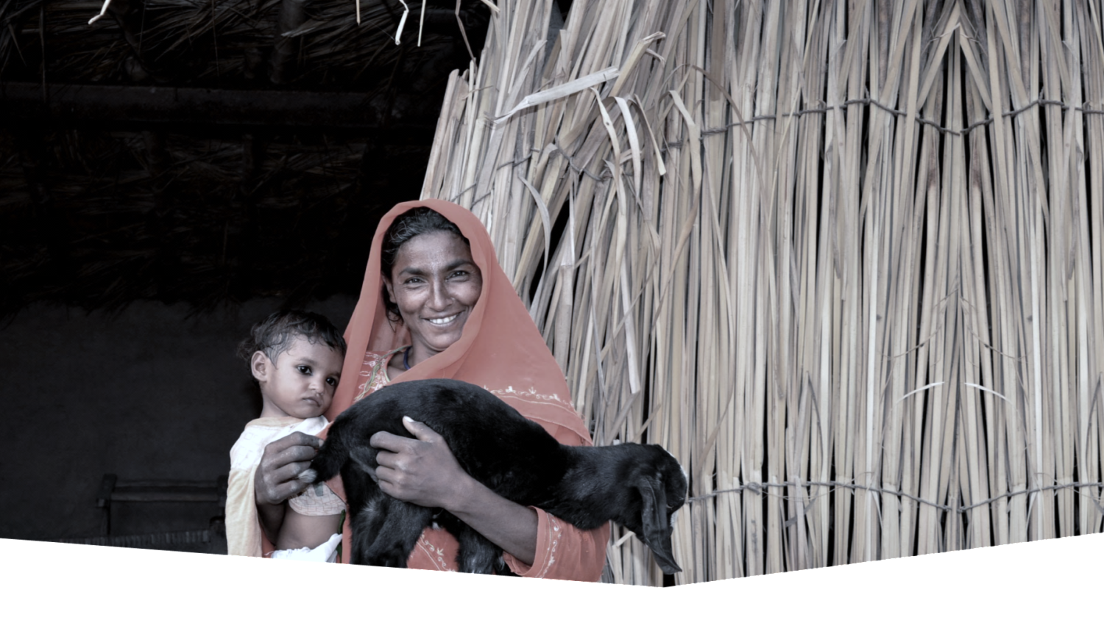






RSPN
OUR OUTREACH
425,588
Community Organisations (211,127 Women COs)
7,278,782
Household membership (52% women members)
145/148
Districts
4,255 / 5,846
Union Councils
1,631
Local Support Organisations
(503 women only)
47.3 million
Population
* As at December, 2017

Slide 13

RSPN
REGIONAL COOPERATION
Cross-Border Programme Afghanistan and Pakistan
(PATRIP Foundation since 2011)
3 RSPs: AKRSP, SRSP, BRSP
Total Project beneficiaries: 299,000
Afghan beneficiaries 22,030
Afghan Women beneficiaries 5000
Afghans nationals crossing border and
Afghan nationals crossing into and out of Balochistan daily about 75,000 – all routes
Health, Water, Infrastructure and Trade
Youth – Sports and Learning Centres at Chaman and Noshki, Balochistan

Slide 14




RSPN
REGIONAL COOPERATION
The largest scale replication of the RSP approach is in India. This process started in 1994 with the South Asia Poverty Alleviation Programme in the State of Andhra Pradesh (Society for Elimination of Rural Poverty – SERP) and has been scaled up nationally.
Since 2010, SERP’s approach has been replicated in India through one of the largest poverty reduction programmes in the world via the National Rural Livelihoods Mission (NRLM).
RSPN is also engaged with the Bangladesh based organisation, BRAC, in a research project which aims to capture learnings from scale up efforts across South Asia and do a thorough, real-time documentation of the innovative projects of RSPs in Pakistan.
Over the past year, RSPN staff has provided consulting services to UNDP Myanmar and the International Fund for Agricultural Development in Tajikistan to strengthen their social mobilisation.
Through the aegis of the Aga Khan Foundation, lessons from AKRSP in Gilgit were taken to Tajikistan in the 1990s, to be espoused by the Mountain Societies Development Support Programme (MSDSP).

Slide 15

RSPN
REGIONAL IMPACT
11.55 million
households
Key Impacts of
Andhra Pradesh,
India
(June 2012)
50 million
people
100%
women

Slide 16

RSPN
REGIONAL IMPACT
70 million
households
National Rural Livelihoods Mission India
Launched in 2011
350 million
population
US $ 5.1 billion
estimated cost

Slide 17
National Multidimensional Poverty Index (MPI)
Prepared by Planning Commission and UNDP
  Complementary measure to consumption / income based poverty estimates
Measures deprivations in Health, Education and Standard of living.
  Together with consumption based poverty, it provides an insight on different forms of monitory and non monitory deprivations
Built by using PSLM datasets
  Has been estimated for every two year period since 2004/5
  Can be disaggregated at the Provincial and District levels
MPI can be unfolded to see how people are poor
According to MPI, 38.8% of the population are poor

Slide 18
Addressing MPI…and more: “WISE”
    Water (potable drinking Water)
    Immunization (preventive Health care)
    Sanitation (solid and liquid Waste management)
    Education (primary Education)
    These make more than 70% of any Provincial Government budget
    But still Govt. struggles to achieve any or all of the above goals because….
      Issue is too large
    But can this be achieved by taking bits of the issue and using the three tiered Social Mobilization model to undertake all of “WISE” in a holistic manner?....WISE at the UC level

Slide 19
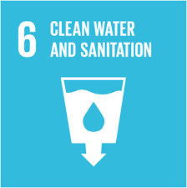


WISE & SDGs
WISE also targets SDGs 6, 3 & 4 which Pakistan missed in MDGs
  Difficult to achieve on National scale
    Immunization coverage-54%*
    Literacy Rate-58%**
    Sanitation -48%***
    Sewerage-18% (40% urban, 6%-rural)***
    Access to safe drinking water-56%****
  Can be achieved at the Union Council Level;
  * http://www.nips.org.pk/abstract_files/PDHS%20Final%20Report%20as%20of%20Jan%2022-2014.pdf
  ** http://www.undp.org/content/dam/pakistan/docs/MDGs/MDG2013Report/UNDP-Report13.pdf
  *** https://en.wikipedia.org/wiki/Water_supply_and_sanitation_in_Pakistan
  **** http://www.dawn.com/news/635992/more-than-40-per-cent-pakistanis-lack-access-to-clean-water

Slide 20
What can Social Mobilization Offer
LSOs become “WISE” implementors
  RSPs act as donors and TA providers
    TA in form of Android based base line data collection and measuring evidence of progress
WISE creates demand for access (through linkages) to public services at the Union Council level and below.
Additional activities that communities can undertake include:
    Malnutrition
    Basic rights and responsibilities as citizen
    Gender
    Peace and Conflict Resolution

Slide 21
Overall Increase in Access to Drinking Water from a Safe Source

Slide 22
Increase In Immunization Coverage-PENTA-3
(Union Councils below 28% of baseline)

Slide 23
Improvement in Solid Waste Disposal

Slide 24
Increase in Latrine Availability

Slide 25
Overall Increase in School Enrollment

Slide 26
Lessons Learnt/Challenges in WISE Implementation
Donors and Provincial Governments have been struggling to improve WISE indicators since decades
  Existing networks of organized communities can show “evidence based results within one year
Results can be achieved across Pakistan and Provinces
Strengthening of Institutional Networking especially with Line Departments is critical
  Positive response from all provinces

Slide 27
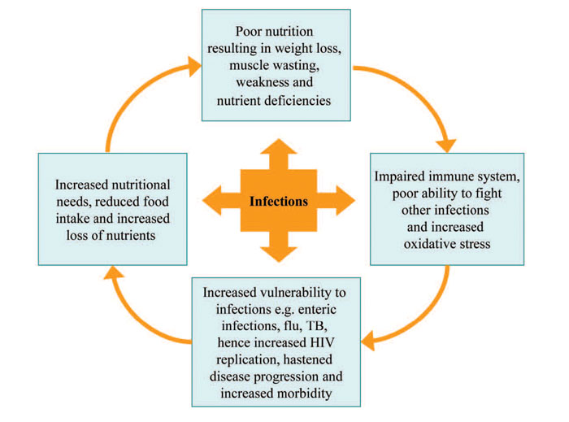
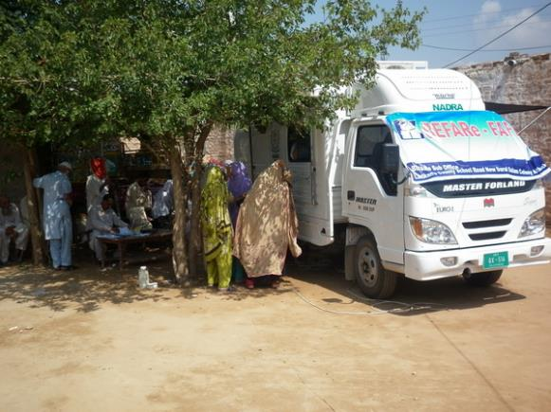

Malnutrition; Basic rights; Gender
Additional activities that can be undertaken through organized communities

Slide 28
Basic rights and responsibilities as citizen
  CNIC coverage
  Birth / Death Registration, Voters registration, Nikah Registration
  Capacity building of office bearers and CRPs in human rights
  Participation in various forums/alliances at local and national level
  Participation in projects for increasing access to public services e.g. enrollment, immunization, nutrition etc.

Slide 29
Gender
Participation
  50% women HHd in organized communities
  Women participation in making the Household level Micro Investment Plans and Village Development Plans
Access
  More than 50% women credit clients
  Women consultation at design stage in Infrastructure projects
    Majority are DWSS
  52% participants in training

Slide 30
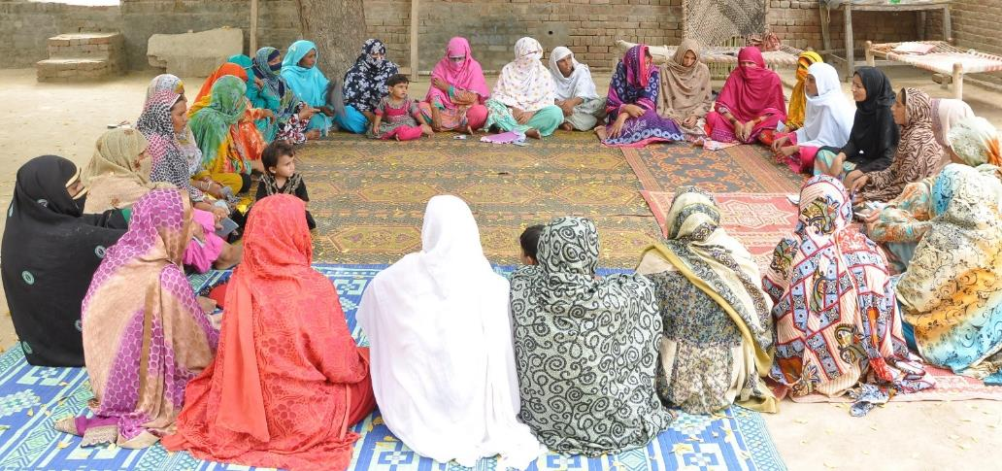

Peace and Alternate Dispute Resolution (ADR)

Slide 31
Peace and conflict resolution Initiatives
Formation of peace committees in villages
Inclusive planning involving sects and minorities
Capacity building sessions for conflict identification and resolution amongst stakeholders
Localized IEC material for awareness raising sessions on peace and stability
Regular dialogues and engagement between LSOs/VOs and local religious leaders especially for girl education, Immunization etc.

Slide 32
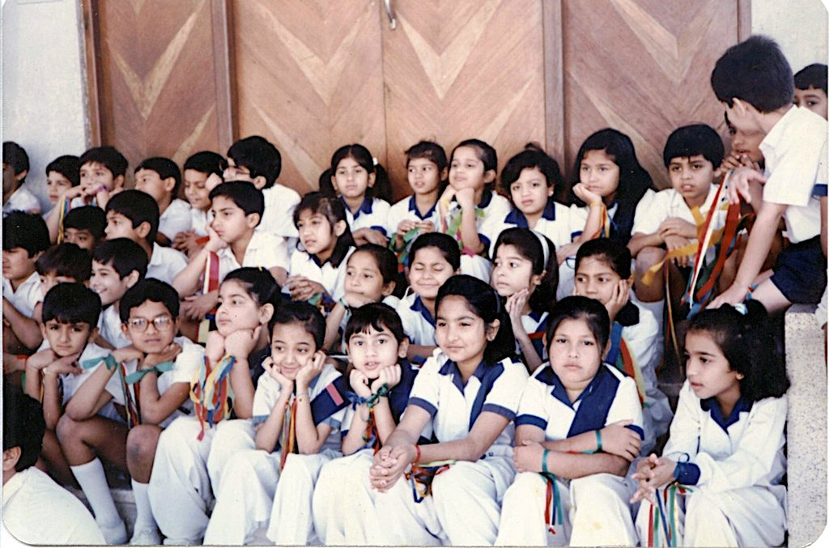
THANK YOU

