Slide 1
The Optional Protocol
Module 8

Slide 2
Objectives
Module flow
Understand the main features of the communications and inquires procedures in the Optional Protocol
Identify the main roles of States, OPDs, and United Nations country teams in promoting its ratification and ensuring appropriate follow-up
What is the communications procedure?
The process from submitting a communication to its resolution
Admissibility criteria
Checklist for submitting a communication
Interim measures
Views and follow-up
What is the inquiry procedure
Benefits of the Optional Protocol
Roles of States, civil society organizations and the United Nations

Slide 3
The communications procedure
Some facts about the communications procedure
A quasi-judicial procedure
What the communications procedure is not
The Committee is not a court
A written procedure
Most communications do not satisfy the preliminary criteria for registration by the Committee (pre-admissibility stage)
There is no oral hearing
There are no lawyers
The result is not legally enforceable
Remedies rely on the political will of the State party
Views are authoritative statements about the Convention’s provisions
The Committee provides its views and recommendations
Notes:
Slide Three

Slide 4
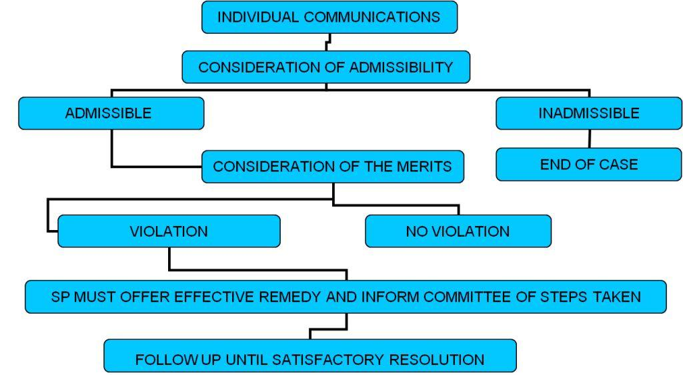
From complaint to resolution
Notes:
(SP: State Parties)
Slide 5
The purpose of this slide is to illustrate the process between submitting a complaint and it being finalized by the Committee.
The trainer might wish to illustrate the procedure by identifying the ‘views’ of another Committee under its Optional Protocol – for example, OP CEDAW – and discussing the process with the participants. By illustrating the process through a real example, the participants might be able to contextualize the process.
4

Slide 5
CHECKLIST FOR SUBMISSION
Submission in writing (or legible alternative format)
Identification of the author and victim (name, contact details, etc.)
Identification of the State party concerned
Clarification of the subject matter of the communication
Clarification of the nature of the alleged violation
Identification of steps taken to exhaust domestic remedies
Clarification of other international procedures examining the complaint
Identification of specific requests or remedies sought
Date, place and signature
List of documents attached (previous decisions, summaries of documents such as national laws in a working language of the Committee)
Notes:
Slide Three

Slide 6
ADMISSIBILITY CRITERIA
Is the communication from or on behalf of individuals or groups of individuals ? | Yes
Does this individual or group claims to be a victim of a violation of the Convention | Yes
Is the claimant subject to the State’s jurisdiction? | Yes
Has the State ratified the Optional Protocol? | Yes
Is the alleged victim anonymous? |  | No
Is the communication an abuse of the Optional Protocol? |  | No
Has the communication come before another international procedure of investigation or settlement? |  | No
Are domestic remedies exhausted? | Yes
Is the complaint manifestly unfounded or unsubstantiated? |  | No
Did the alleged conduct occur after the Optional Protocol’s entry into force for the State? | Yes
Notes:
Slide Three

Slide 7
Interim measures
At any time after the receipt of a communication and before a determination of the merits has been reached, the Committee may transmit to the State Party concerned for its urgent consideration a request that the State Party take such interim measures as may be necessary to avoid possible irreparable damage to the victim or victims of the alleged violation.
Optional Protocol, art. 4 (1)

Slide 8
Views and follow-up
Committee working group or special rapporteur on follow-up
Views
published
State had 6 months to report
Committee may seek further information
State to report in next periodic report

Slide 9
The inquiry procedure
Receipt of reliable information of grave or systematic violations
Invitation to the State to cooperate
Designation of one or more Committee members to conduct the inquiry
Country visit if State agrees
Findings, comments and recommendations transmitted to State
Observations from the State to be transmitted within 6 months
Invitation to the State to report in its periodic report

Slide 10
Benefits of the Optional Protocol
Can strengthen national protection mechanisms such as courts
Can validate laws and policies
Can validate or query national court decisions
Helps the Government bring about domestic change
Provides an opportunity to States to benefit from the advice of international experts
Clarifies how to implement the Convention by reference to specific situations
Helps to incorporate the Convention into domestic law
Provides a mechanism for strategic litigation by civil society organizations to support key changes
Can provide protection to victims
Relatively easy for victims to use

Slide 11
Roles for stakeholders to support the Optional Protocol
States | Civil society | United Nations country teams
Ratify the Optional Protocol | Promote ratification | Promote ratification
Strengthen implementation | Assist authors with complaints | Collect and disseminate jurisprudence
Strengthen domestic remedies | Draft communications on behalf of victims | Raise awareness and train stakeholders such as judges and CSOs
Provide timely information to the Committee | Provide reliable information for inquiries | Provide reliable information for inquiries
Follow up on recommendations | Monitor compliance | Assist with follow-up
Disseminate the Committee’s views | Disseminate the Committee’s views | Disseminate the Committee’s views
Report on follow-up | Report on follow-up | Report on follow-up

Slide 12
Sources
Convention on the Rights of Persons with Disabilities
Committee’s Rules of Procedure (CRPD/C/4/2)
Fact sheet on the procedure for submitting communications to the Committee on the Rights of Persons with Disabilities under the Optional Protocol to the Convention (CRPD/C/5/2/Rev.1)
Revised guidelines for submission of communications to the Committee on the Rights of Persons with Disabilities under the Optional Protocol to the Convention (CRPD/C/5/3/Rev.1)
www.ohchr.org/EN/HRBodies/CRPD/Pages/CRPDIndex.aspx (accessed 10 August 2012)
Elements for an optional protocol to the International Covenant on Economic, Social and Cultural Rights (E/CN.4/2006/WG.23/2)

