Slide 1
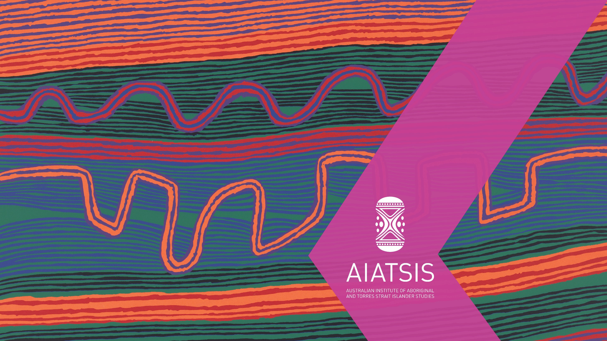
The AIATSIS
Return of Cultural Heritage Project
Craig Ritchie
Chief Executive Officer
Australian Institute of Aboriginal and Torres Strait Islander Studies
Dr Iain G. Johnston
Senior Researcher
Return of Cultural Heritage Project
Australian Institute of Aboriginal and Torres Strait Islander Studies

Slide 2
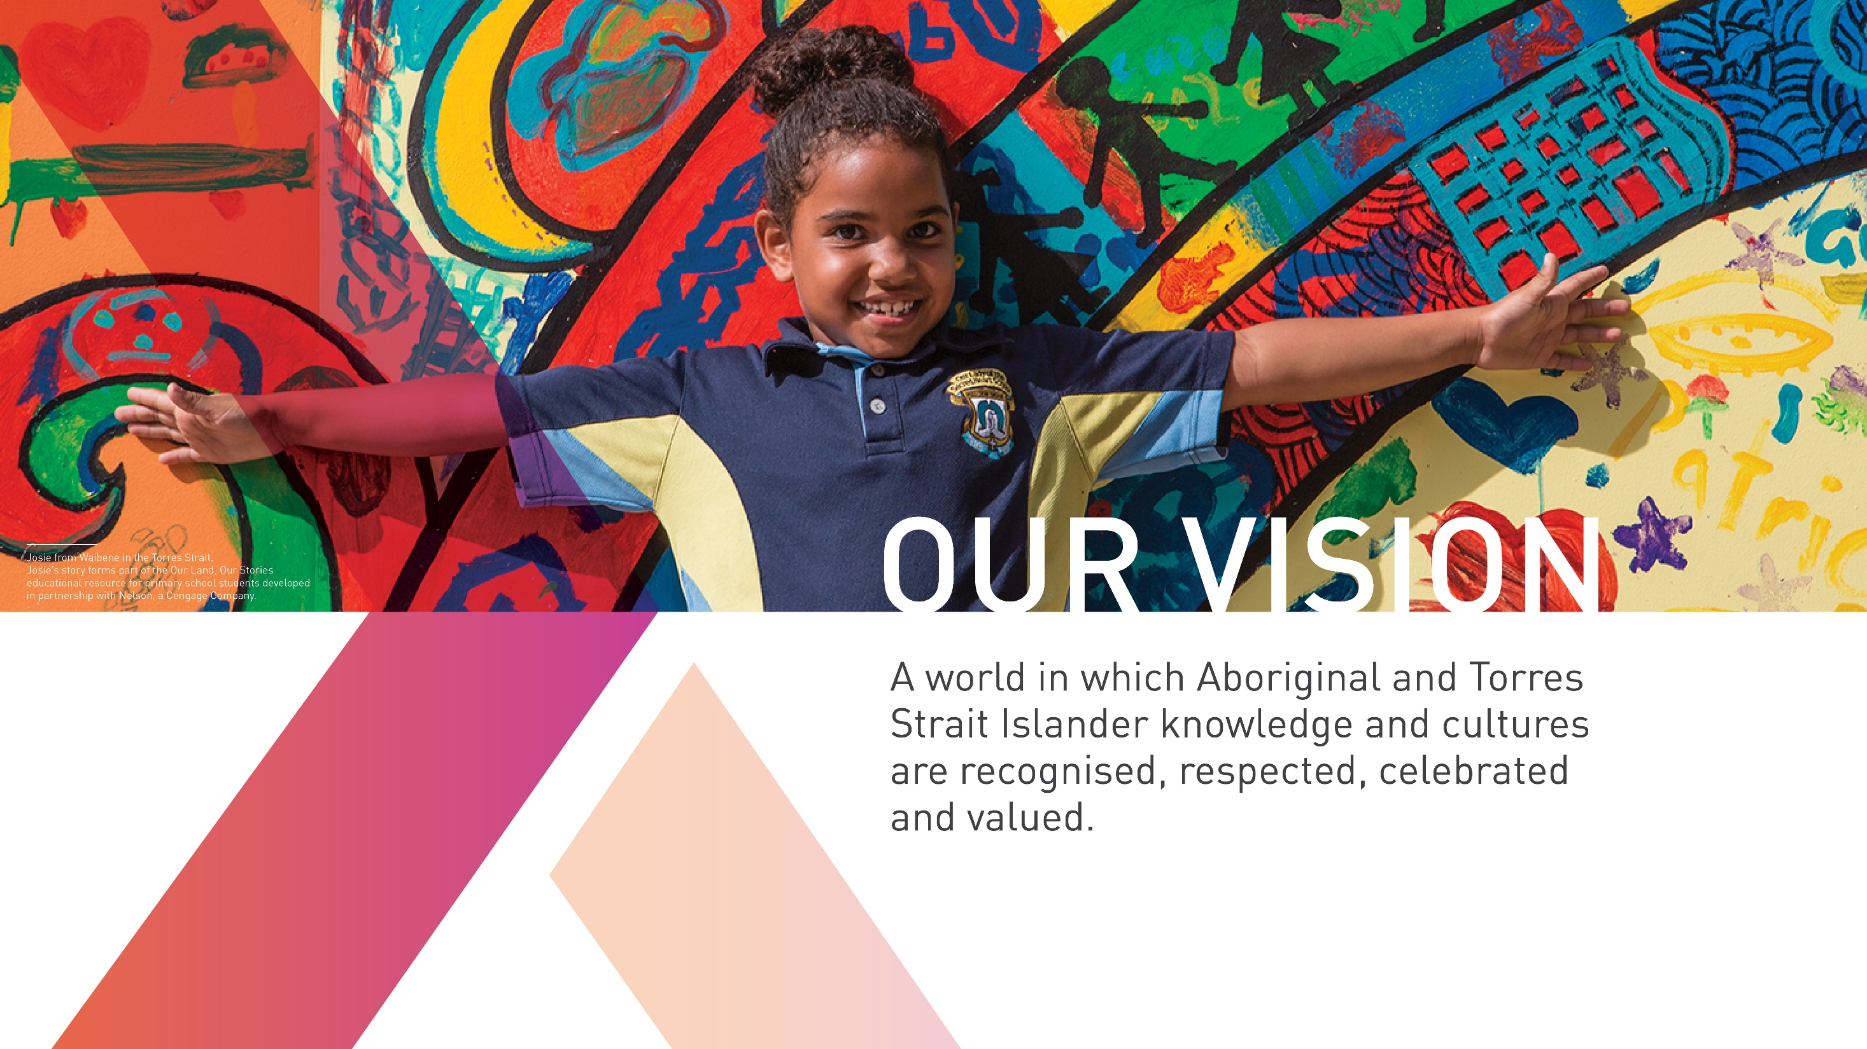

Slide 3
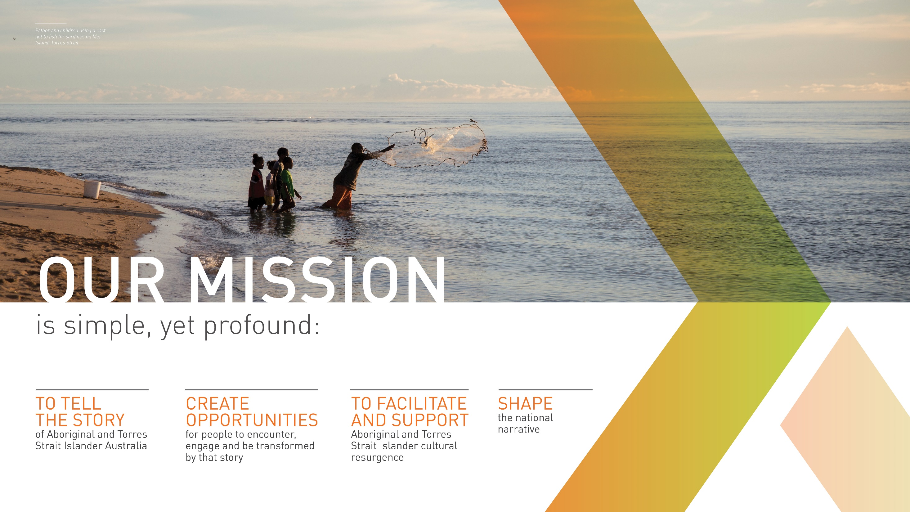

Slide 4
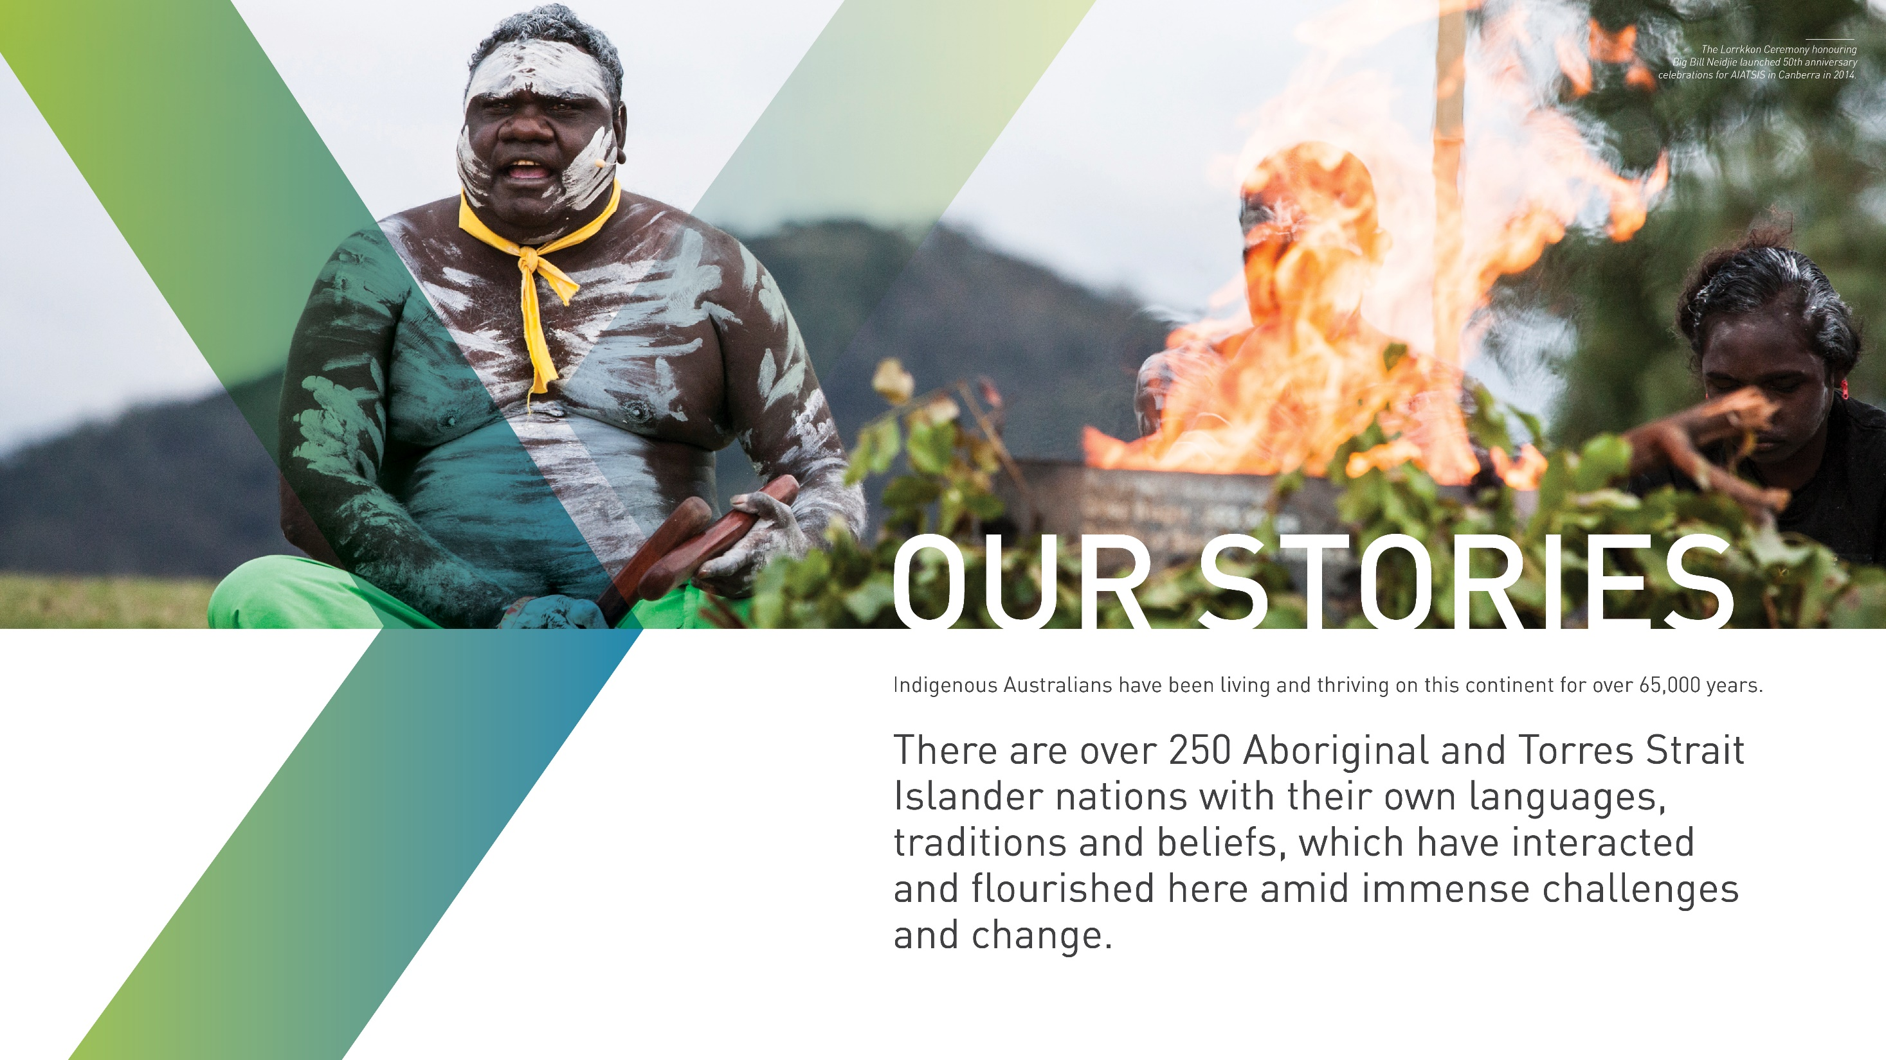

Slide 5
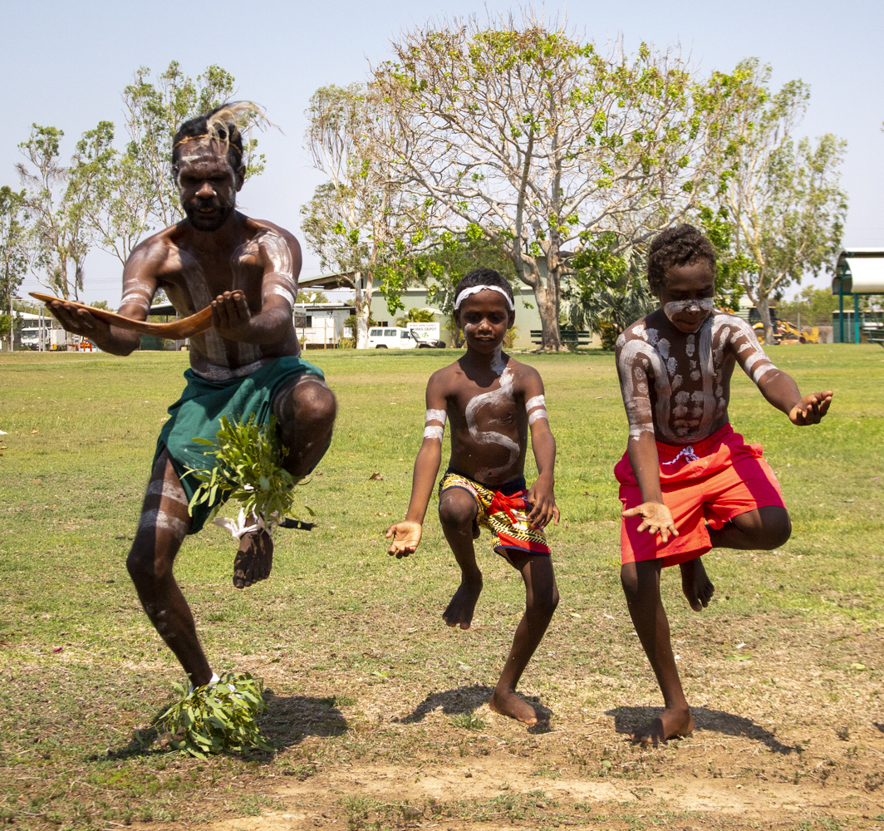
The Return of Cultural Heritage Project

Slide 6
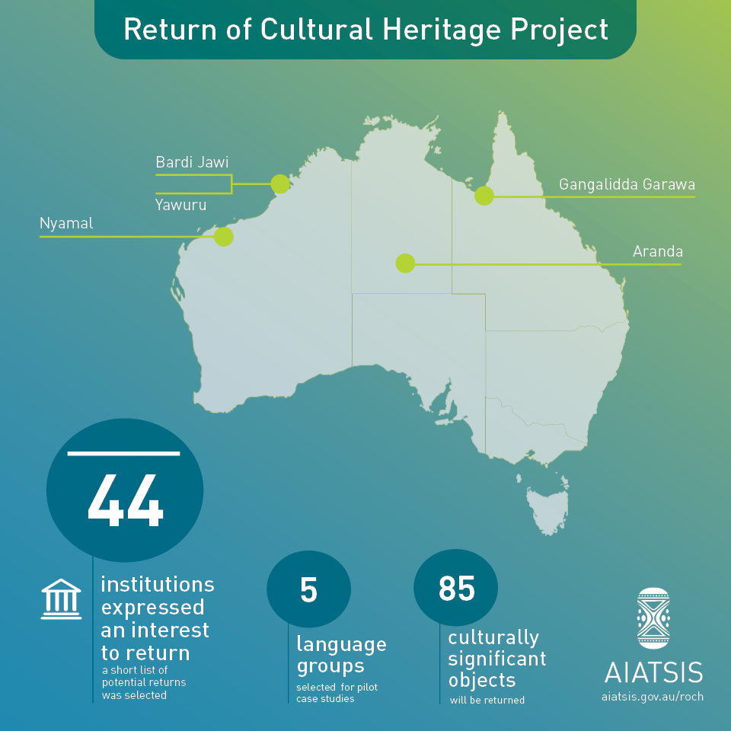

Slide 7
Initial research phase and corresponding with overseas institutions
Liaising with Aboriginal and Torres Strait Islander peak bodies
Partnering with communities
Planning for the return together
Returning the material back to Country
An overview of the Return of Cultural Heritage Project method

Slide 8
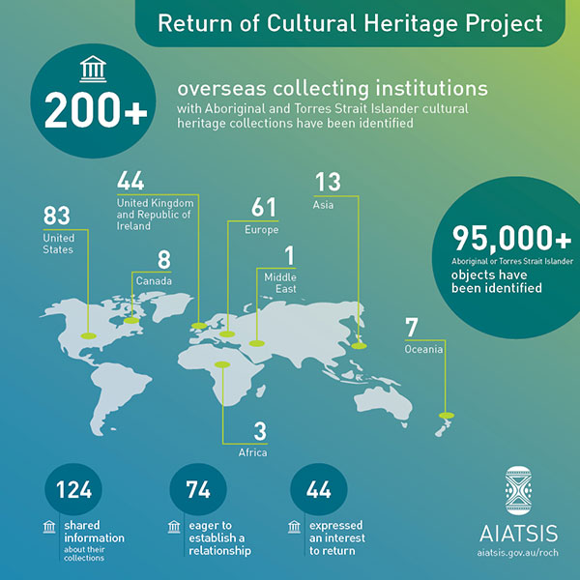
Initial research phase and corresponding with overseas institutions results

Slide 9
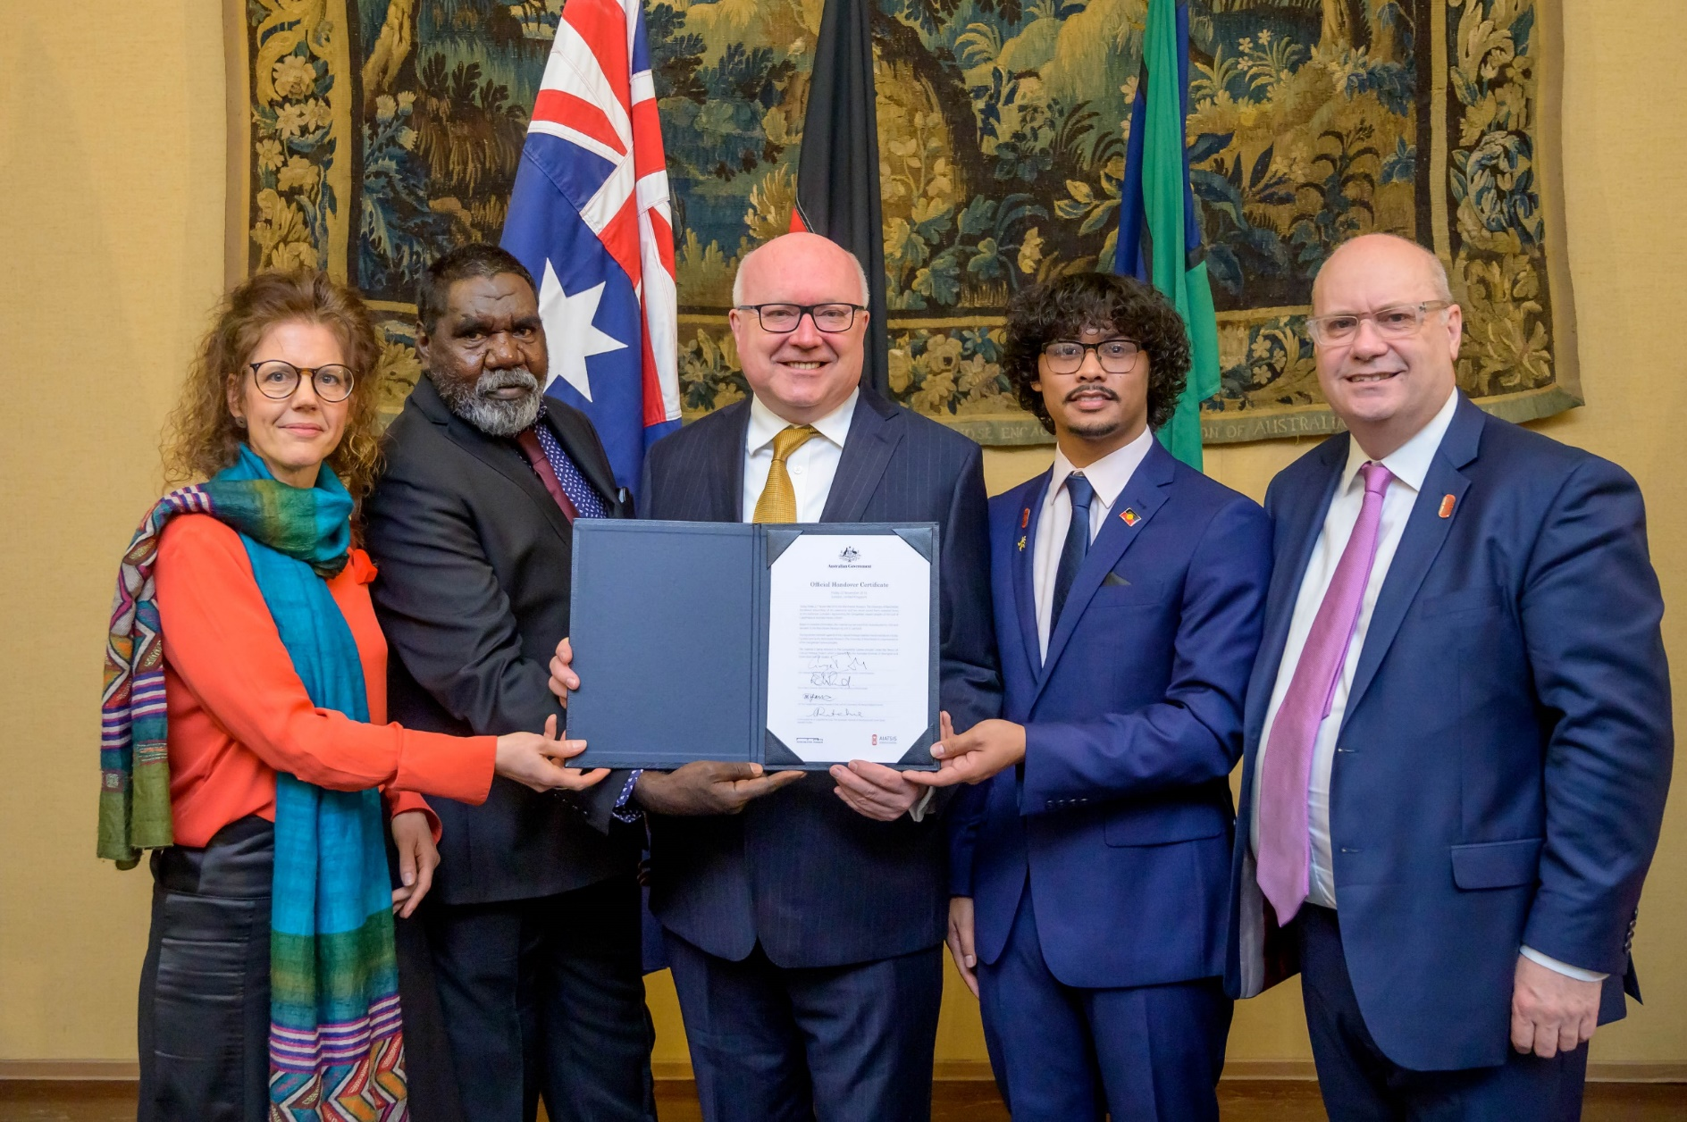
We share a dark history – but it’s moments like this, when we come together as one, united by our desire to do better, to be better and to right the wrongs of the past, that we start to heal spiritual hurts and the intergenerational trauma that still exists today.
Mangubadijarri Yanner, Representative for the Gangalidda Garawa Native Title Aboriginal Corporation

Slide 10
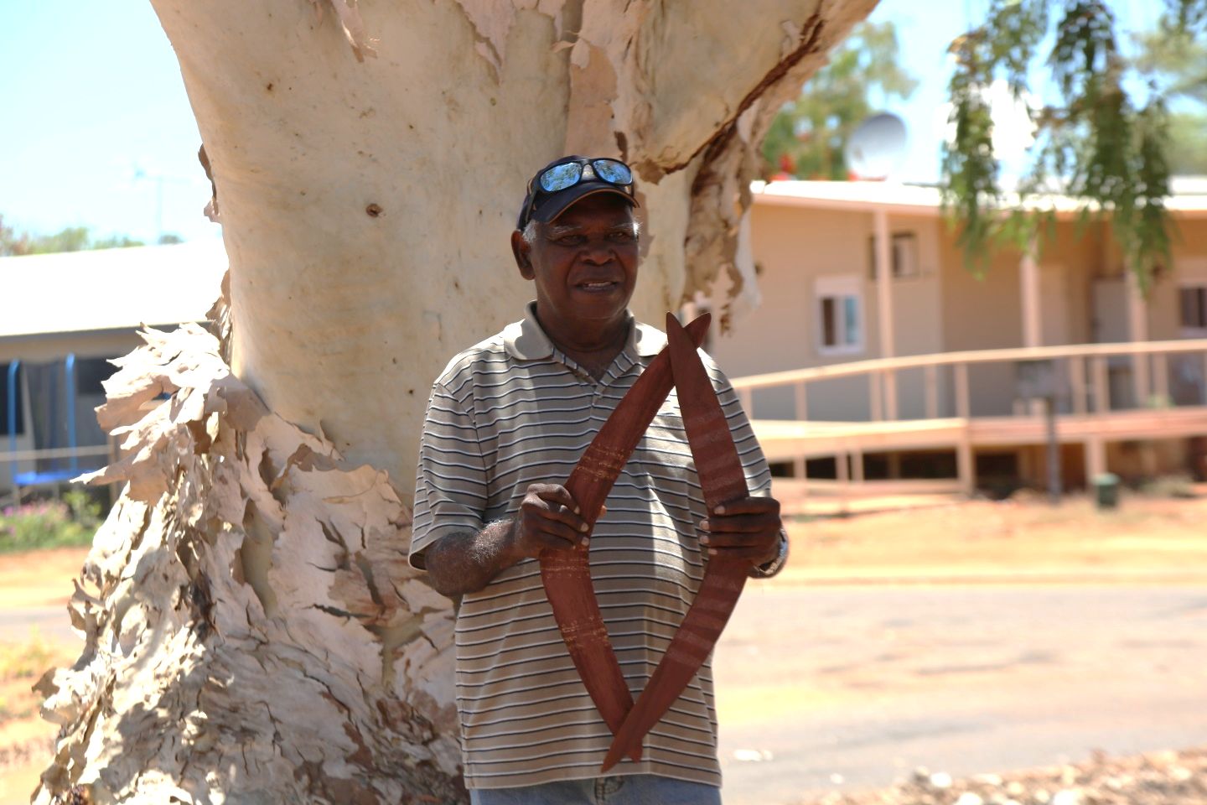
We are very strong with our culture here, we still practise our culture here, but it [the repatriated material] does give us, strengthen us more and for the young people to look at these things and say hang on ... we can't lose it now, we've just got to carry on.
Frank Davey, Senior Bardi Lawman

Slide 11
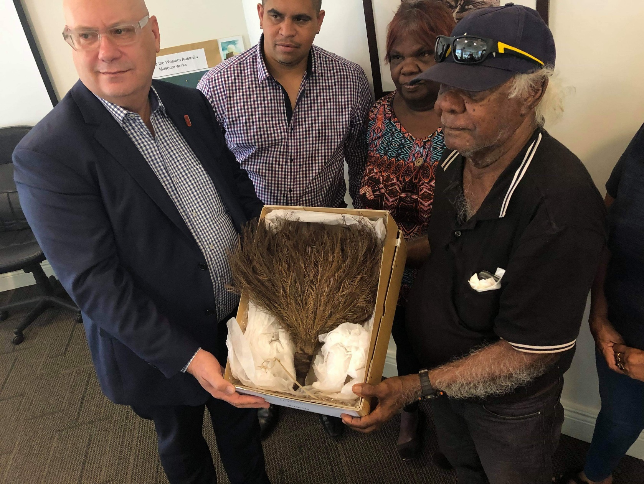
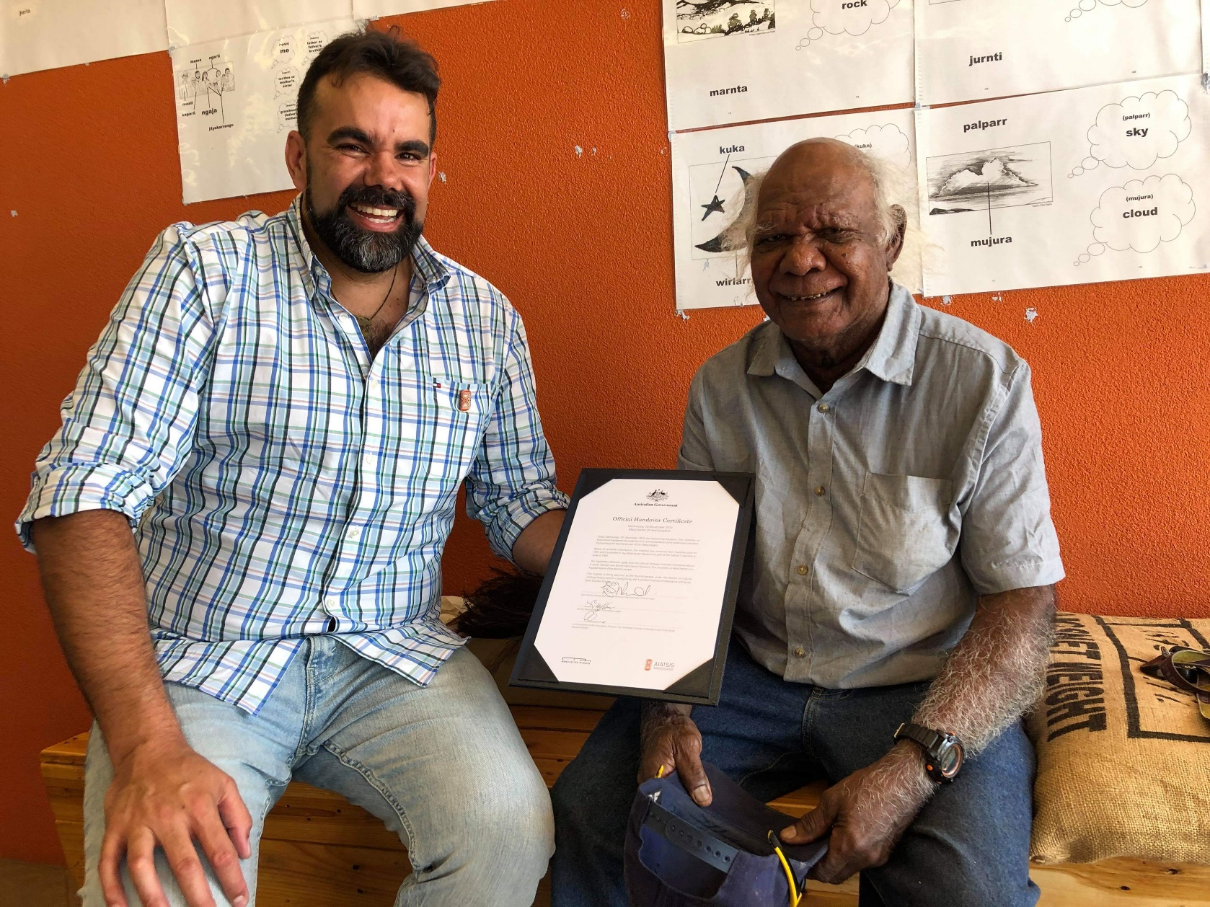
We cannot fix the past only the future, so this is the start of closing those small gaps of what has been taken from us. So we as Aboriginal people can heal and build that trust to work together and educate ourselves to build a better future as one.
Nathan Newland, Njamal People’s Trust

Slide 12
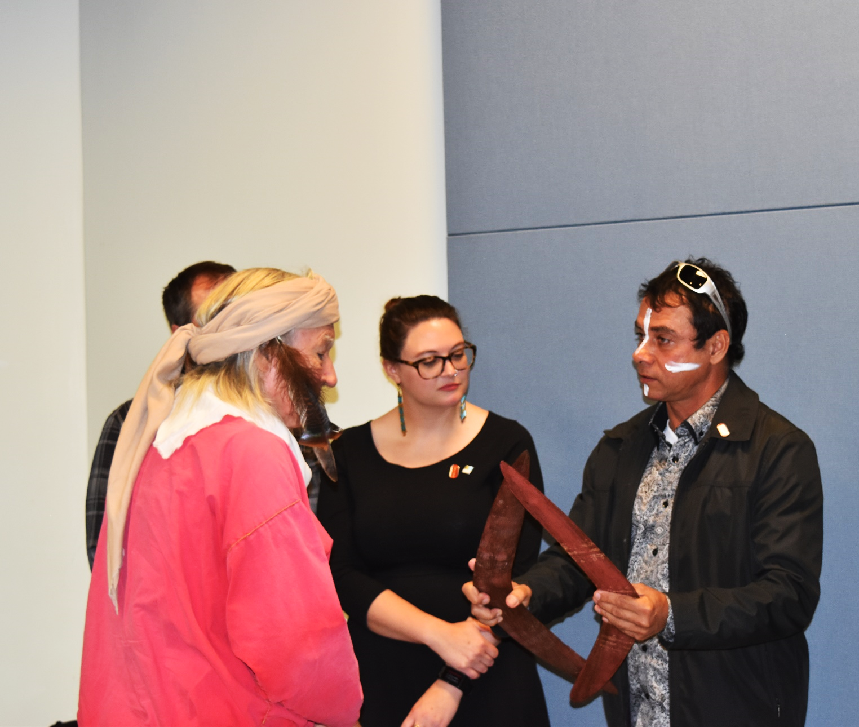
We are really honoured and proud to be here in Springfield [USA] and to be representing our people. On behalf of our Elders past and present we have travelled a very long way to return our material back home. The items were made with a small number of tools and their return will allow us to better understand how our ancestors made these particular items.
Russell Davey, Bardi Lawman

Slide 13
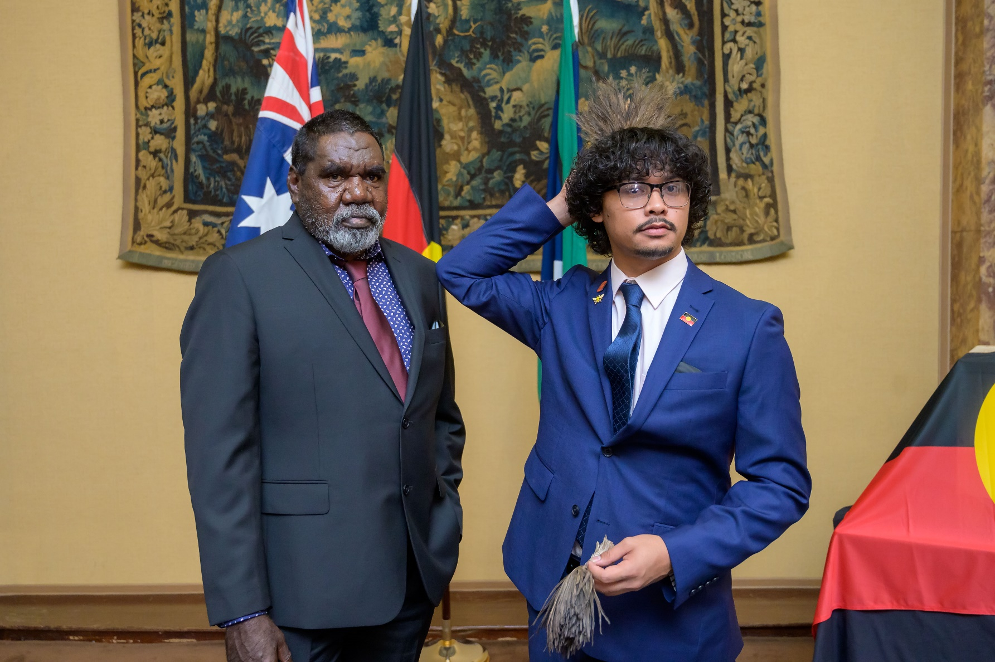
The repatriation of our sacred cultural heritage items is a fundamental part of the healing and reconciliation process, both within our communities and between our mob and the Government. Bringing these sacred cultural heritage items back to Country is important and necessary for the purpose of cultural revitalisation – because locked deep within these items is our lore, our histories, our traditions and our stories.
Mangubadijarri Yanner, Representative for the Gangalidda Garawa Native Title Aboriginal Corporation

Slide 14
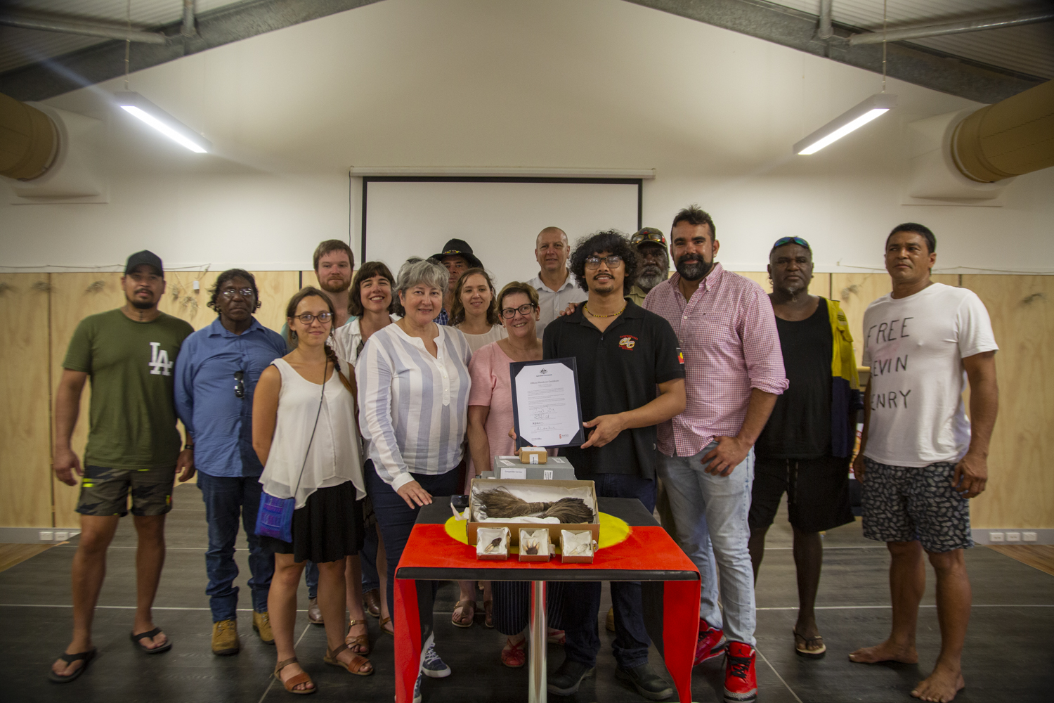
It’s not just the items, it’s the spirit attached, they were taken. The people who once owned them, their spirit went with them and they returned today… It’s a very, very powerful event and it helps in the cultural revival that’s going on.
Murrandoo Yanner, Chairperson of the Gangalidda Garawa Native Title Aboriginal Corporation

Slide 15
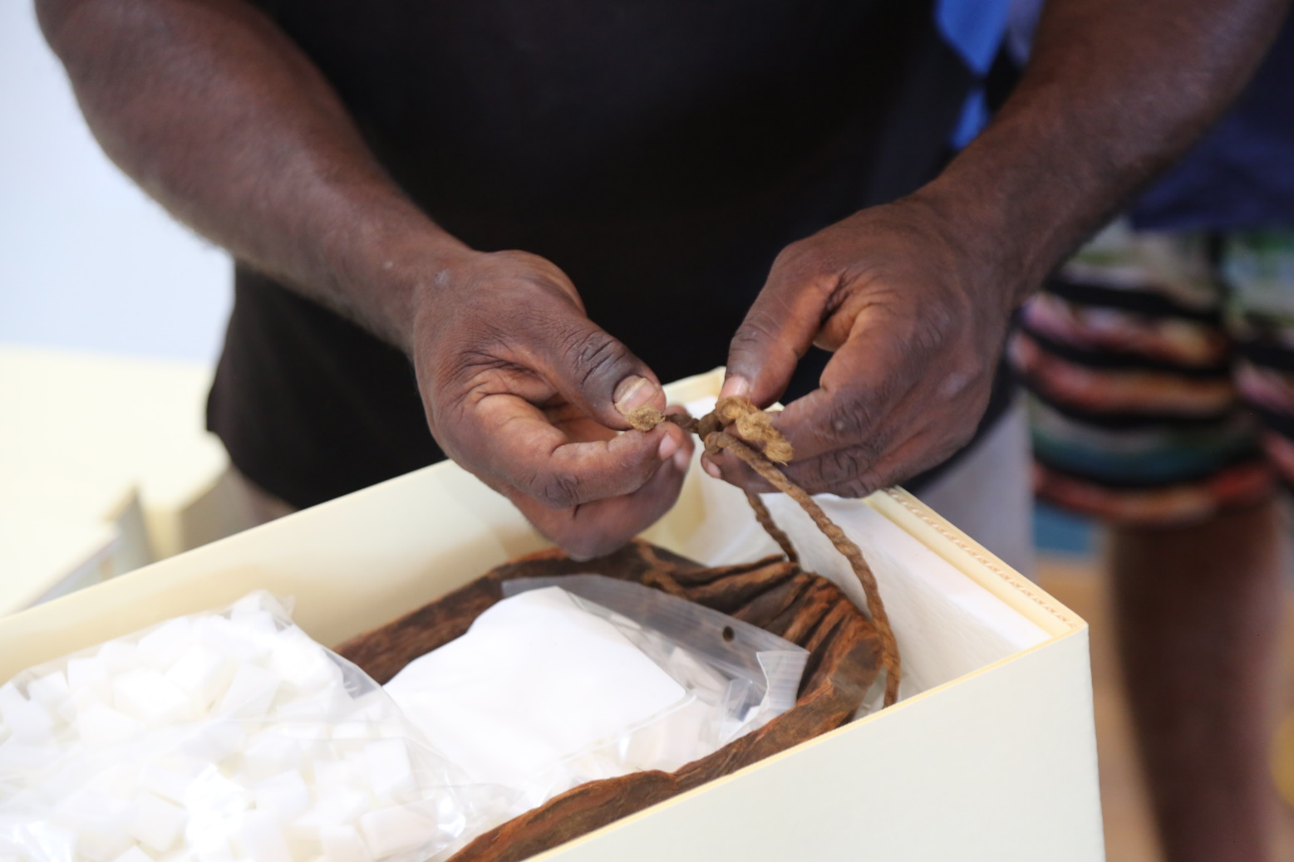
We’re excited and happy that the Bardi Jawi material is coming home and believe that this is the right thing to do. These items were taken a long time ago but we’re glad that the museum looked after them and are now retuning them back to the rightful tribe. Other important things are missing too and a lot more work needs to be done, and we’re glad it’s happening. We’d like to thank the Australian Government for their help.
Kevin George Senior Bardi Lawman

Slide 16
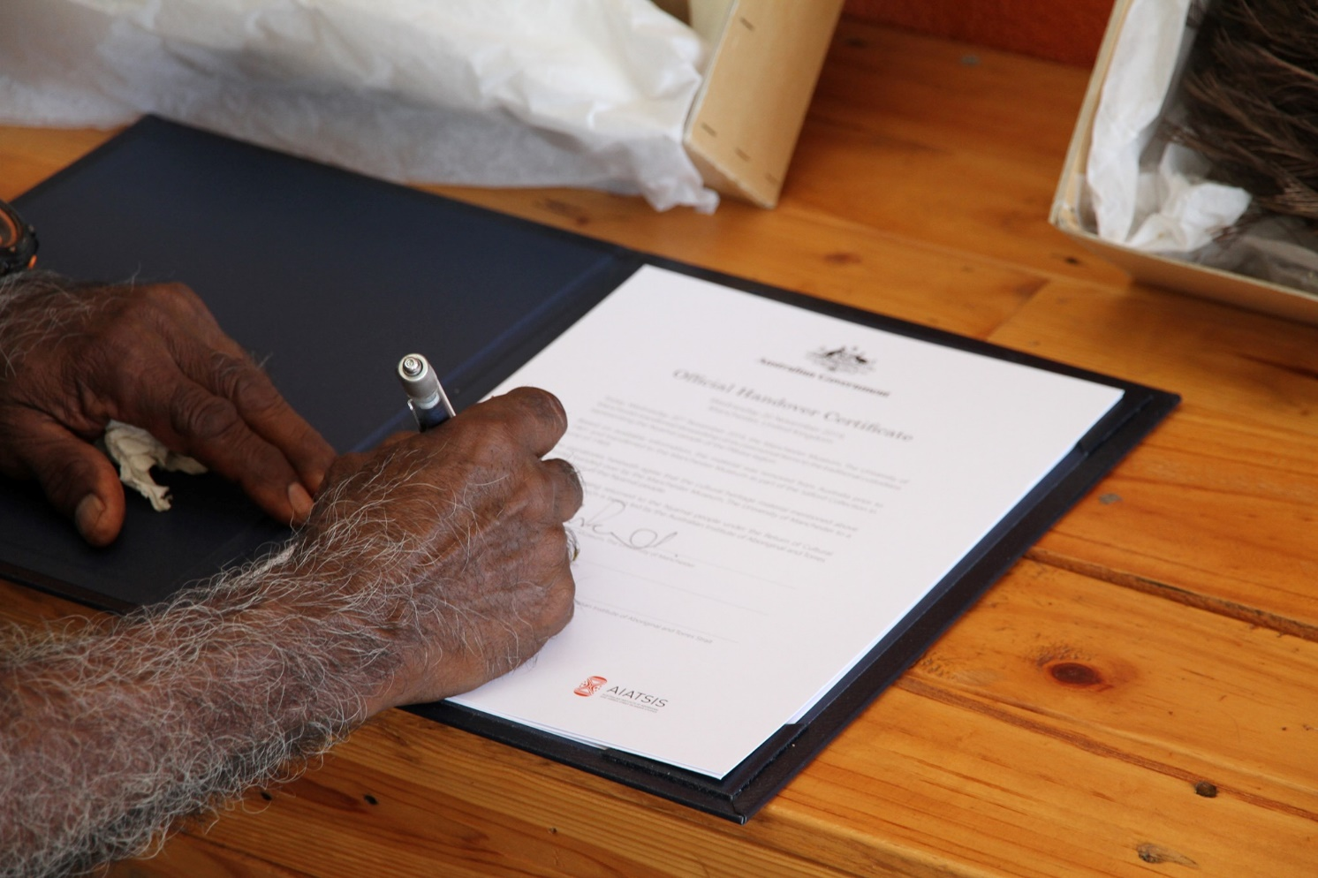
All too often debates about repatriation happen behind closed doors and there is fear and uncertainty about how it actually works. We want to be more transparent and open in the hope that it encourages and supports others… Debates about repatriation usually focus on what is lost, not what is gained; the new understanding, insights and perspectives when museums show a commitment to healing and care.
Esme Ward, Director of Manchester Museum, the University Manchester

Slide 17
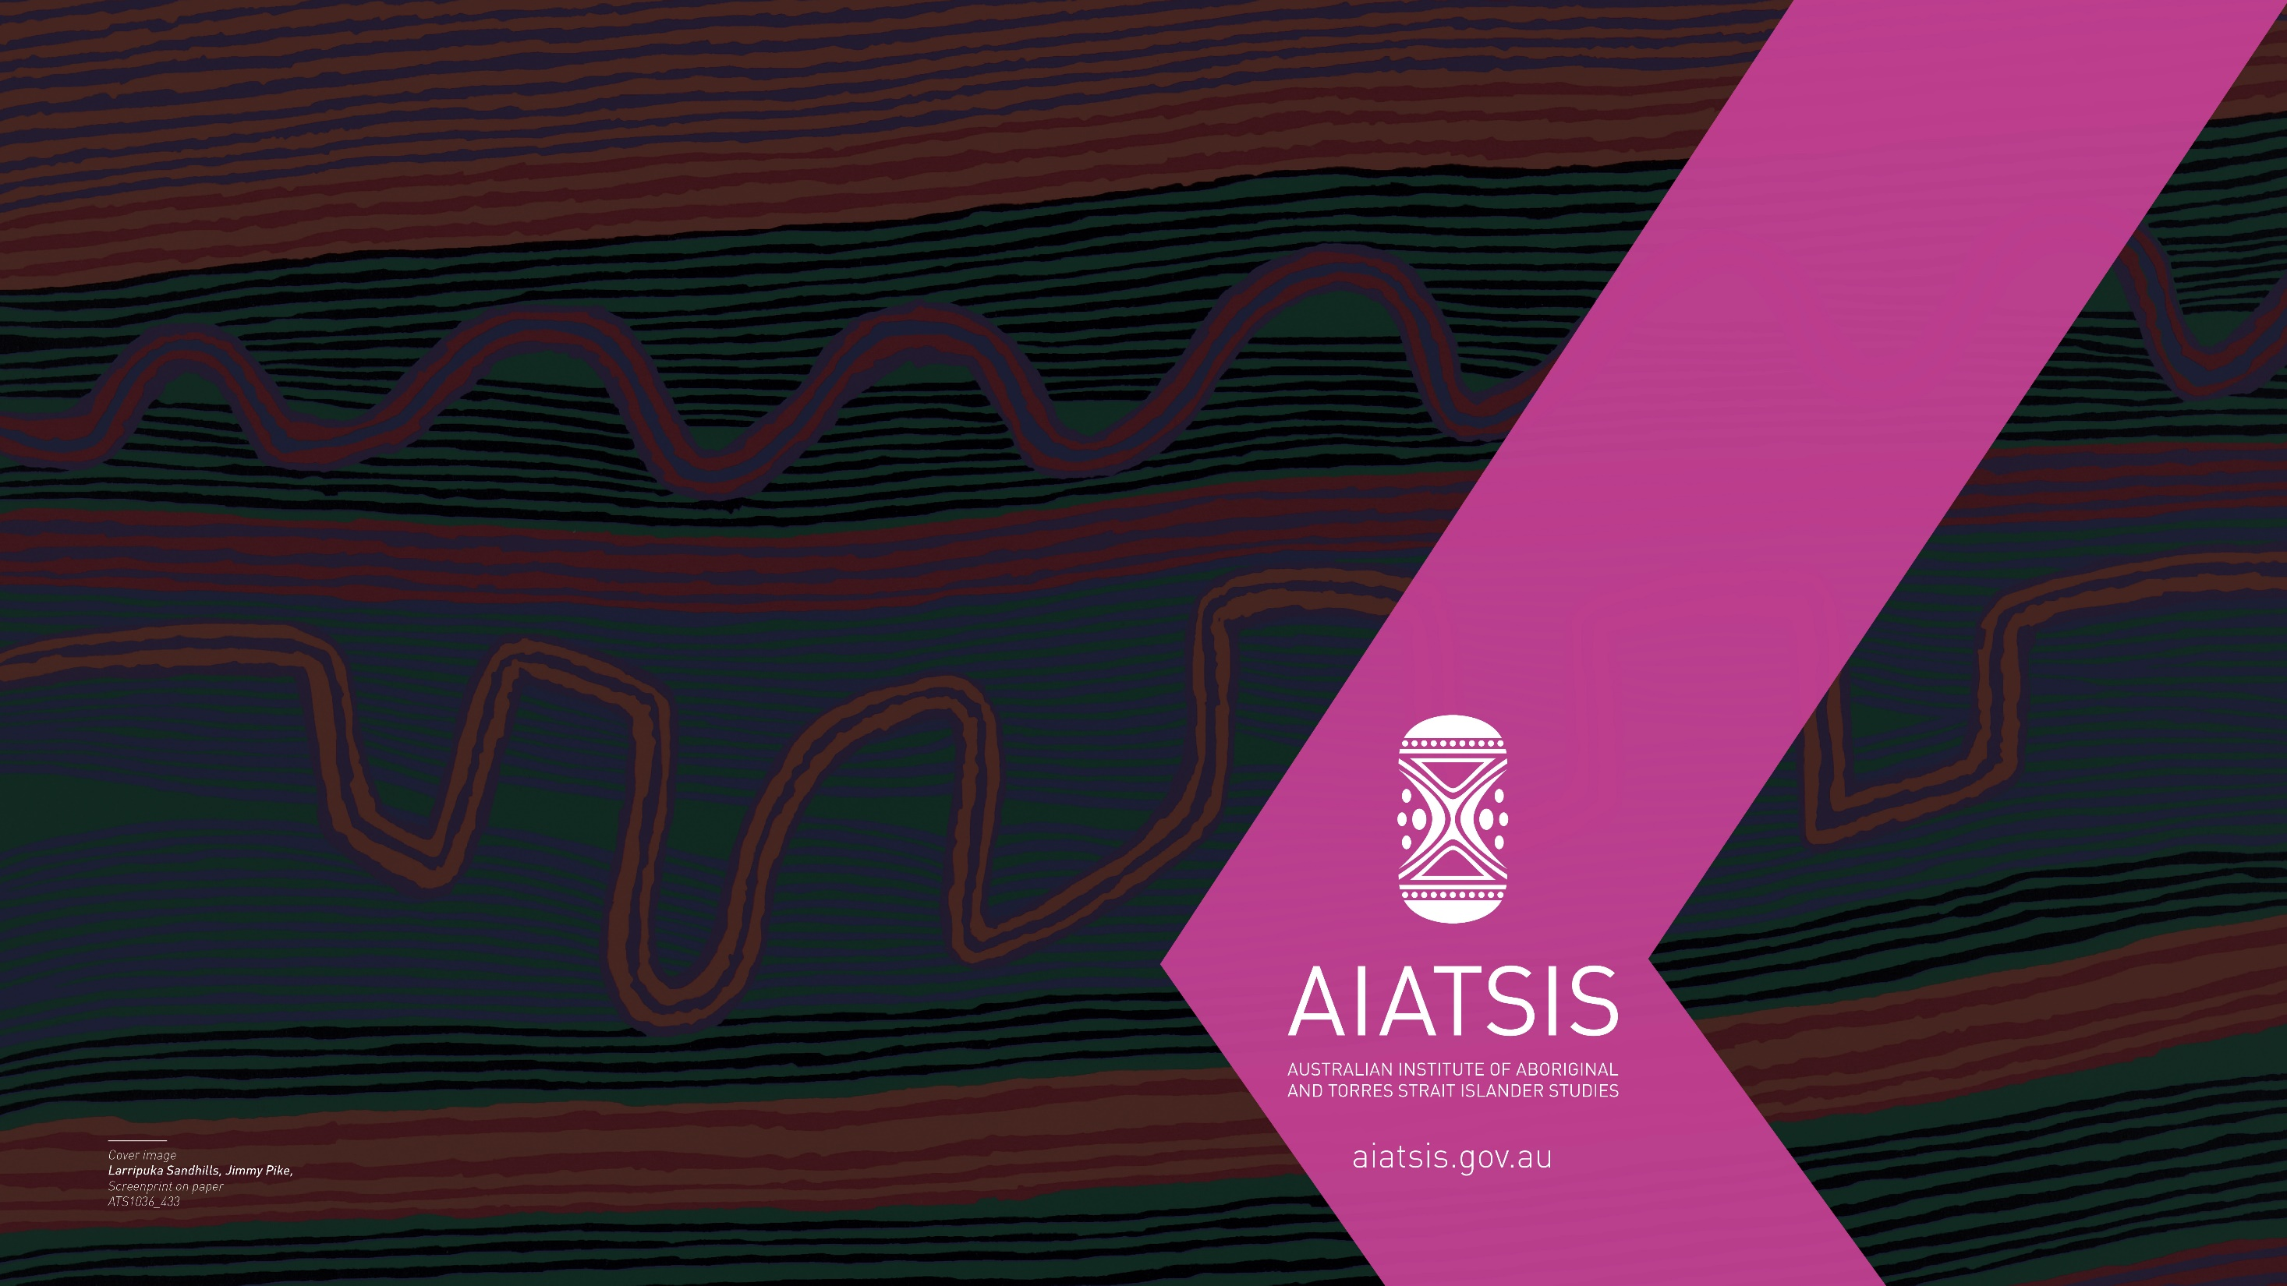
For further information please contact:
The Return of Cultural Heritage Project
Australian Institute of Aboriginal and Torres Strait Islander Studies
rochproject@aiatsis.gov.au

