Slide 1


Quality Rights Initiative
Act Unite & Empower for Mental Health
_______________________
Consultation on Human Rights & Mental Health
Palais des Nations 15. May 2018
Dr Peter McGovern
Notes:
Madam Chair, Excellency’s, and distinguished panelists;
Thank you for the opportunity to present the World Health Organisations (WHO) QualityRights initiative & the successes of its implementation so far.
The paradigm shift called for in Dr. Pūras’ seminal report in 2017 is long overdue. QualityRights provides mental health services with a transformative, yet practical framework to make this possible. Its implementable tools translate the rights based and recovery-orientated approaches enshrined in the CRPD, into a reality for services and the people that use them.
QualityRights focuses on how services can support people to live a good life rather than force people to comply. It outlines how to create services that have autonomy, will and preference at their core.

Slide 2

Capacity building materials
Core mental health and human rights modules:
Understanding human rights
Promoting human rights in mental health
Improving the mental health and related service environments and community inclusion
Realising recovery and the right to health in mental health and related services
Protecting the right to legal capacity in mental health and related services
Creating mental health and related services free from coercion, violence and abuse
Specialised modules:
Realising supported decision making and advance planning
Promoting recovery in mental health and related services
Implementing strategies to end the use of seclusion and restraints and other coercive practices
Notes:
The QualityRights initiative training materials are developed in collaboration with people with lived experience of using services, Disabled People’s Organizations (DPOs), mental health, human rights and legal professionals as well as policy and academic experts. The comprehensive package of face-to-face training and guidance tools builds rights capacity amongst all stakeholders, as well as developing the skills to put these human rights into practice.
This global initiative is already being rolled out in settings across the world. It brings together diverse groups of people with different professional and lived experience backgrounds; to not only explore the relationship between human rights, mental health and recovery, but to collaboratively build solutions to implement rights in practice.
These solutions, in the form of service improvement plans, are rooted in the local cultural context and challenges of mental health service provision. Improvement plans consist of achievable and measurable changes that can begin immediately in addition to medium and longer term goals for the service.

Slide 3
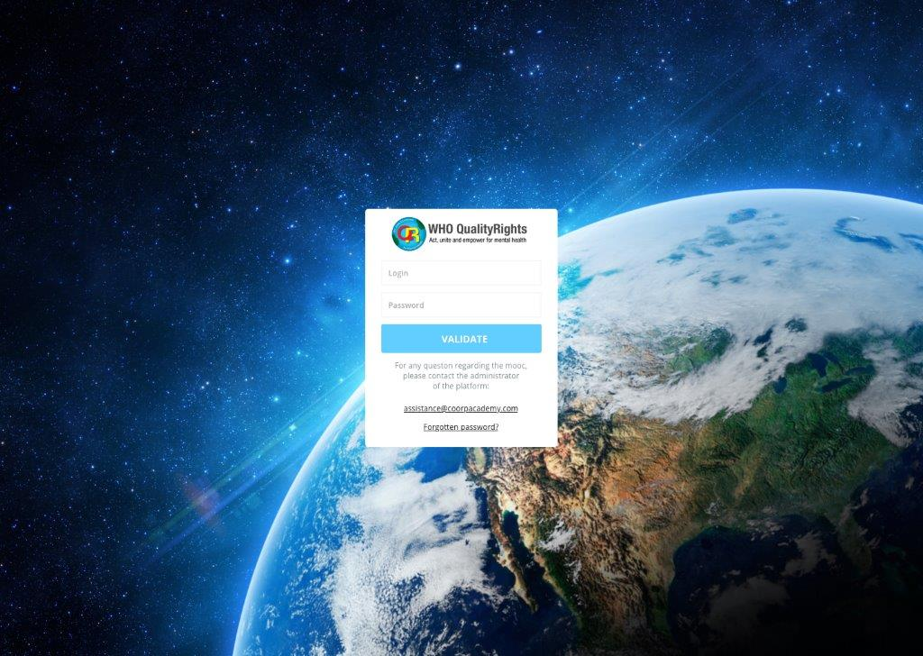
E-training
E-training version of 6 core human rights modules
Short videos, documents, challenges, online coaching and forums
Reach, engage and train more people
Identify champions and build stronger movement to advocate for human rights & quality services
Change in attitudes, norms and practices
Notes:
The E-Training platform expands the potential for access to QualityRights materials. Participants from different countries can come together to complete core modules in Human Rights as well as participating in moderated discussions with access to expert coaches and mentors online everyday.

Slide 4
Face to face training
Active discussion of the most challenging topics
Challenges identified
Long held view points confronted
Complex scenarios adapted to local context
Resistance & hierarchy
All stakeholders as part of the training – mixed groups
Notes:
I hope to focus today on the process and impact of Face to Face training
Underpinning QualityRights is a desire to promote active discussion of the most challenging topics that can often divide opinion. Representation from all stakeholder groups in the one room is key to successful face-to-face training. Health professionals, policy advisors, civil organisations with influence to shape services alongside those with the insight & lived experience of using services to make that change meaningful.
The diversity of opinion & at times frank disagreement is palpable on day 1 of trainings. It is this energy that drives the change that occurs over the course of the training. QualityRights confronts this head on, resulting in a unique forum for services and their users to have interactive discussions on human rights and mental health on an equal basis.
Participants learn to find rights based solutions in complex scenarios. For example they:
Start by identifying rights denials in services or case studies, based on what has been learnt (about the CRPD and recovery approach).
Explore what the barriers to change are & why they should be removed.
Discuss what steps can we take to overcome barriers?
This is a process in which the resistance to change & the rationale for rights denial are aired and challenged in a safe forum, in a way that can bring about meaningful opinion change and in turn more rights-based approach thinking.

Slide 5
The change in the room
Resistance
Initial Engagement
Too much to change?
Rights promotion in practice
Rise of the service user voice
Meaningful improvement plans w/ shared ownership
Notes:
Resistance to change in how mental health services are provided is self evident, which is partly why we are here today. QualityRights works with this resistance, engages participants & builds momentum to support people in a different way.
It’s often pointed out in training that rights based approaches not only benefit those that use services, but also make those services better places to work - services to be proud of.
This newfound enthusiasm can be replaced by a sense of overwhelming challenge. There’s simply too much to change & not enough resource.
QualityRights is clear that this is not an academic conversation about aspirational change that can be delayed to another day. Training is a call to action and guide for how everyday changes, that can begin today, can promote rights of people with mental health conditions & psychosocial disability. This is where the voice of the service user rises in the training.
“This is how I deserve to be treated, how I will be supported from now on”.
It is when the denials of rights and solutions to these denials are brought to life that changes in mentality occur.

Slide 6
“..The best part about the training is that it allows you to understand HOW to apply rights in daily life and practice”
⁸
I did what I had to do—give medicines and injections.
Now things have changed, I listen and try to understand users and in doing so, make them feel heard
Notes:
WHO EURO Quality Rights Evaluation forms 2017
Pathare, S, Kalha, J, Joseph, T, Funk, M, Drew-Bold, N, and Khenti, A. QualityRights Gujarat. in: P Kerrigan, S Bhattacharya, S Peel, M Romero Sá, R Kishore, A Wade (Eds.) Mental health: pasts, current trends and futures. Centre for Global Health Histories, University of York. Orient Blackswan, York, UK; 2017: 64–78
So what do people say about the training : (READ)
“…The best part about the training is that it allows you to understand HOW to apply rights in daily life and practice”

Slide 7

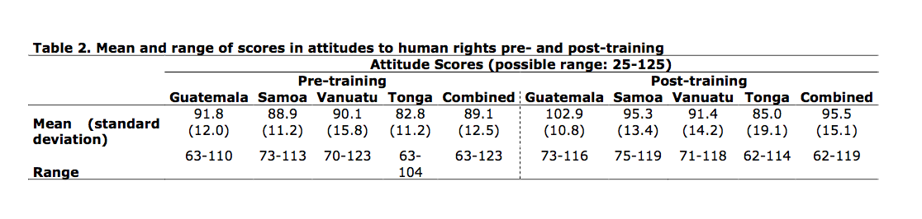
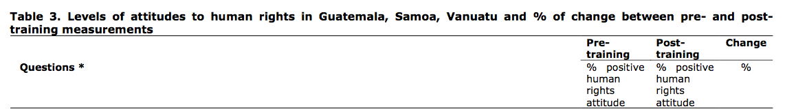
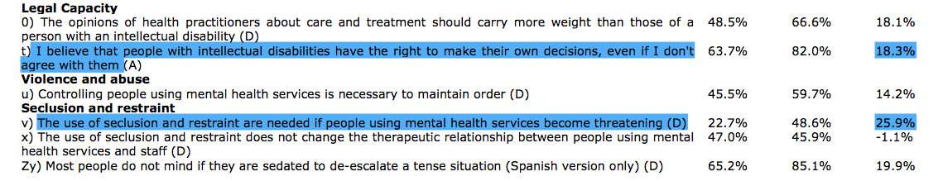
Preliminary results: attitude change
Notes:
3. Oliveria D et al. World Health Organization QualityRights Training on Mental Health, Human Rights and Recovery. University of Nottingham. March 2018
The right to legal capacity and use of coercive practices within mental health services are often cited as the most challenging aspects of the CRPD to implement. This group demonstrated sizebale attitude change toward the use of coercive practices in crisis scenarios & people’s right make decisions for themselves after just 3-5 days of training.
Rights based respones showed increases of 25.9% and 18.3% respectively.

Slide 8
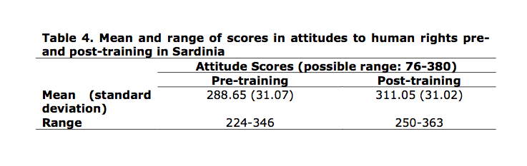
You can only inspire hope once the person has recovered
showed the greatest change: prior to training, 12% strongly disagreed and this increased to 50% in the post-training test.
The opinion of the health practitioners about care and treatment should carry more weight than those of a person with an intellectual disability
35% strongly disagree/disagree prior to training and this increased to 83% post-training
There is little mental health and other practitioners can do to promote the rights of people with mental health conditions
Jump from 47% ‘strongly disagreed’ in pre-training to 78% ‘strongly disagreed’ in post- training
Notes:
3. Oliveria D et al. World Health Organization QualityRights Training on Mental Health, Human Rights and Recovery. University of Nottingham. March 2018
QualityRights addresses the fundamental barriers to achieving a rights based and recovery informed approach to mental health care. As these results show QualityRights training directly addresses the hopelessness that is felt, not just by those that use the services but those that work in them, regarding what can be achieved at an individual level in Recovery and in terms of wider system change.
QualityRights challenges the heirarchies that exist in services that result in barriers to recovery.
Participants work together to discover that change is possible and that rights can and must be respected, protected and fulfilled.

Slide 9
People that use services must be at the centre of driving reform.
Diversity of personal and professional background is key to the success of trainings
The most challenging topics are confronted and clear rights based solutions outlined.
QR encourages shared ownership of service improvement plans - as solutions are rooted in the reality in which services exist
Notes:
In conclusion: Core to the success of the QualityRights training and guidance materials is that they have been developed and driven by those with lived experience of services. The learning environment both online and face-to-face encourages direct interaction between all stakeholders, to solve previously intractable problems.
As a result the challenges identified and solutions suggested to protracted denials and abuses of human rights are rooted in the reality of the service and the culture it exists in.
This results in shared ownership of the resulting service improvement plans and presents opportunities for wider culture change that promotes a shift toward a human rights based approaches in mental health support.
Thank you for your time.

Slide 10
Thank you
petemcgovern@me.com
Search: WHO Quality Rights Initiative

