Slide 1


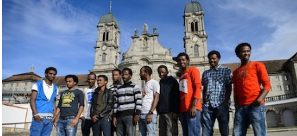

IKEA Switzerland – Providing opportunities to refugees
Lorenz Isler
Sustainability Manager, IKEA Switzerland @LorenzIsler
Geneva, 27.11.2017

Slide 2
IKEA’s humanistic tradition and the large influx of refugees led to different engagements in IKEA retail countries.
IKEA values diversity and inclusion.
Large influx of refugees over the past years
Emergency situation & challenging integration
Initiatives in many IKEA retail countries
Notes:
IKEA Germany
Large donations to refugee cause through co-worker run projects
Child friendly spaces in refugee centers with Save the Children
Job inclusion program - 50 jobs for refugees

Slide 3
The Refugee Inclusion Program is a standardized program active in all IKEA Switzerland stores.
Refugee inclusion program at IKEA Switzerland
6 months internships combined with inter-cultural awareness trainings for 2 refugees in every IKEA Switzerland store
9 stores in Switzerland - 18 participants per round - 2 rounds per year - 108 participants over 3 years
Set up and constant exchange with authorities
Goal: Participants gain self-confidence and work experience, get to know Swiss (work)culture, improve language skills, and get in contact with people working in Switzerland

Slide 4
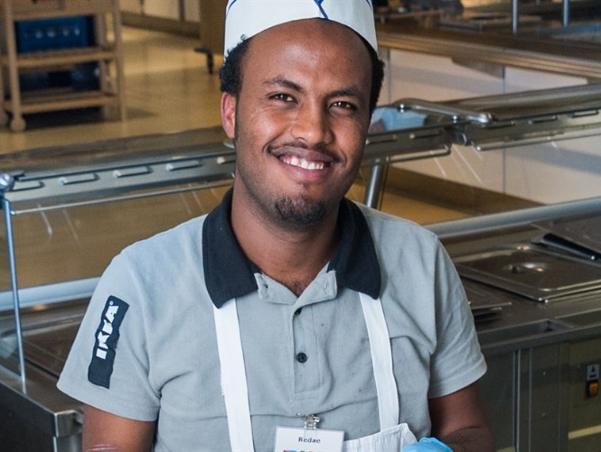
The Refugee Inclusion Program shows promising first results.
Results from first 2 rounds – 36 participants
Highly motivated participants
Participants gain self confidence, connect with others and improve their language skills
Employment of 13 refugees (36%)
Radea, IKEA Grancia

Slide 5
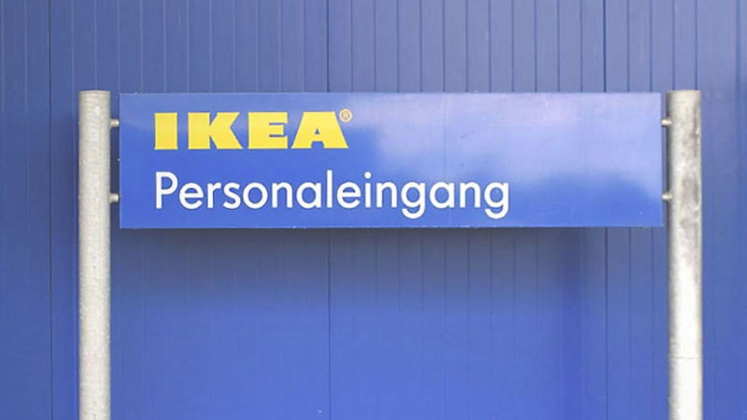
The success of the Refugee Inclusion Program is based on several factors.
Success factors
Support / anchoring in organization
Taking clear stand
Cooperation with public authorities

Slide 6
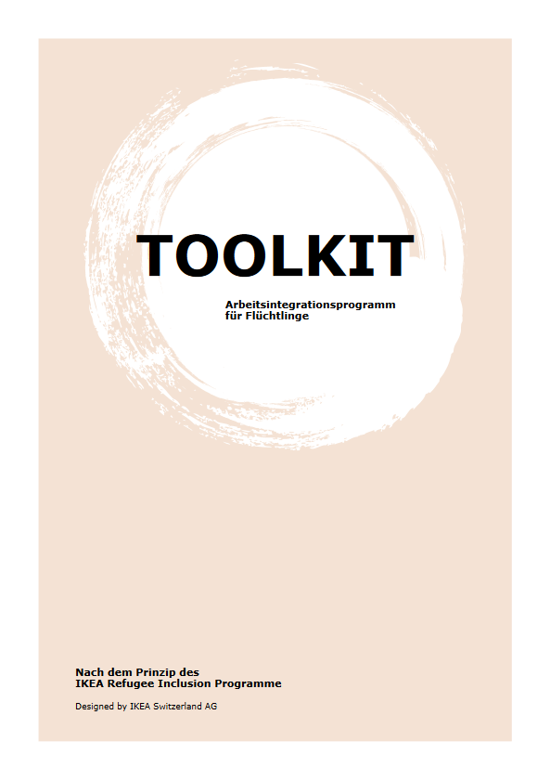
Now we try to inspire others.
We would like to inspire others
Refugee Integration Toolkit (here)
Refuge Integration Dialogue, November 22 2017
140 participants from businesses, non profit organizations and administration
speeches, best practice and workshops on integration of refugees into the workforce.

Slide 7
Thanks
Lorenz Isler Sustainability Manager IKEA Switzerland @LorenzIsler Lorenz.Isler@ikea.com

