Slide 1
Becoming a Stranger at Home – Sharing Fear and Resistance in Europe
SHAYNA PLAUT, PHD
Research Manager
Global Reporting Centre
Shaping the Public Narrative on Migration: Promoting Tolerance and Countering Xenophobia Against Migrants
OHCHR, Geneva
21 April 2016

Slide 2
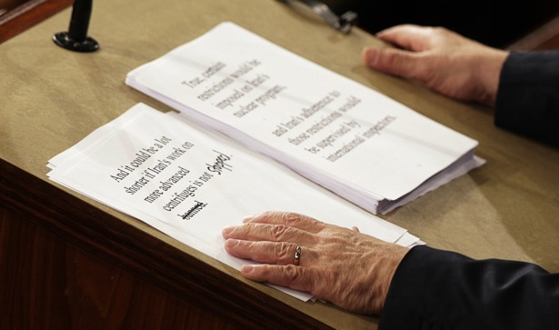
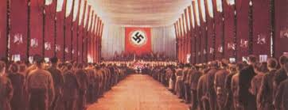
“It’s 1938 all over again”
THE CENTRAL QUESTION: IS IT 1938?
“If today's world resembles Europe on the eve of invasion, carnage, and the Holocaust, then Netanyahu's warnings are prudent and wise.
But what if the analogy is wrong?”
–The Atlantic March 3, 2015

Slide 3
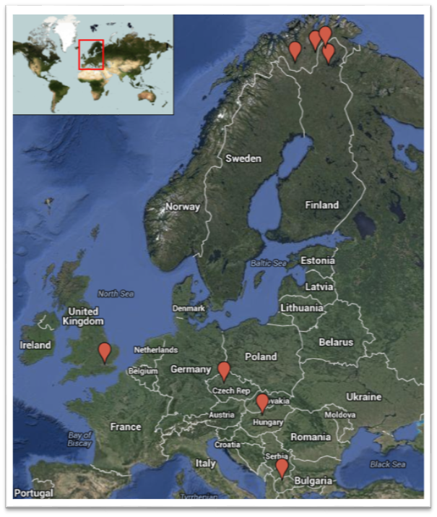
What Europe?/Which Europe?

Slide 4
What stories are being heard? What stories are being ignored?
Dominant narratives supporting dominant power structures
Issue emergence/non immergence (Carpenter, 2007; 2009; 2014)
“Culture talk” (Mamdani, 2004)
What stories are being silenced?

Slide 5
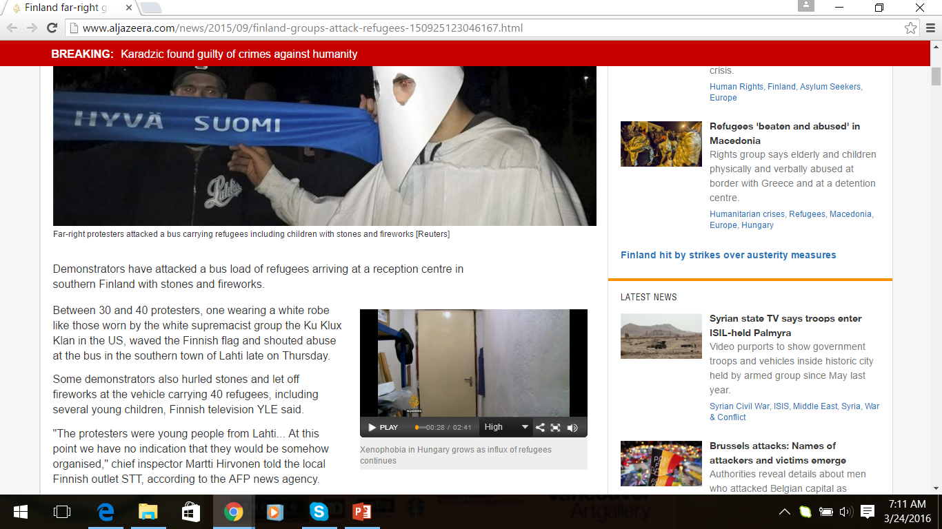
Is this a story about refugees? Or Finland? Hungary? The EU?
Notes:
http://www.aljazeera.com/news/2015/09/finland-groups-attack-refugees-150925123046167.html

Slide 6
Rather than “the” story, what if we had storytellers?

Slide 7

Notes:
I’ve been thinking about all of these issues, as we are building a new non-profit Global Reporting Centre that’s focused on innovating global journalism – and I kept coming back to this word “empowerment.” Last year some of my colleagues and I wanted to start a project about the rise of xenophobia in Europe – a complex issue and one that is too easy to simplify for an outside observer. So instead of sending in foreign correspondents to report on the growing tensions with immigrants, hostility towards Muslim citizens, the resurfacing of anti-Semitism and the ongoing prejudice and violence against Roma people – we decided to empower people from these communities to tell their own stories.

Slide 8
“The traditional model of the foreign correspondent is a pretty colonial approach” – Maggie O’ Kane (quoted in Murrell, 2015, p. 114)
Notes:
http://www.lucify.com/the-flow-towards-europe/

Slide 9
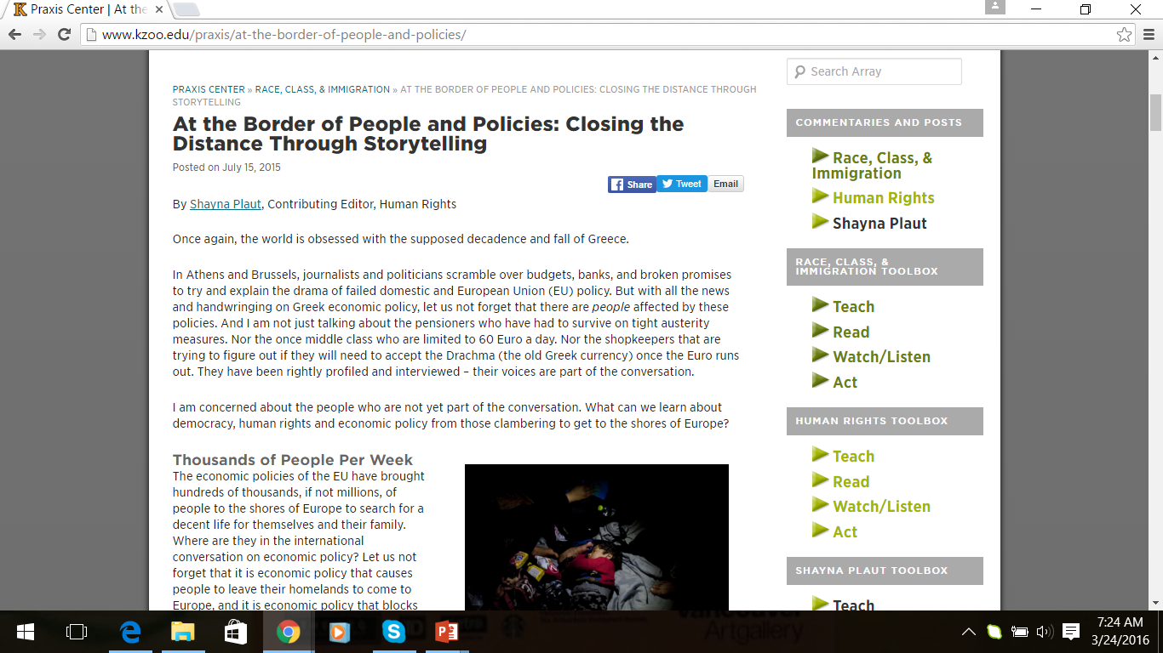
What could be different if we focused on narrative politics (Brysk, 2013) rather than abstract policies and politics?

Slide 10
Who are we listening to and who are we privileging and what are the consequences?
What if we could change policy by changing discourses of the possible?

Slide 11
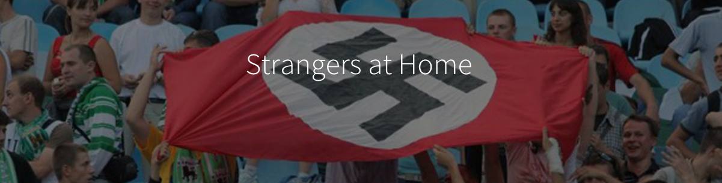
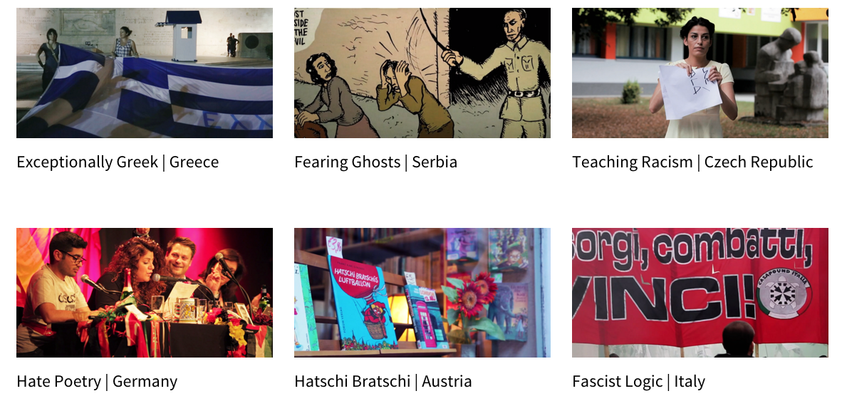
Notes:
http://strangers.globalreportingcentre.org/

Slide 12
THANK YOU!
Shayna Plaut, PhD
Research Manager
Global Reporting Centre
Simons’ Fellow for International Law and Human Security
School for International Studies – Simon Fraser University
Shayna.plaut@gmail.com

