Slide 1


Peer Support & the CRPD
Sera Davidow
Contact: Sera@WildflowerAlliance.org
Slides: tiny.cc/UNSD21

Slide 2

Childhood Trauma Messages vs. System Messages
Messages Related to Childhood Trauma | Messages Related to Treatment in the MH System
It is your fault. | There is something inherently wrong with you.
Don’t tell or someone will get hurt. | If you complain, you can lose your rights.
They won’t believe you anyway. | Your words can’t be trusted.
Comply or it will get worse. | Comply or it will get worse.
You are lying. | Your experiences are not real/It’s all in your head.
You wanted it. You deserve this. | We had to do what we did based on your actions.
Suck it up/get over it. | If our treatment fails, there’s something wrong with you.
I am doing this for your own good. | We are doing this for your own good.
You should be grateful you have it this good. | Accept and be happy with a very limited life.
There is nothing you can do. | Your feelings and preferences don’t matter.

Slide 3
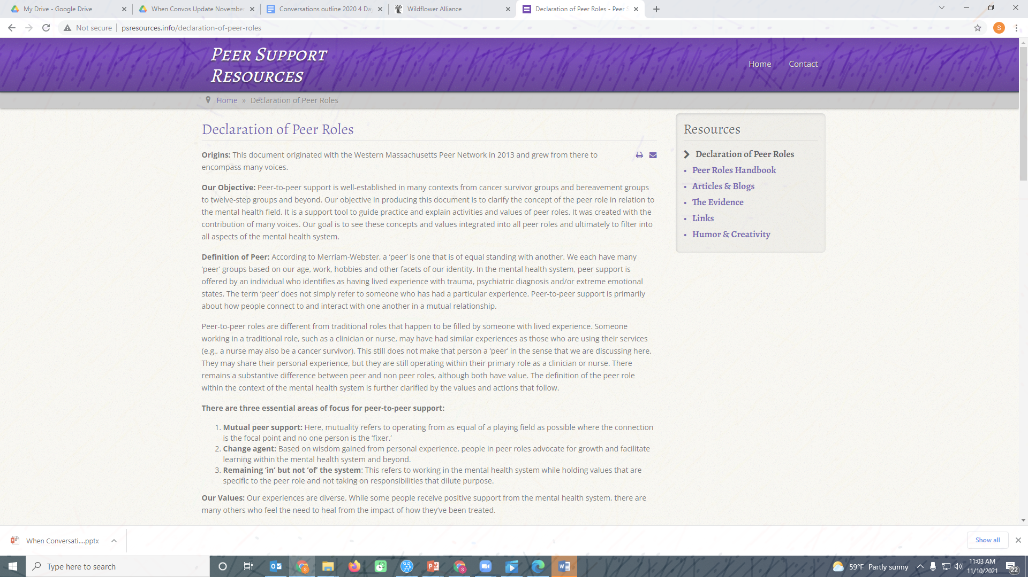
The dignity of being a whole person
Prioritization of self-determination and choice; And
The importance of Community involvement
https://tinyurl.com/DPR2013

Slide 4
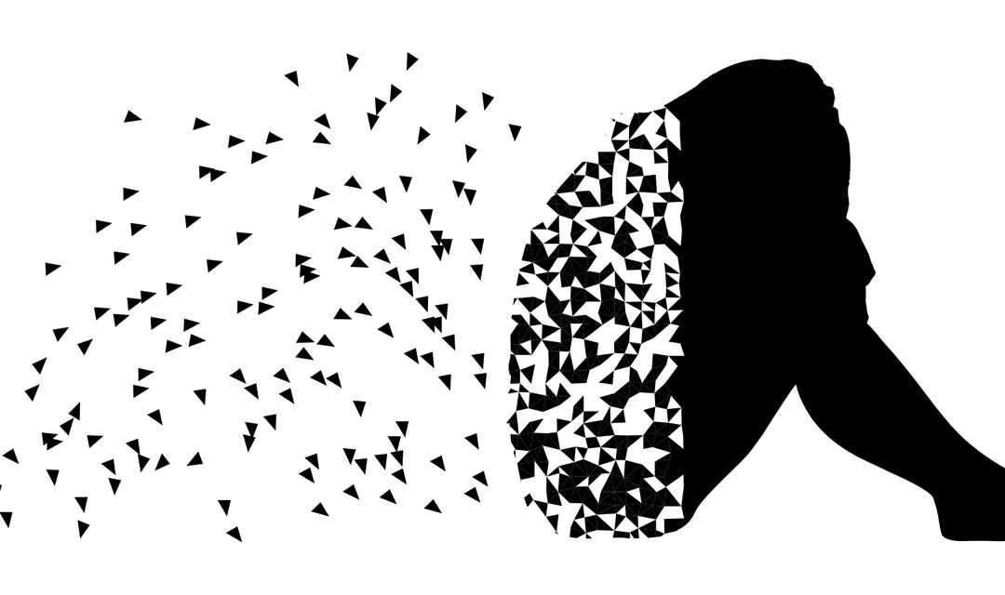
Developed by the Wildflower Alliance by people who’ve been suicidal
Makes space to talk about suicidal thoughts and other taboo topics without fear of loss of liberty and other negative consequences
Focused on supporting people to make meaning of their experiences
Not necessarily about getting rid of all suicidal thoughts so much as it is about shifting the power imbalance so that those thoughts hold less power over the person
Alternatives to
Suicide

Slide 5
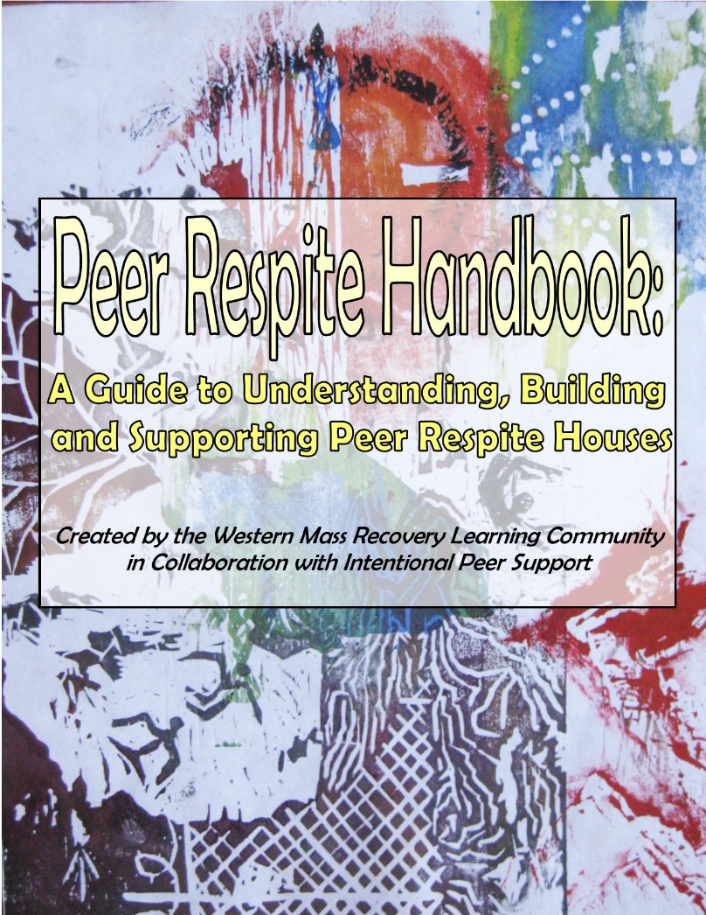
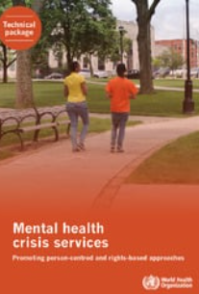
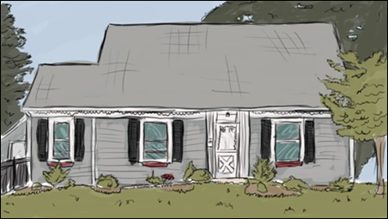
Afiya Peer Respite
Non-clinical (everyone who works there has experienced life-interrupting challenges)
Alternative to locked psychiatric units
Focus on rights, diginity, self-determination and self-discovery
Emphasis on experiences and adaptations rather than ‘diagnosis’ and ‘symptoms’
Private bedroom (with a lock!)
Stay for up to one week
tiny.cc/PRhandbookO
tiny.cc/WHOcrisis

Slide 6

Definition of: “Discrimination on the basis of disability” means any distinction, exclusion or restriction on the basis of disability which has the purpose or effect of impairing or nullifying the recognition, enjoyment or exercise, on an equal basis with others, of all human rights and fundamental freedoms in the political, economic, social, cultural, civil or any other field. It includes all forms of discrimination, including denial of reasonable accommodation.
The Convention on the Rights of Persons with Disabilities says that the Human Rights of People with Disabilities (inclusive of people with psychiatric histories), are entitled to several human rights just like anyone else and those include (but are not limited to):
CRPD | Afiya Peer Respite
Equality before the law without discrimination | Supports people to know their rights, to help train attorneys to better represent them, etc.
Right to life, liberty and security of the person | Supports people to avoid forced commitments altogether, or sometimes to be able to get an earlier release
Right to work | Supports people to stay at the respite while also continue to work, maintain their own housing, access mail to pay bills, etc.

Slide 7

Women’s Power by Michael Christmas http://tiny.cc/MCwomenspower
We need to shift from using our power OVER people to using our power UNDER people… to lift their voices up, and so they can take some control back in their lives.

