Slide 1


Intersessional Seminar on Access to Medicines and Vaccines in the Context of the Right of Everyone to the Enjoyment of the Highest Attainable Standard of Physical and Mental Health
Human rights challenges in the context of the Covid-19 pandemic, with a special focus on developing countries, particularly their poorest and most vulnerable populations

Slide 2
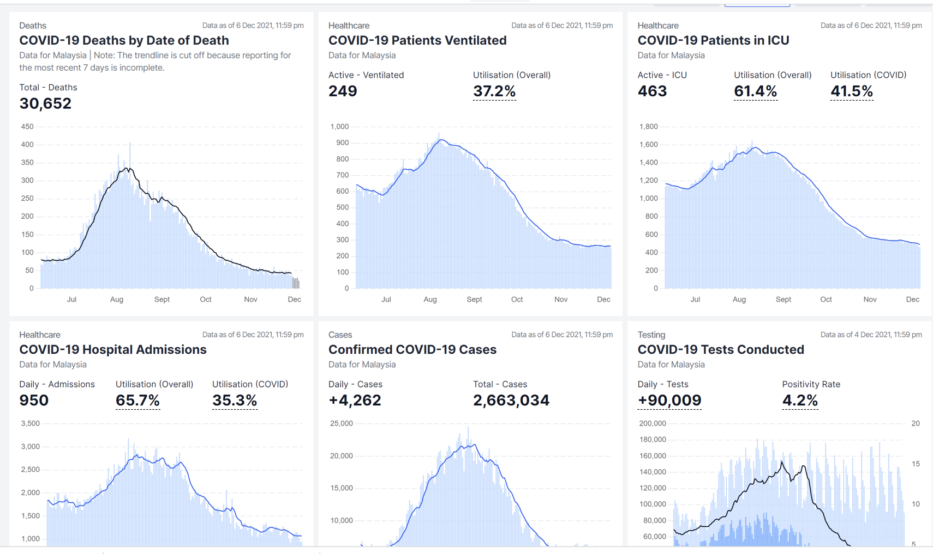

Slide 3
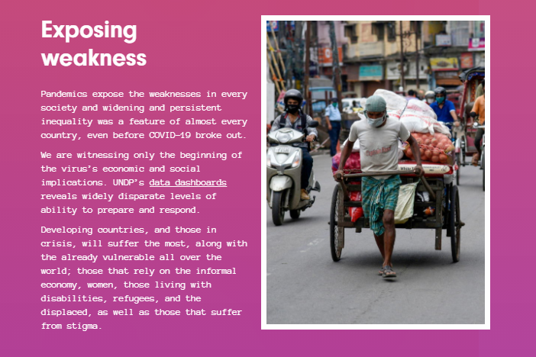
https://feature.undp.org/coronavirus-vs-inequality/

Slide 4
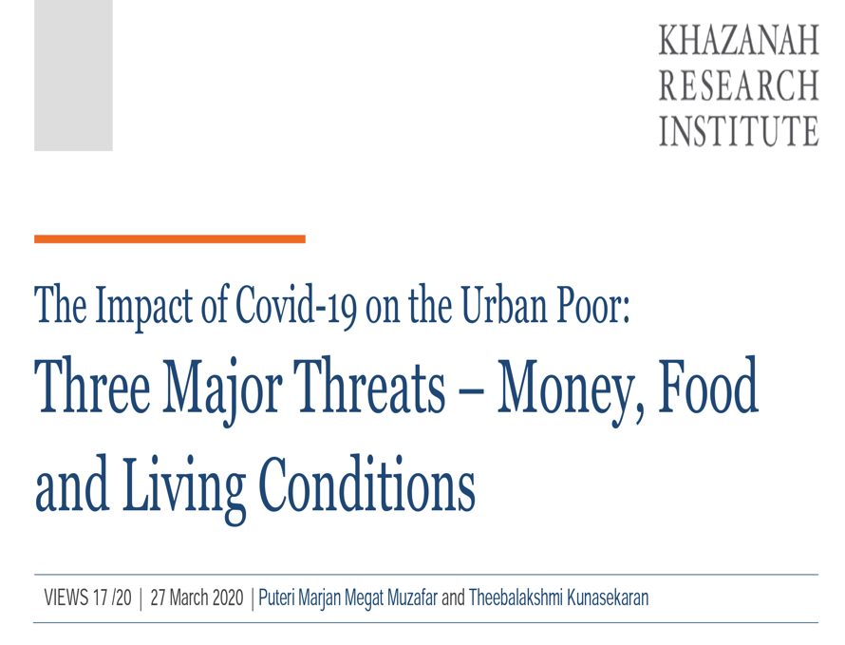

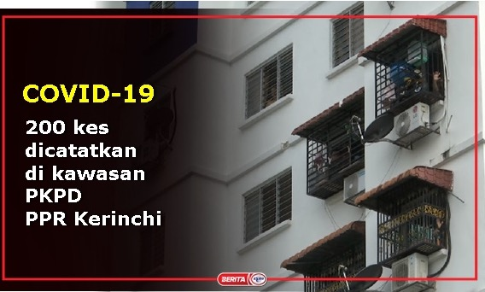
Adverse impact on their income and financial security
1.Adverse impact on their income and financial security
2.Limited access to affordable food and goods, as well as a risky reliance on public transportation
3. Poor infrastructure exacerbating the problem –
“a typical PPR in Kuala Lumpur consists of at least 316 units per 17-floor block. If the average household size is 4.6, then assuming all units are occupied, approximately 1,455 people would be crammed all together in one building. If we are not careful, these PPRs might be the perfect breeding ground for the novel coronavirus…..

Slide 5
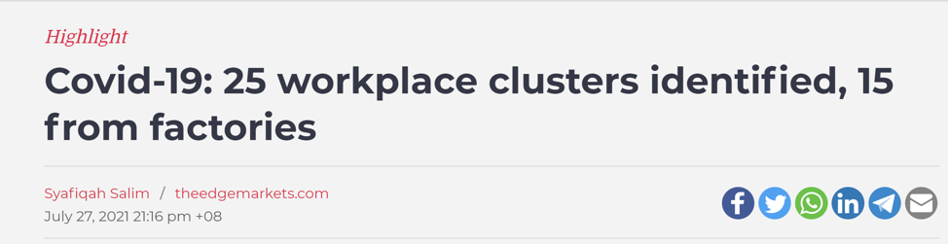
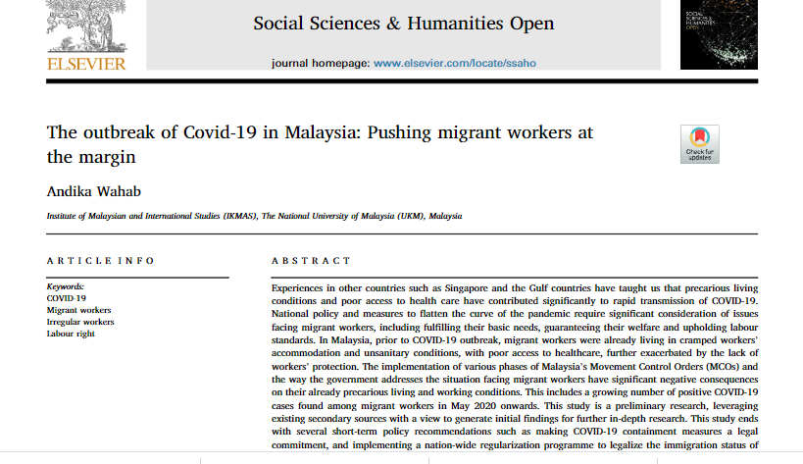
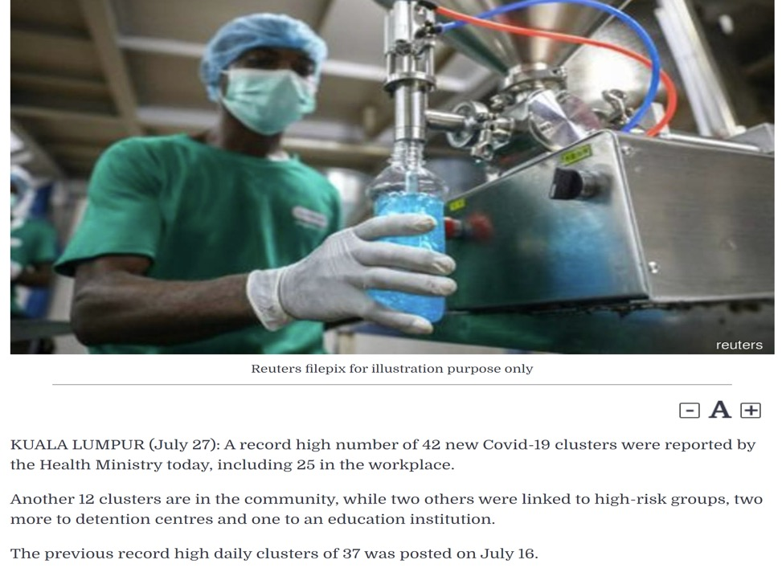

Slide 6
Foreign Workers - Access to Healthcare
Population of foreign workers - range from 4 – 7 million, with most citing undocumented migrants as the bulk of the group.
Pre-pandemic – a 2015 study of Bangladeshi migrant workers showed that lack of medical insurance and prohibitive medical fees is a key deterrent for seeking care
COVID-19 pandemic – confusing messages from government regarding cost of care
Fear of prosecution
Language & employer related barriers
Reliance on daily wages

Slide 7
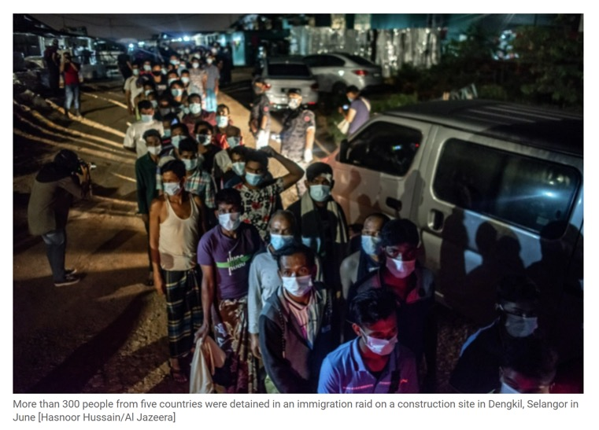
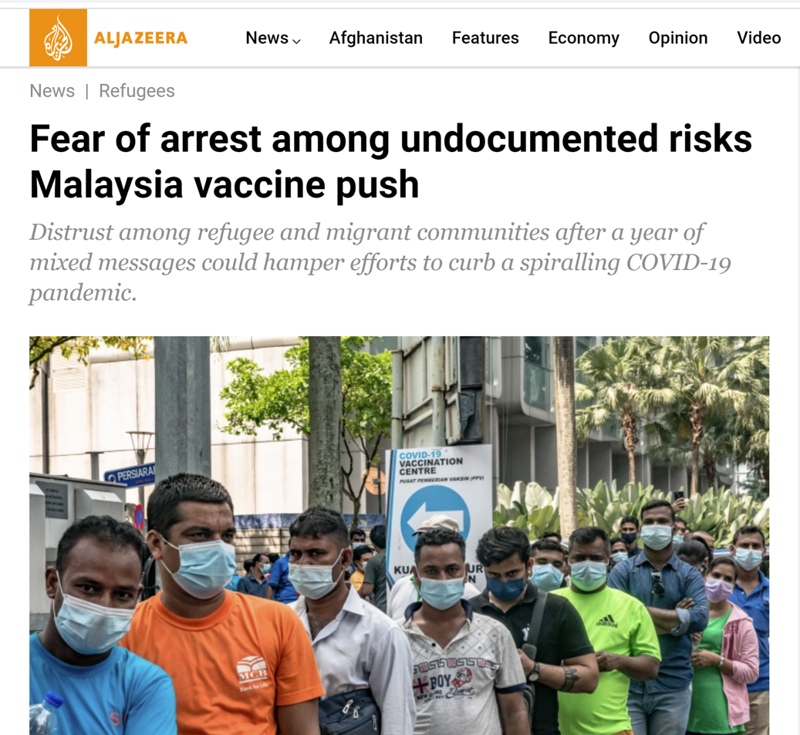
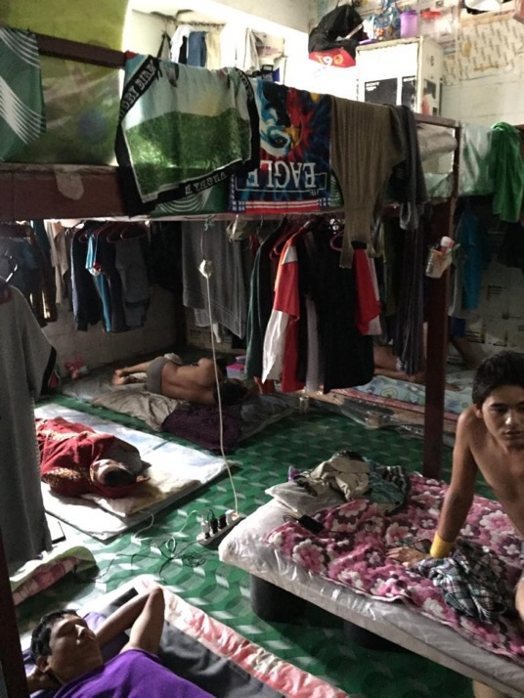

Slide 8
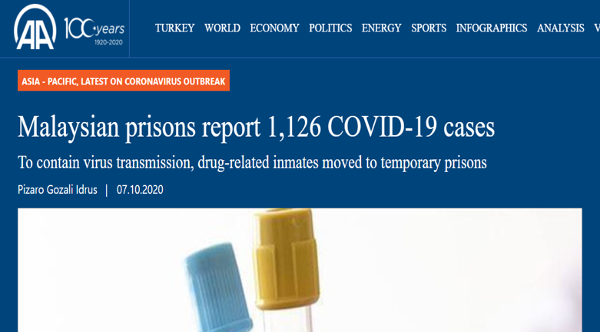
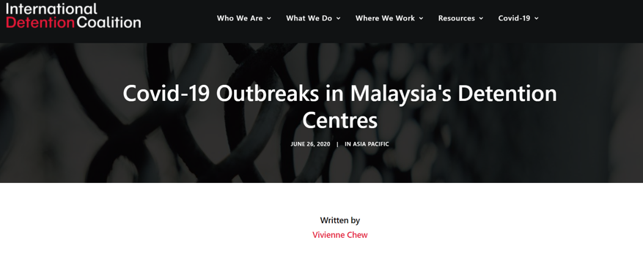
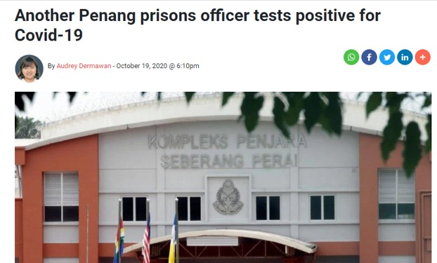
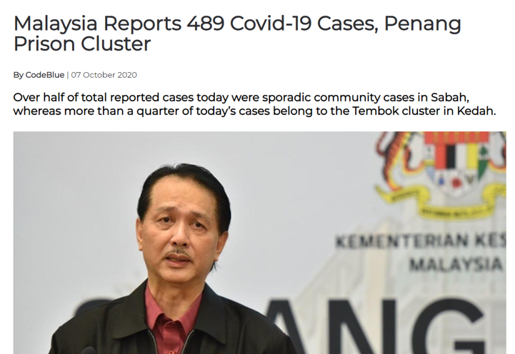
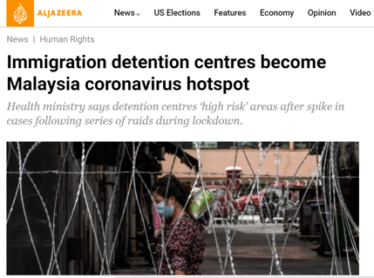
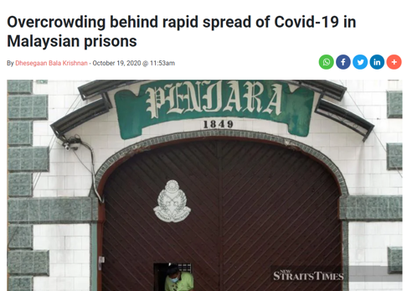
The 1,126 prison-related positive cases, 39 are prison officers or staff.

Slide 9
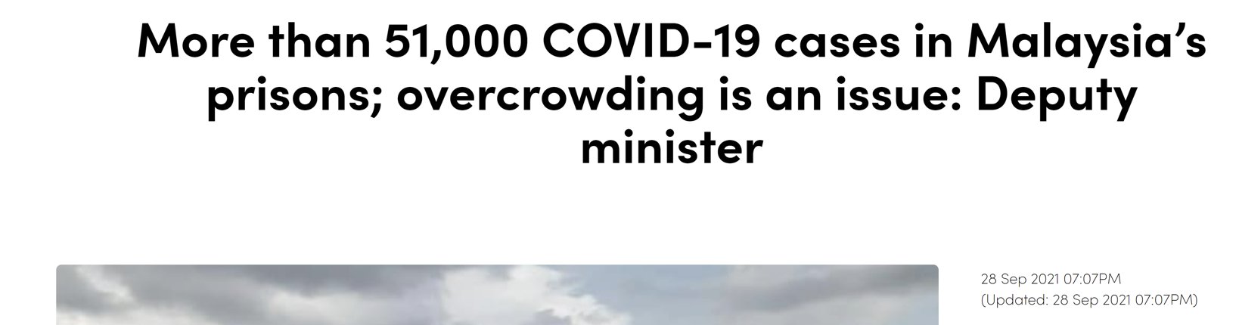
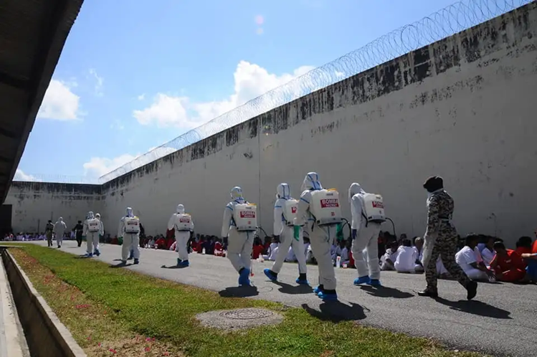

Slide 10
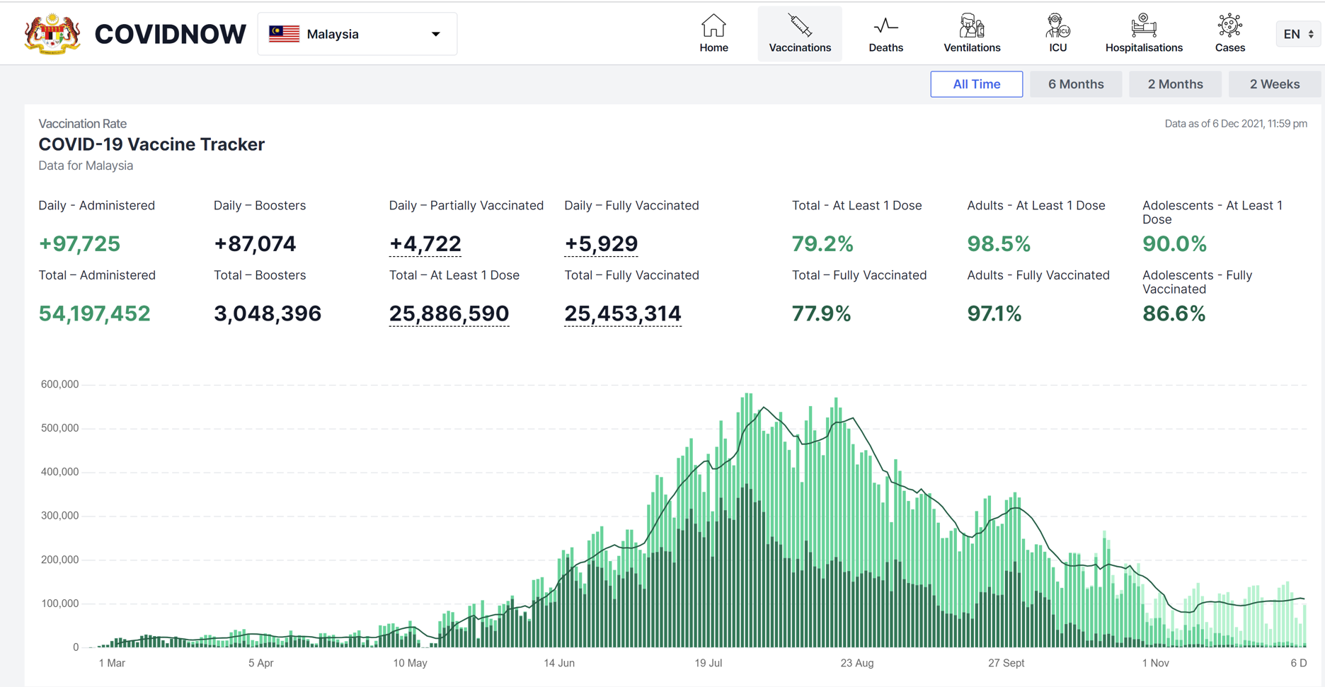

Slide 11
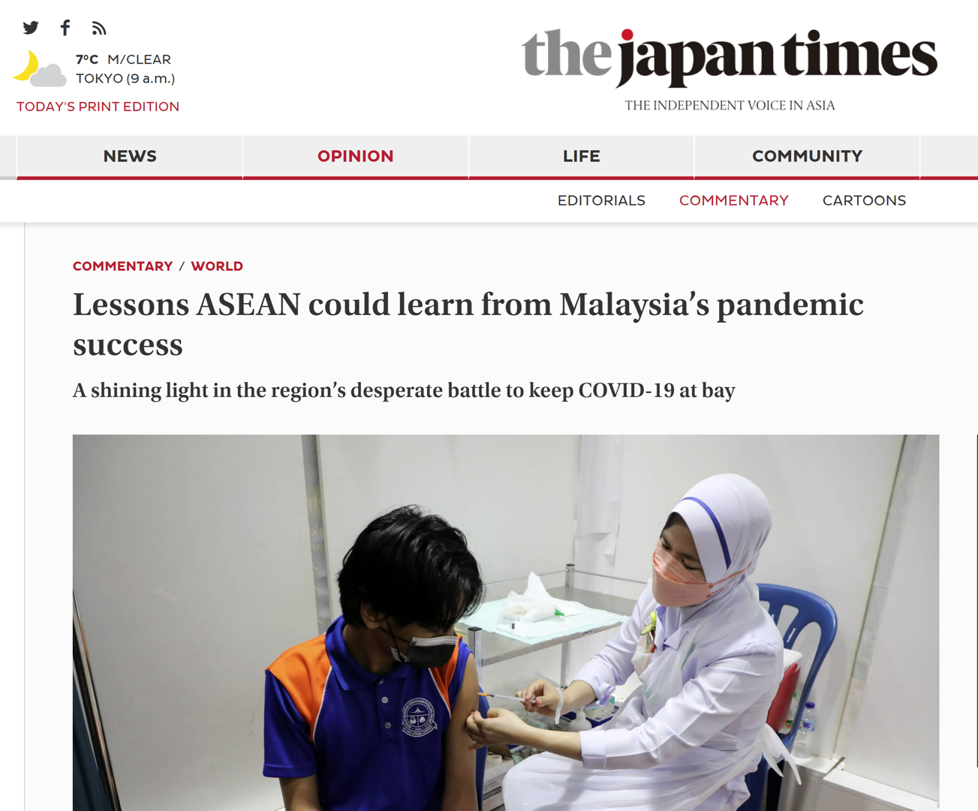

Slide 12

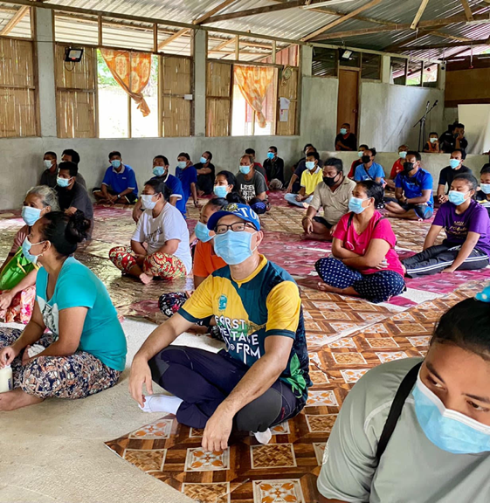
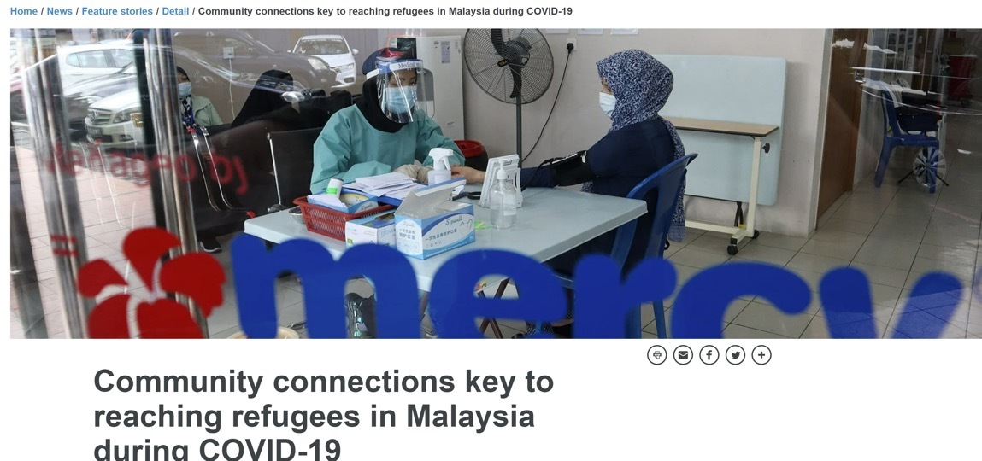
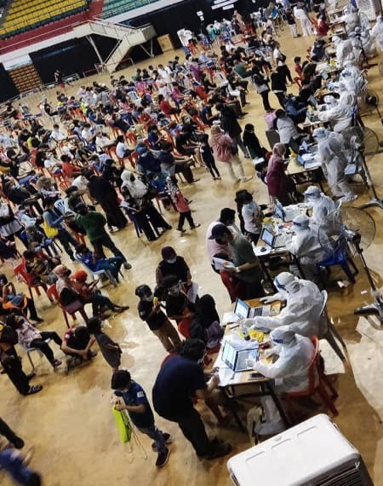
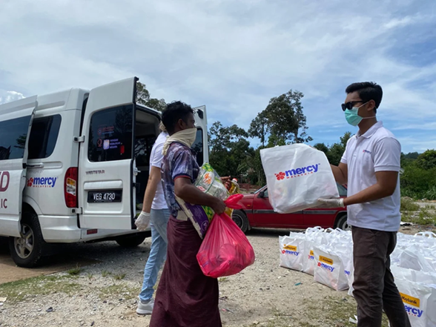
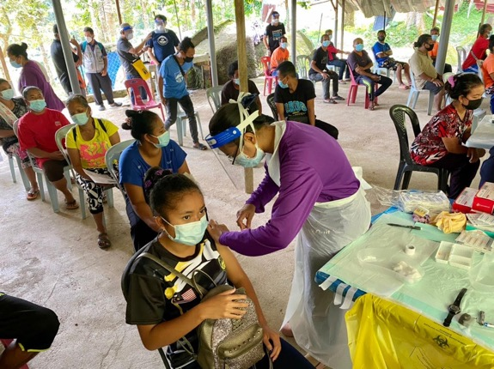

Slide 13


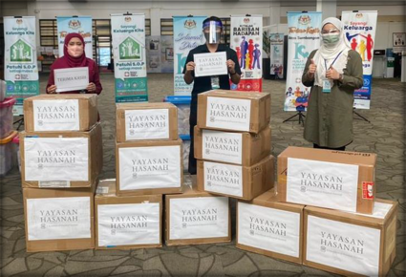
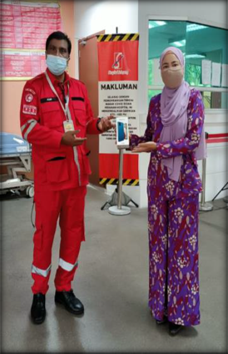


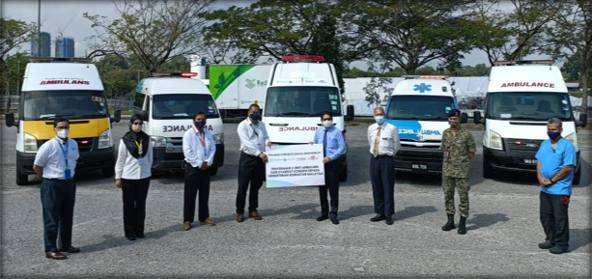


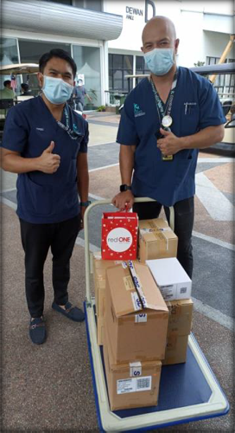
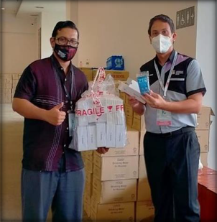
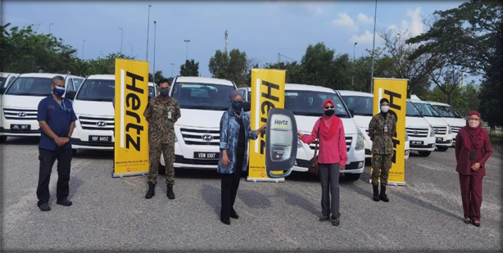
PUBLIC-PRIVATE PARTNERSHIP
18
SERVICES
Development of VOIP
Reminders for non-responsive patients HIQ Robocall & SMS
Call centre for mental health
ASSETS DONATION
Ambulances MPV Starex Handphones Laptops
Pulse oximeters
Oxygen concentrators Beds
Field hospital
Cash
Food packs

