Slide 1
19th session of the Intergovernmental Working Group on the Effective Implementation of the Durban Declaration and Programme of Action
Implementation of the DDPA by Member States, UN and other stakeholders
14 October 2021
EN

Slide 2
ENAR
Pan-European anti-racism network that combines advocacy for racial equality and facilitates cooperation among civil society anti-racism actors in Europe ​
Over 150 anti-racism NGOs across the EU​
Members provide grassroots perspective to ENAR’s work and bring the voice of victims of racism and discrimination to European level.​
ENAR works to: ​
research different forms of racism across Europe​
build capacity of our members,​
advocate for change at EU and national level

Slide 3
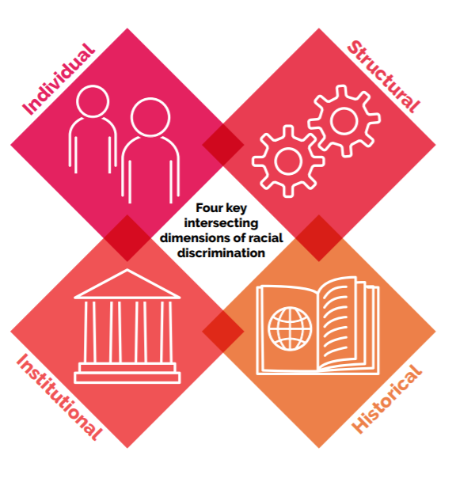
Dimensions of racism

Slide 4
Importance of NAPARs
Come as a complement to other national policies against discrimination
Resonate to the sense of emergency requiring strong actions and commitments from States
Response to the urgencies of day-to-day reports of racist violence or discrimination
Powerful commitment in public debates and contribute to shift mentalities and attitudes in society
Lack of implementation of legislation: need incentive measures​
Positive action measures to complement legislation​
Comprehensive and action-oriented policy that allow mainstreaming and coherence across policy areas​
Building a united front geared towards a common advocacy goal

Slide 5

5 main indicators of content
Sophisticated understanding of the concept of racism
Intersectional approach
Recognition of the specific forms of racism
Equality data collection
Scope

Slide 6
Case Studies Scotland Race Equality Framework 2016-2030
The Scottish Framework recognises that racial inequalities can be the result of structural discrimination and expresses its intention to tackle this manifestation of racism.
Intersectionality is an overarching guiding principle, which spells out its intention to “further explore intersectional issues around the goals and actions set out in the Framework”
Recognise Scotland’s involvement in the slave trade and colonialism, and how “the impact of these global events can still be seen in the inequalities faced by minority ethnic communities today”
Includes anti-migrant discrimination: ‘recent migrants face additional barriers to employment, on top of the barriers relating to the structural and personal racism faced by the wider minority ethnic population in Scotland”. It mentions lack of recognition of overseas qualifications as an additional challenge and proposes to improve recognition of such qualifications to improve access to the labour market for migrants

Slide 7
Case Studies Scotland Race Equality Framework 2016-2030
Build on existing data collection practice
Sets out measures to tackle racial inequality across social and economic policy areas including community cohesion and safety, participation and representation, employment, education, health and housing
Has an explicit link is made between the Framework and other key strategies, legislation and other key areas of work all listed in an appendix to the document
Developed as a result of intense consultation and involvement of a wide range of organisations and individuals.
The actions within the Scottish Framework are monitored internally by the civil servants responsible for the Framework. The Scottish Government is also keen to continue its stakeholder engagement to get their views on progress. An independent adviser was appointed to act as a “race equality champion” and to help drive forward the implementation of the Framework.

Slide 8
Case Studies Swedish National Action Plan Against Racism and Other Forms 2016 onwards
The Swedish Plan provides a sophisticated definition of racism that includes structural racism, which it defines as “racist actions […] not always based on individual’s political convictions but can also be unconscious. This means that racism, in various forms, exists as part of the structures of society
Recognises intersectionality and highlights its intention to link up with other government agendas, including gender equality and LGBTQ rights
Spells out the specific groups that are the focus of targeted measures namely: Afrophobia, Antisemitism, Antigypsyism, Islamophobia and racism against the Sami. It also includes a focus on combating homophobia, biphobia and transphobia
Recognises Afrophobia and has a number of targeted measures aimed at tackling Afrophobia, mentioning the UN Decade as a framework for action at a national level

Slide 9
Case Studies Swedish National Action Plan Against Racism and Other Forms 2016 onwards
The Swedish Plan is the one of the few that recognises and defines the concept of Islamophobia and Antiypsyism - does not provided targeted measures
Recognises the limitation of data: “takes a restrictive view of statistics and data collection in relation to the national minorities and the Government has no reason to re-evaluate this approach”. The main source of data used in the Plan is therefore based on attitudes and experiences surveys. In addition, it collects hate crime statistics.
focuses mainly on educational measures and measures to tackle hate crime
Transversal approach: its actions need to operate in conjunction with other government plans including reducing the democratic deficit, social and economic inclusion, education and youth policy and preventing violent extremism
Budget allocation

Slide 10
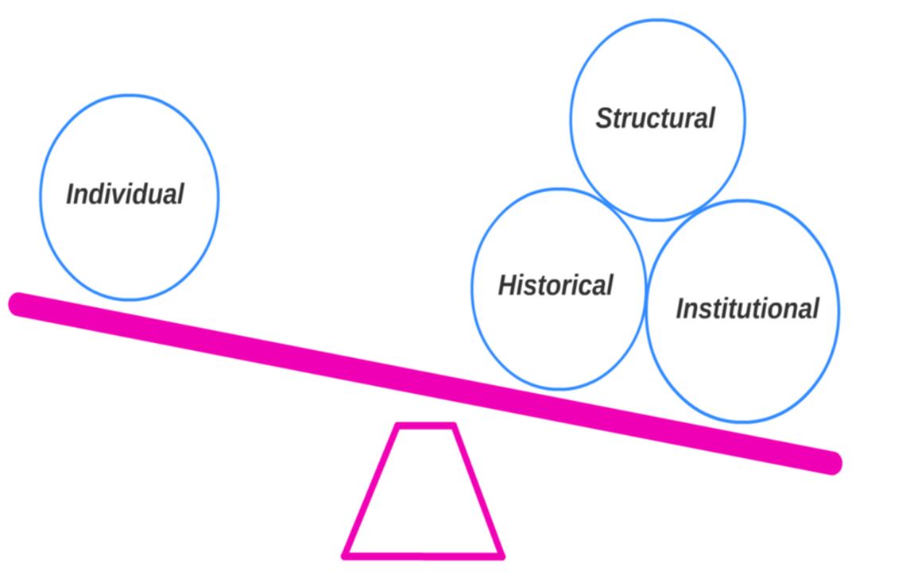
Reality check of NAPARs
Source: Center for Intersectional Justice

Slide 11
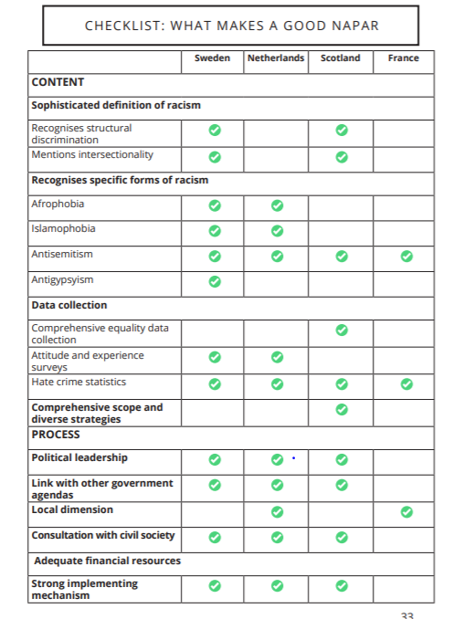

Slide 12
Additional recommendations
EU APAR structure and guidelines (Subgroup on NAPAR)
Security policies and criminal justice should be at the core of the experiences and narratives of discrimination of racialised groups
Intersectional policy making is about ensuring that legislation and policies take into account the situation of most marginalized at the intersections of inequalities and that are not contributing to further exclusion

Slide 13
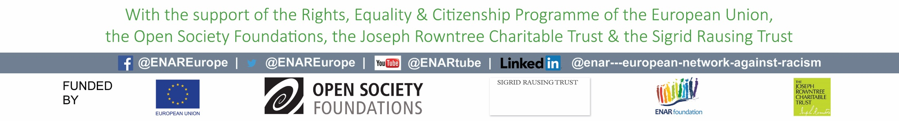
Thank you!

