Slide 1
Presentation to the 19th session of the Intergovernmental Working Group on the Effective Implementation of the Durban Declaration and Programme of Action 11 - 22 October 2021, Geneva, Palais des Nations, conference room XX
Dominique Day, Chair,UN Working Group of Experts on People of African Descent

Slide 2
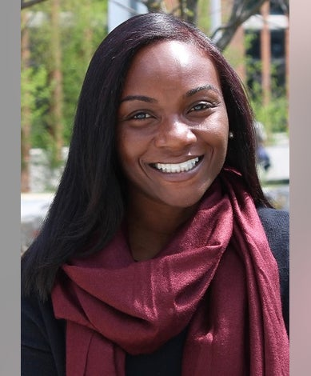
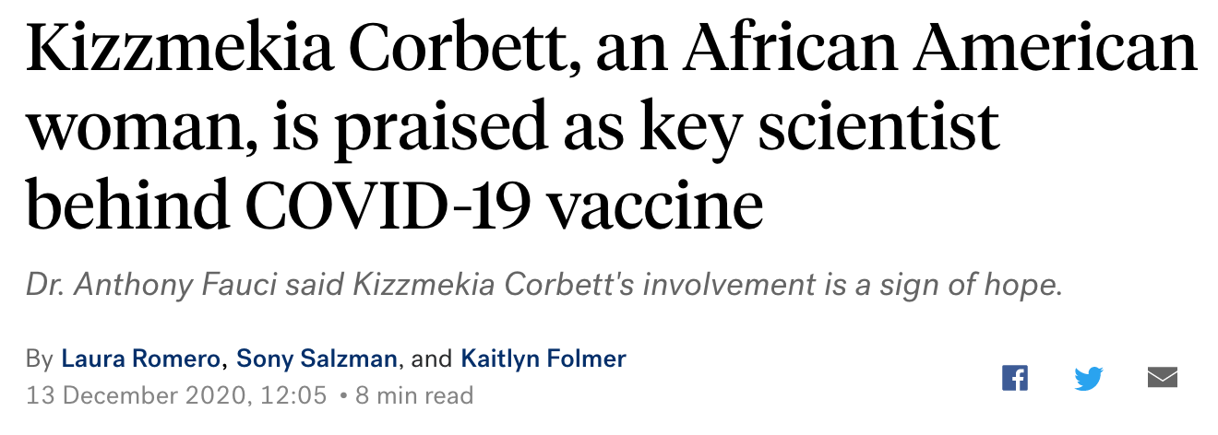
Dr. kizzmekkia corbett

Slide 3
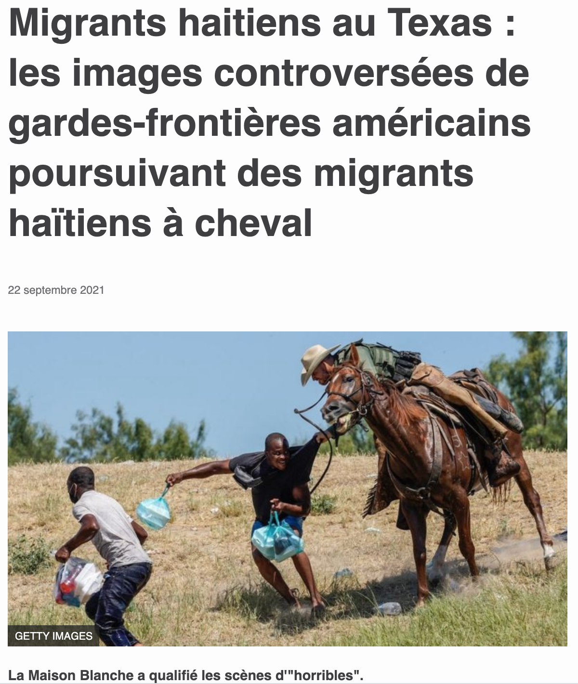

Slide 4


Temp agencies willing to present white candidates only

