Slide 1

A World of Work Perspective on
Article 5 of the Convention on the Rights of Persons with Disabilities
Day of General Discussion on the Right to Equality and Non-Discrimination:
Committee on the Rights of Persons with Disabilities
August 25, 2017

Slide 2
In reference to the CRPD’s:
Article 5(3). “In order to promote equality and eliminate discrimination, States Parties shall take all appropriate steps to ensure that reasonable accommodation is provided.”
Article 5(4). “Specific measures which are necessary to accelerate or achieve de facto equality of persons with disabilities shall not be considered discrimination under the terms of the present Convention.”
Notes:
Following the suggested preliminary outline of the General Comment provided by the Committee, the substance of the ILO’s inputs will relate to the following:
II. Normative Content
-Article 5 (3)
duty to provide reasonable (effective) accommodation according to art. 2 CRPD: defining reasonable accommodation; disproportional / undue burden; burden of proof; elements of implementation;
-Article 5 (4)
specific measures and distinction from reasonable accommodation
III. Interrelation with specific other articles
-Article 27 – Work and employment
In addition, I shall be making a general comment on Article 16 – Freedom from exploitation, violence and abuse, and its relationship to the notion of “harassment” as mentioned in Article 27.

Slide 3
1. Reasonable accommodation/
workplace adjustments

Slide 4

The ILO’s new guide on “workplace adjustments”
Promoting diversity and inclusion through workplace adjustments: a practical guide / International Labour Office. - Geneva: ILO, 2016
Notes:
“Promoting Diversity and Inclusion through Workplace Adjustments: A Practical Guide” (International Labour Office, Geneva, 2017)

Slide 5
Currently, there is a lack of technical guidance to enterprises (of all sizes) on how to implement reasonable accommodation.*
*Note: The CRPD states that “States Parties shall safeguard and promote the realization of the right to work . . .by taking appropriate steps” to “Ensure that reasonable accommodation is provided to persons with disabilities in the workplace” (Article 27(1)i).

Slide 6
The ILO guide provides a series of cases studies, showing practical application of concepts such as:
“reasonableness”;
“effective measures”;
“disproportionate burden”;
“essential and non-essential functions”.

Slide 7
The ILO guide provides:
examples of when requirements for reasonable accommodation have been met;
examples of when these requirements have not been met (and the guide explains the reasons why).

Slide 8
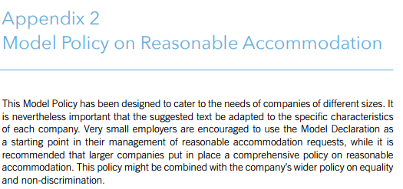
The ILO guide provides a “Model Policy on Reasonable Accommodation” (Appendix 2)

Slide 9
Article 4(1)e+ of the CRPD can be taken in conjunction with the CRPD’s approach in Article 2 that denial of reasonable accommodation is a form of discrimination.*
+Article 4(1)e of the CRPD notes that States Parties undertake “To take all appropriate measures to eliminate discrimination on the basis of disability by any person, organization or private enterprise.”
*Article 2 of the CRPD clarifies that the term “‘discrimination on the basis of disability’ . . . . includes all forms of discrimination, including denial of reasonable accommodation.”

Slide 10
“The company acknowledges that, as a general principle, denial of a reasonable accommodation is a form of discrimination.”*
*Source: Appendix 2, “Model Policy on Reasonable Accommodation”, ILO guide page 66.

Slide 11
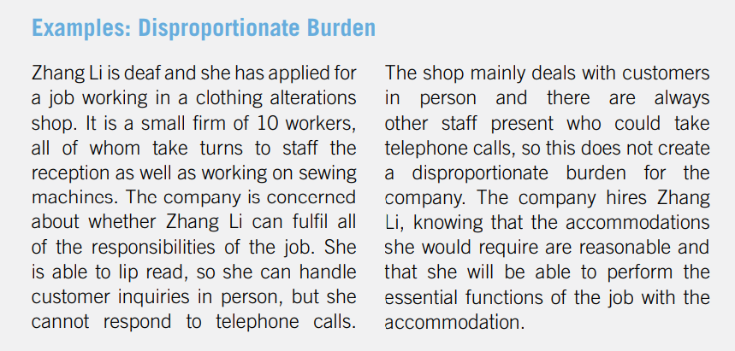
Example from “Promoting diversity and inclusion through workplace adjustments: a practical guide”, page 20.

Slide 12
The ILO Guide mentions four categories of workers that could benefit from reasonable accommodation:
workers with disabilities;
workers living with or affected by HIV or AIDS;
pregnant workers and workers with family responsibilities;
workers who hold a particular religion or belief.

Slide 13
These four categories of workers were included in this guide, because they “represent the most common circumstances in which an individual worker will request an accommodation” (page 11).
Notes:
The ILO guide also leaves open the possibility of other categories of workers being covered, such as transgender workers who may need reasonable accommodation while transitioning along the continuum of gender identity.

Slide 14
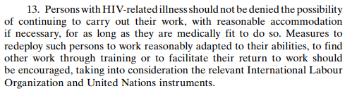
Note: Paragraph 13 of the ILO’s Recommendation 200: Recommendation concerning HIV and AIDS and the world of work is relevant to the CRPD and references it by implication:
Notes:
The ILO guide also leaves open the possibility of other categories of workers being covered, such as transgender workers who may need reasonable accommodation while transitioning along the continuum of gender identity.

Slide 15
Presenting “reasonable accommodation” as applicable to a variety of categories of workers:
Shows this as an integrated labour rights issue;
Highlights that enterprises are already providing reasonable accommodation to some workers, even if they are not using this term.

Slide 16
In summary, a world-of-work approach to reasonable accommodation suggests:
Reasonable accommodation should be fully reflected in relevant State legislation (workplace, employment and vocational training).*
*Where such legislation exists, enforcement through labour inspection is important, as well as measures to raise awareness of national inspectorates and judicial authorities.

Slide 17
b) Concrete, practical guidance on reasonable accommodation should be provided for workers and employers -- training materials, case studies and polices;

Slide 18
c) As the ILO guide mentions, most reasonable accommodation can be made at little or no cost.*
Note: The ILO guide also notes that, “in many countries there are external funds from public or private sources that can assist employers in meeting any costs linked to reasonable accommodation” (page 24).
Notes:
*The ILO’s code of practice on Managing disability in the workplace observes that governments can provide:
“financial supports to employers, to serve as an incentive or to ensure that the employment of the person does not cause any additional cost or other problems to the employer, and support services to ensure that the relevant technical advice is provided and any problems are quickly resolved” (Managing disability in the workplace. ILO code of practice Geneva, International Labour Office, 2002, Appendix 3, pages 40-41).

Slide 19
d) It is useful to build on enterprises’ existing experience with providing reasonable accommodation to other categories of workers.

Slide 20
2. Measures and policies to
achieve equality of
opportunity and treatment*
*From a world-of-work perspective, this covers matters such as access to employment, education, training, opportunities for advancement, and protection from unjustified dismissal.

Slide 21
“Measures” in the CRPD and the ILO’s Convention 159:
Article 5(4) of the CRPD:
“Specific measures which are necessary to accelerate or achieve de facto equality of persons with disabilities shall not be considered discrimination under the terms of the present Convention”;
From Article 4 of the ILO’s Vocational Rehabilitation and Employment (Disabled Persons) Convention, 1983 (No. 159)):
“Special positive measures aimed at effective equality of opportunity and treatment between disabled workers and other workers shall not be regarded as discriminating against other workers.”

Slide 22
Article 5 of the ILO Discrimination (Employment and Occupation) Convention, 1958 (No. 111):
1. Special measures of protection or assistance provided for in other Conventions or Recommendations adopted by the International Labour Conference shall not be deemed to be discrimination.
2. Any Member may, after consultation with representative employers' and workers' organisations, where such exist, determine that other special measures designed to meet the particular requirements of persons who, for reasons such as sex, age, disablement, family responsibilities or social or cultural status, are generally recognised to require special protection or assistance, shall not be deemed to be discrimination.

Slide 23
Without entering into a debate on the efficacy of measures such as workplace quotas, priorities in public procurement+ and others,* these can be seen as compatible with both Article 5(4) and Article 27 (1)h of the CRPD.
+ The ILO’s Discrimination (Employment and Occupation) Recommendation, 1958 (No. 111) references public procurement: “making eligibility for contracts involving the expenditure of public funds dependent on observance of the principles” of non-discrimination (3(b)ii).
*The ILO’s code of practice on Managing disability in the workplace (2002) mentions “The competent authorities should make available technical supports, wage subsidies and other incentives to promote or facilitate employment opportunities and job retention for people with disabilities and inform employers of these incentives” (2.2.8.).

Slide 24
However, workplace “measures” need to be in compliance with the CRPD.
Growing international consensus prefers workplace measures that promote employment for persons with disabilities in the open labour market, instead of reserving certain categories of jobs.

Slide 25
A world-of-work approach sees “specific measures” aimed at promoting the equality of workers with disabilities as not discriminatory, when they are in compliance with the CRPD.

Slide 26
3. Violence and harassment in the world of work:
Towards (a) possible future ILO Standard(s)

Slide 27
In reference to the CRPD’s:
Article 16 on “Freedom from exploitation, violence and abuse”; and
Article 27(1)b’s reference to “protection from harassment” within the context of the world of work.

Slide 28
The ILO’s standard-setting process on “Violence and harassment against women and men in the world of work”.
Violence and harassment because of disability or because of the intersection of disability and other grounds has been referred to during this process.

Slide 29
“Discrimination based on these and other grounds, including disability, HIV status, sexual orientation and gender identity, migrant status and age, are also important factors . . . .Where grounds of discrimination intersect, such as gender and race or disability, the risk of violence and harassment is exacerbated.”*
*Source: From the conclusions of the ILO’s Meeting of Experts on Violence against Women and Men in the World of Work (held on October 2016), found in Paragraph 12, Annex I of GB.328/INS/17/5: http://www.ilo.org/wcmsp5/groups/public/---ed_norm/---relconf/documents/meetingdocument/wcms_533534.pdf

