Slide 1
The need for a UN Declaration on the rights of peasants and other people working in rural areas
Margaret Nakato
World Forum of Fish Harvesters and Fish Workers ( WFF)

Slide 2
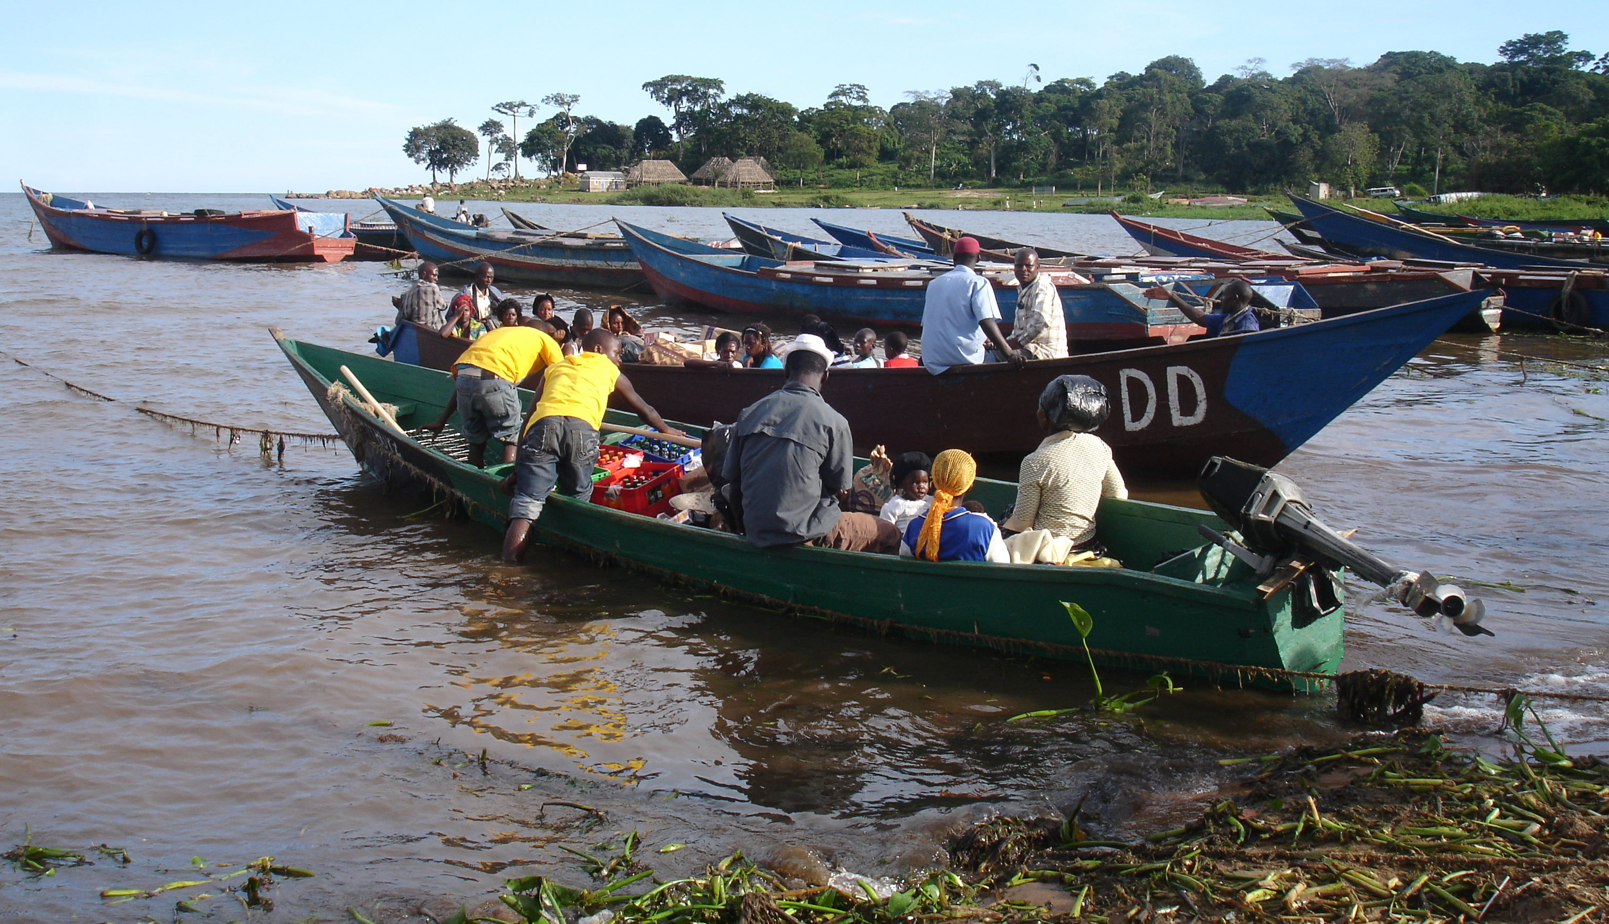
Small scale fisher communities

Slide 3
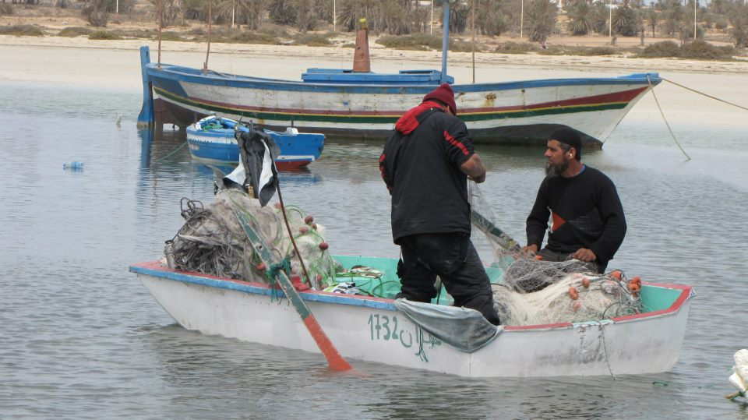
small scale fisher from Tunisia

Slide 4
The need for a UN Declaration on the rights of peasants and other people working in rural areas
Negotiated against the backdrop of increasing interest in sea and coastal land, land close to lakes, rivers

Slide 5
A fishing community in Mumbai real estate development

Slide 6
Restriction of access
Restricting access to natural resources or by removing freedom to use resource as they wish
spiritual
Fishing
Leisure

Slide 7
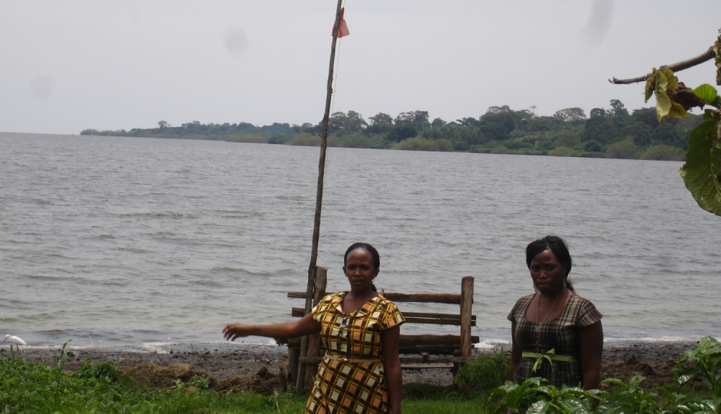
Mpunge landing site on the shores of Lake Victoria in Uganda

Slide 8
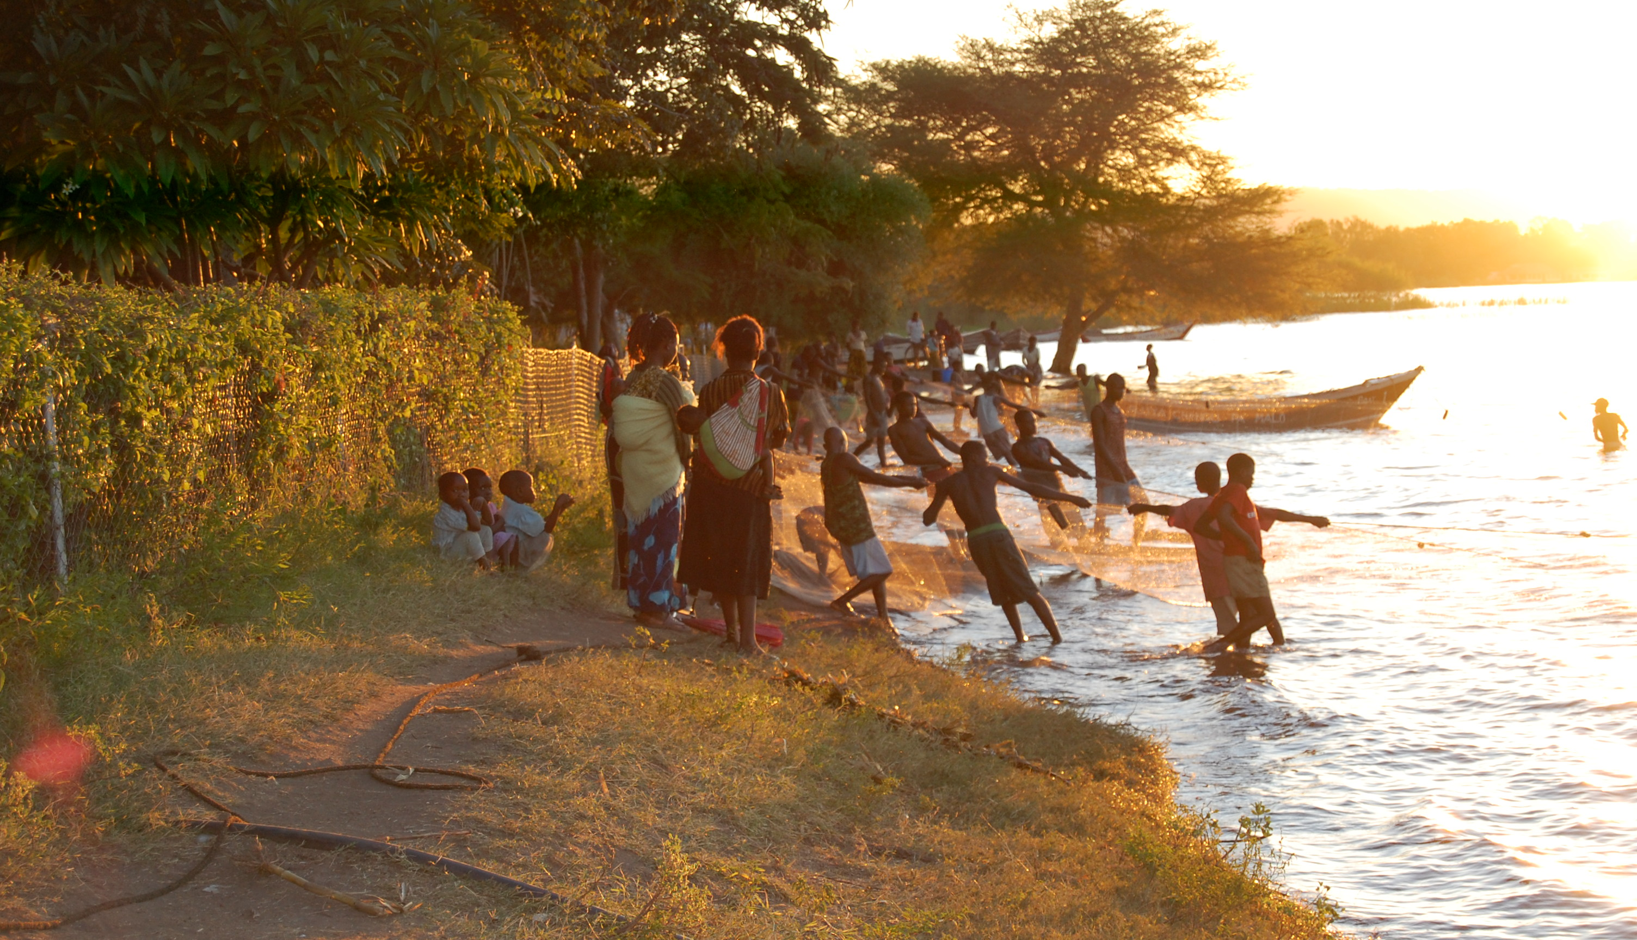
Fishing in Lake Malawi

Slide 9
Forms of use that threaten fisher folk
tourism development,
oil and gas explorations ,
aquaculture
agriculture activities .

Slide 10
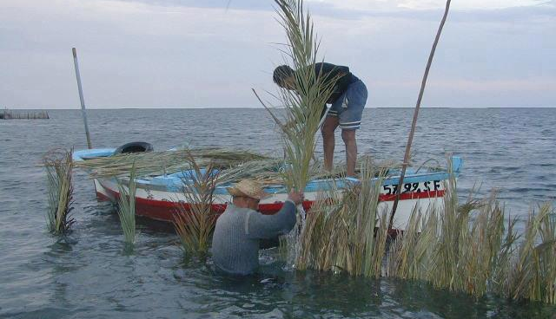
Small scale fisheries as a model of production

Slide 11
Against the backdrop of ;
Limitations through arrangement , access agreements.
Privatization of fishing rights
Export oriented production
Pollution

Slide 12
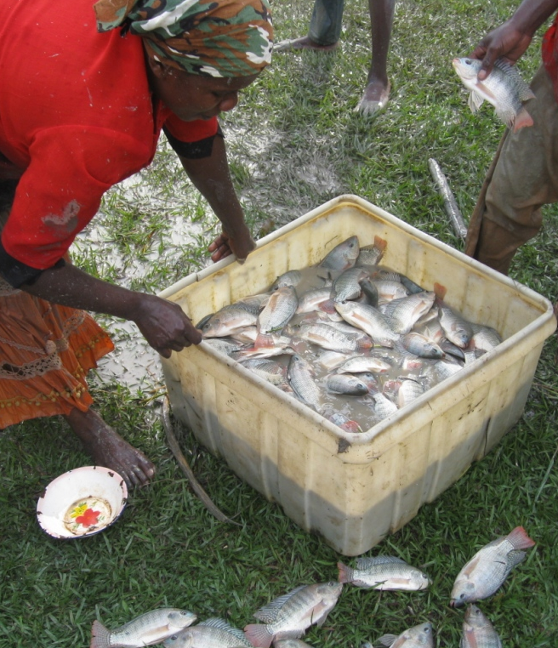
Women in fishing communities.
human dignity
equity and justice
non-discrimination
gender equality,
a holistic and sustainable approach
consultation and participation

Slide 13
…rights are all interrelated, interdependent and indivisible.
The UN Declaration is very important dealing with a critical issue of small scale fisher communities and women to use to address raising conflicts.
Once finalized the Declaration can be a tool that communities can use to secure the rights of peasants and all those working in rural areas.

Slide 14
Relation to other instruments/ policies
Voluntary Guidelines for responsible governance of tenure of land fisheries and forests.
useful for on going negotiations on the IG SSF guidelines by the Committee of Fisheries ( COFI) of the Food and Agriculture Organization ( FAO) the International Guidelines for securing sustainable small scale fisheries
Responsible agriculture investment

Slide 15
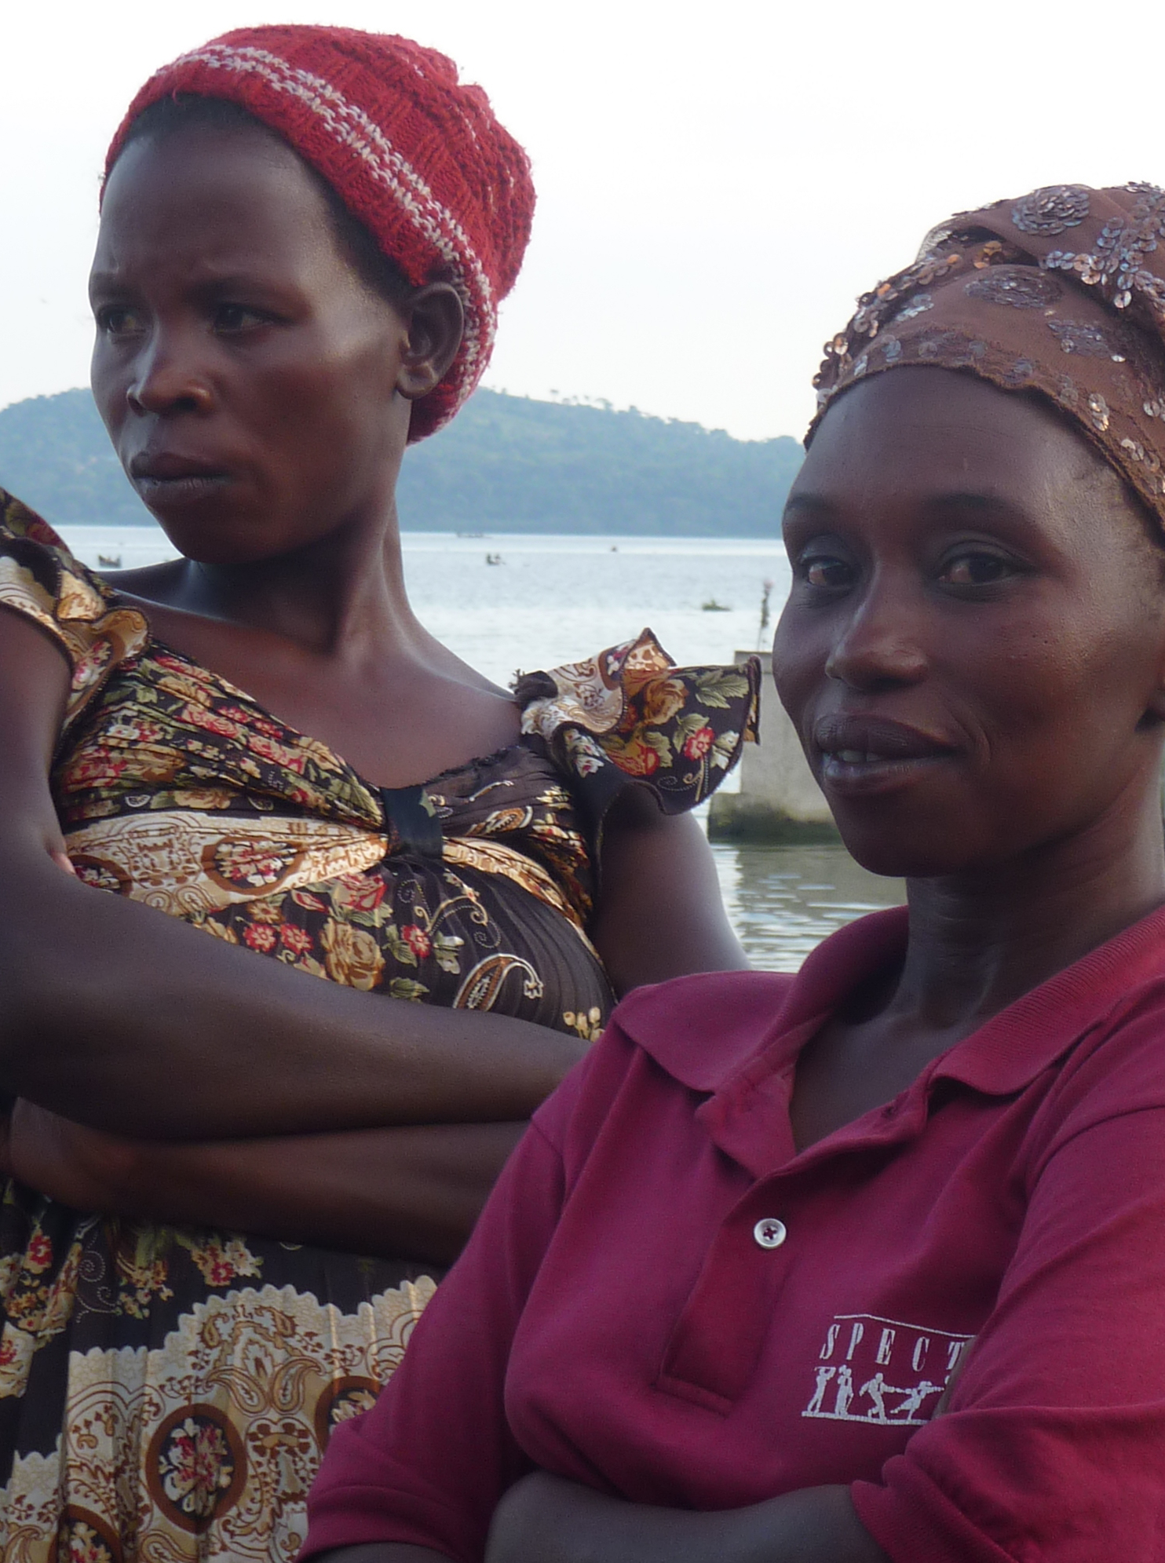
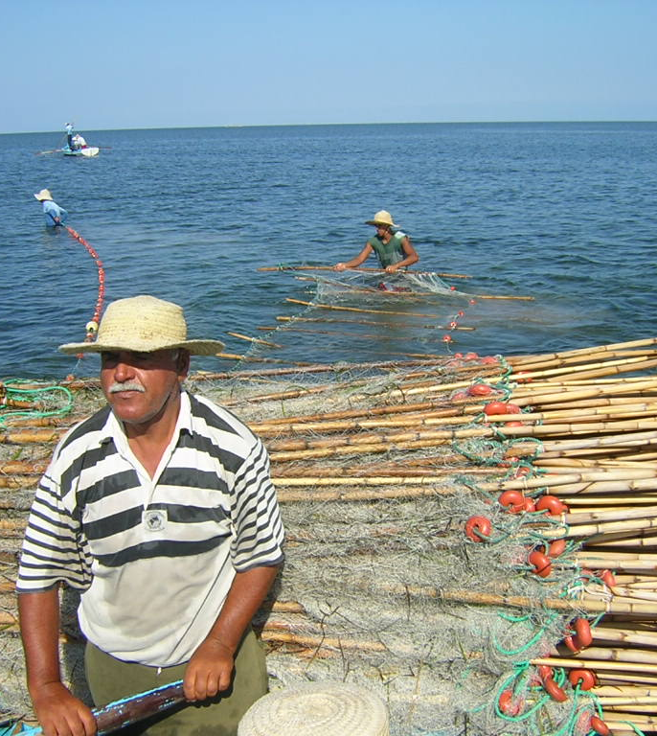
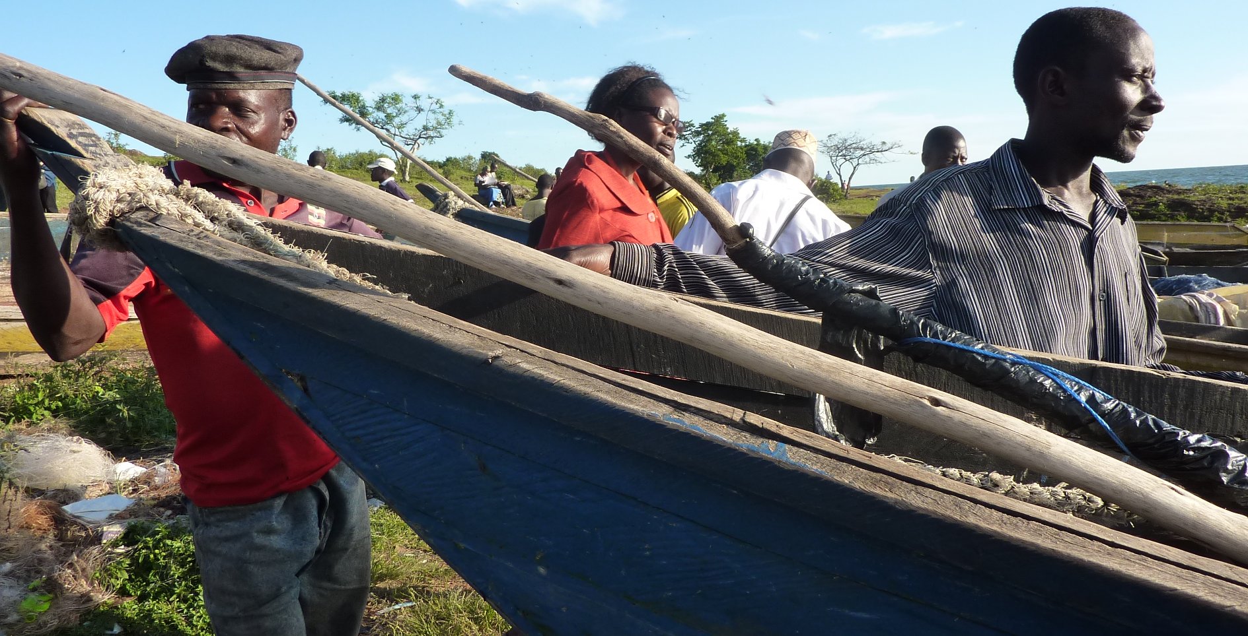
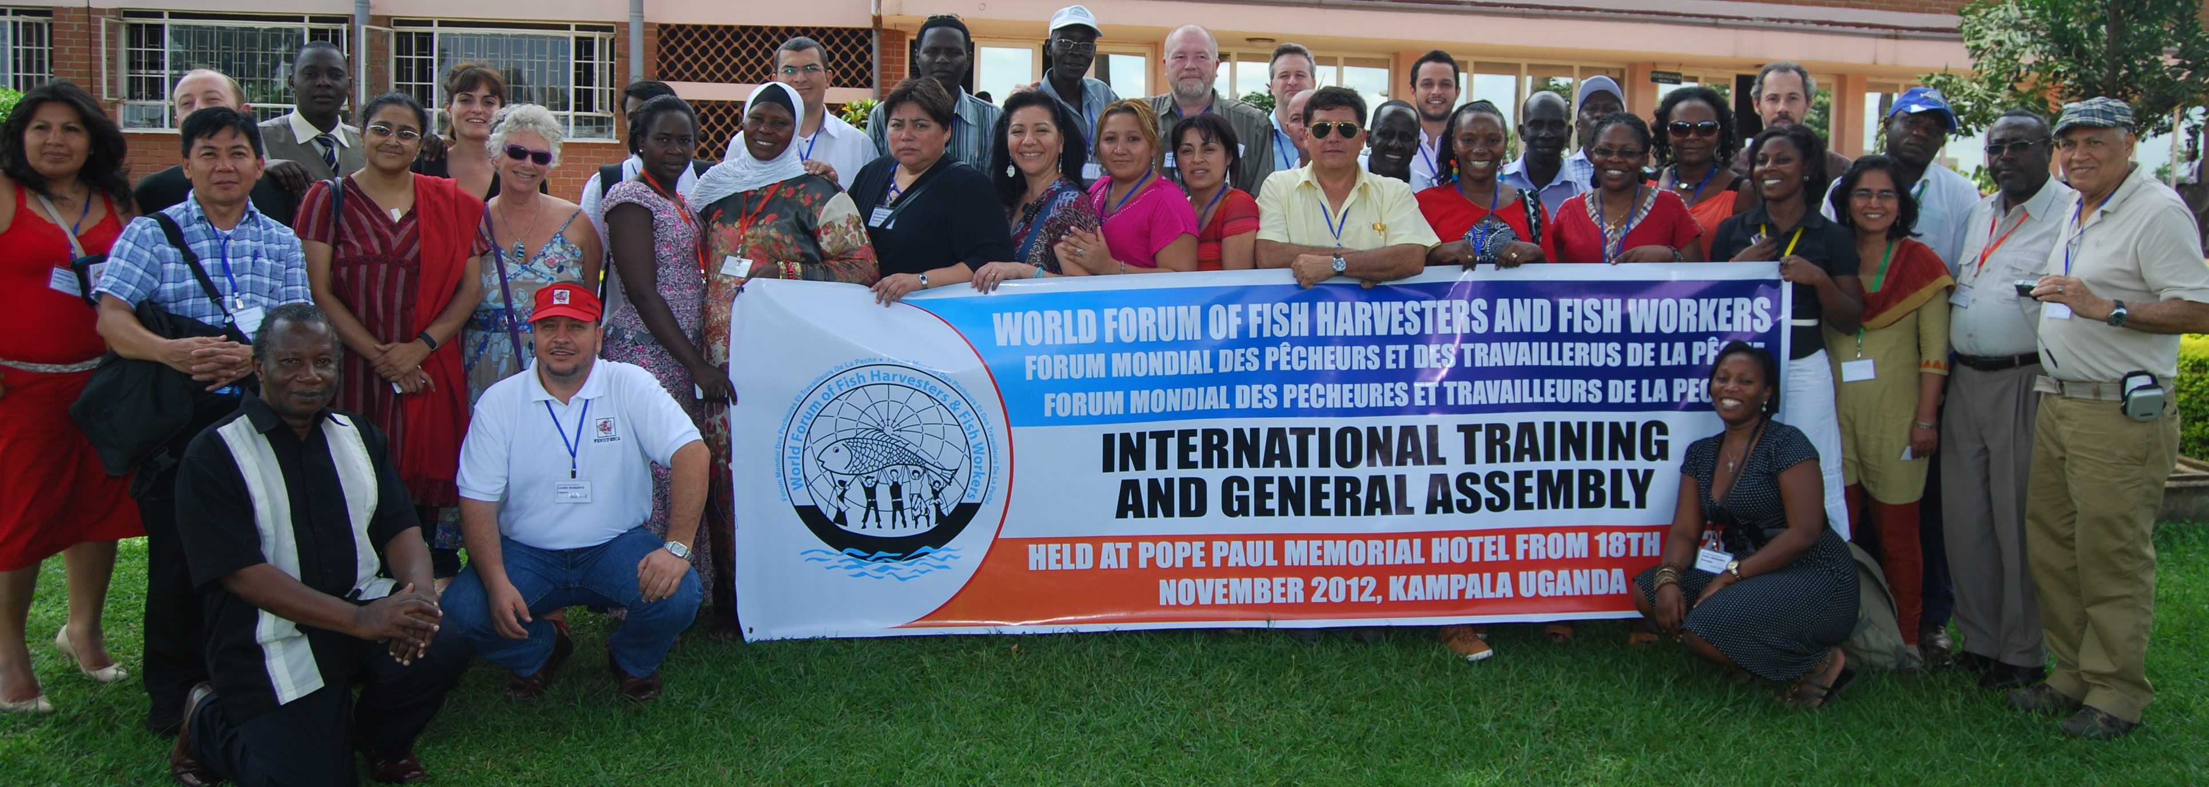
Human face

