Slide 1


CORPORATE RESPECT FOR HUMAN RIGHTS
An Economist Intelligence Unit research programme
Notes:
Earlier this year The EIU embarked on a global programme of research to investigate the role of business in protecting human rights. The project is sponsored by the following:
-Universal Rights Group
- DLA Piper
- Global Business Initiative for Human Rights
- IPIECA – the Global Oil & Gas Industry Association for Environmental and Social Issues
- International Chamber of Commerce - World Business Organisation
- International Organisation for Employers
- Mazars
- Norway, Government of
- Telenor
UK, Government of
The survey has also benefited from the input and support of the UN Working Group on Business and Human Rights.
In order to tackle this topic, we have conducted a survey of businesses encompassing:
The business definition of human rights
Business attention to human rights
Evaluation methods
Pressure on businesses to address human rights issues
This presentation draws on early data from a global survey of business executives – to date we have surveyed 534 executives.
Of these, 36% are from Europe (both Western and Eastern Europe), 27% from Asia-Pacific, 18% from North America, 9% from Latin America and the remainder from the Middle East and Africa. Respondents hail from 18 sectors, with financial services, professional services, IT and technology, healthcare and manufacturing especially prominent in the sample. The respondents are relatively senior—40%hold C-suite positions—and they work in organisations of different sizes, with 50% working for companies with an annual turnover of US$500m or more.
Today I will be sharing insights from the interim survey results and telling you about the how the program will progress from here. As the research is not yet complete, I offer these results without interpretation or judgement. I hope they provide some interesting food for thought for the panel that follows my presentation, as well the rest of this event.

Slide 2

85% of executives believe human rights are a matter for business as well as the government
61% say human rights discussions have become more prevalent at their company
ROLE OF BUSINESS
Notes:
There is widespread support among senior executives for the idea that business has an important human rights role.
85% of survey respondents agree that human rights are a matter for business as well as governments. Nor is this simply about compliance: 72% say that their firm’s responsibility to respect human rights is not just about complying with relevant local laws
61% say that human rights discussions have become more prevalent at their organisations in the last five years

Slide 3

RIGHTS RELEVANT TO BUSINESS
Notes:
The senior executives we surveyed also appreciate that business operations have an impact on, and create some responsibility within, a broad range of human rights areas.
For each of eleven specific clusters of human rights covered in the survey, a majority of respondents believed that they were relevant to their own corporate operations. In particular, over three-quarters said this of employment issues - both working/employment conditions (94%) as well as collective bargaining and unionisation rights; education and access to technology; the right to a private life, as well as an intellectual, spiritual and cultural life; and environment-related rights.
This acceptance of the relevance of a large number of rights to business operations is broadly consistent across respondent geographies and economic sectors.

Slide 4


RESPONSIBILITY HAS SPREAD
Responsibility for human rights issues has spread beyond the CSR function to other parts of the company.
Functions actively involved in meeting the company’s responsibility to respect human rights:
CSR
HR
Legal
Public Affairs
Operations
Strategy
The CEO
Notes:
Responsibility for human rights issues has spread beyond the corporate social responsibility (CSR) function to other parts of the company.
At 44% of companies, the CEO takes a leading role in meeting the company’s responsibility to respect human rights, followed by CSR (35%), human resources (21%), and strategy (21%)
Seven separate functions are actively involved in this area at more than 50% of respondents’ companies: CSR, HR, Legal, Public Affairs, Operations, Strategy and the CEO.

Slide 5

ADDRESSING HUMAN RIGHTS
56% of companies do not have a specific policy that references human rights
11% of businesses do not address human rights at all
41% of companies communicate with internal stakeholders about human rights issues
27% of companies communicate with external stakeholders about human rights issues
Notes:
Despite the high level of intellectual acceptance of the importance of human rights and its implications for functions across the business, fewer companies are specifically addressing human rights.
The majority of respondents say that, although their company addresses human rights issues, it lacks a specific policy that references human rights (56%) and a further 11% of businesses do not address human rights at all. However, some companies may integrate their human rights policy within a wider code of conduct.
*Nor do most companies talk a lot about human rights issues.
41% of companies communicate with internal stakeholders about human rights issues, and 27% to external stakeholders

Slide 6
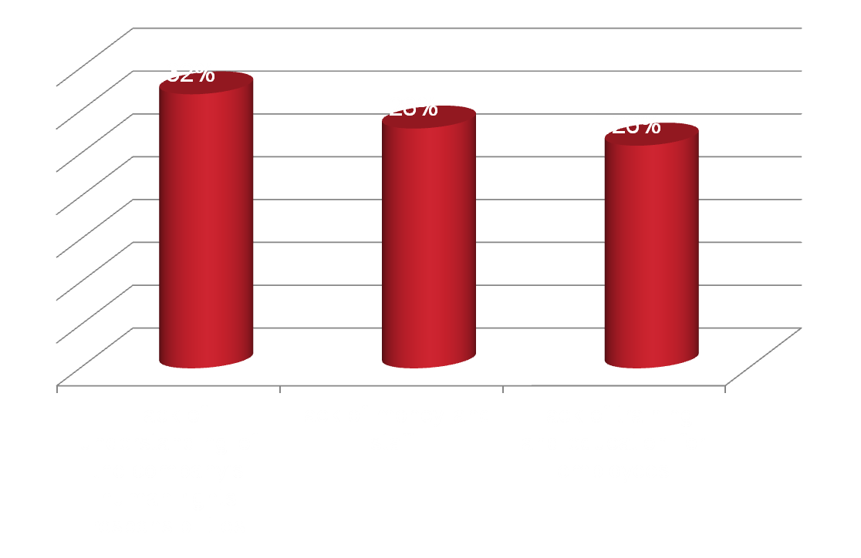
BARRIERS TO ADDRESSING HUMAN RIGHTS
Notes:
Respondents list lack of understanding of the company’s human rights responsibilities as the most common barrier to progress in the field, followed by lack of money and staff, and lack of training and education for employees.
The priority areas cited by respondents also indicate that many companies may still working out the basics: better operational grievance mechanisms (25%), monitoring the activities of partners and suppliers (24%), and strengthening policy commitment to respect human rights (22%) are at the top.

Slide 7

20% of corporate commitments to human rights are driven by a clear business case
Notes:
20% of companies say that corporate commitments to human rights are driven by a clear business case. The three most cited drivers of corporate commitment to human rights are: building sustainable relationships with local communities (45%); protecting the company brand and reputation (44%); and meeting employee expectations (42%). 12% refer to shareholder pressure as a driver.
New initiatives which respondents are most likely to say would help them are about providing information: public benchmarking of company performance (42%) and access to reliable, independent information on country-level human rights situations (31%).

Slide 8

NEXT STEPS
Notes:
As more complete survey data becomes available, The EIU will update these findings. We will also conduct in-depth interviews with senior executives from a range of companies, as well as subject experts, to bring together with the survey findings in a report due to be published in January.

