Slide 1

FORCED/ NON-CONSENSUAL MARRIAGE IN CANADA
Deepa Mattoo
Staff Lawyer
10/27/2013

Slide 2
The South Asian Legal Clinic of Ontario is a community legal clinic funded by Legal Aid Ontario (LAO).
We provide poverty law legal advice, representation, public legal education, community development and law reform work for the low-income South Asian community in the Greater Toronto Area.
45 Sheppard Avenue East, Suite 106 A, Toronto
Tel: (416) 487 6371
www.salc.on.ca
Notes:
This is from the SALCO brochure
2

Slide 3

The Forced Marriage (FM) Project
FORCED MARRIAGE (FM)
  Beginning a dialogue around the issue of forced/
  non-consensual marriages in order to:
    Prevent Coercion
    Promote Safety, and
    Build Community Accountability
Since 2005
FM Project Advisory Committee – 2007
International Symposium - 2008
Network of Agencies Against Forced Marriages (NAAFM) and Service Providers training tool kit - 2010
National Conference and Survey leading to a policy recommendations – 2012/ 2013.
Notes:
The ultimate aim of the project is to encourage dialogue and build public and institutional accountability in responding to the issue of forced marriages in ways that confront and do not perpetuate racism, gender oppression, and other forms of violence.
The Forced Marriage Project at SALCO denounces the threat and practice of forced, non-consensual marriage. We commit to identifying strategies that promote the safety and security of all individuals and their right to choose marriage freely.
‘Forced Marriages Project Advisory Committee’ has over 25 community activists, researchers and organizations participating in it. Members of the committee help by providing input to the planning, implementation and dissemination process for SALCO’s Forced Marriages project. The Advisory Committee acts as an information and community resource to the Forced Marriages project and advances the sharing of experiences and knowledge specific to working towards creating accessible resources and awareness around the issue.
SALCO’s Initiatives around Forced Marriages
2005-2006: Forced Marriages Working Group
2007-2008: The Right to Choose Symposium
2009-2010: Resources Development to address the issue of Forced Marriages
Goals:
Development of an educational tool-kit on forced marriages
(including prevention, recognition, intervention and safety planning)
Creation of a centralized website where information on forced marriages can be accessed
Conduct community workshops to launch educational materials and further dialogue on forced marriages
3

Slide 4
What is a forced marriage?

Slide 5
“A forced marriage is a form of violence and an abuse of human rights. It is a practice in which a marriage takes place without the free consent of the individuals getting married. Forced marriage can happen to anyone; of any gender, of any age.” -SALCO/NAAFM

Slide 6
Both men and women of all ages and cultural, religious and socio-economic background experience FM.

Slide 7
FM and arranged marriage are often mistakenly conflated. Arranged marriage has the full, free, and informed consent of both parties who are getting married, while FM lacks that same consent.

Slide 8
  Forced Marriage and Human Trafficking
In case of a FM incident it may
Involve a single or multiple perpetrator trafficking a victim domestically or internationally.

Slide 9
  FORCED MARRIAGE: LEGISLATION IN CANADA
So far the issue of forced marriage has not yet been formally addressed in Canada.
There are various provisions in family law, immigration law, and criminal law identify scenarios related to potential consequences of marriage without consent.
Canada is also a signatory to several international consensus documents and treaties related to FM.
Notes:
Canada is also a signatory to several international consensus documents including the Universal Declaration of Human Rights, the Convention on the Elimination of All Forms of Discrimination against Women and Convention on the Rights of the Child. However, Canada has not signed or ratified the Convention on Consent to Marriage, Minimum Age for Marriage and Registration of Marriages and has no domestic legislation specific to FM. As the national courts of any country are not legally bound by international documents, recognition of international conventions and treaties does not provide adequate protection against FM.
For a complete list of international treaties and international consensus documents, please see Annotated bibliography on comparative and international law relating to forced marriage (2007, p. 10-17).
Annotated bibliography on comparative and international law relating to forced marriage (2007, p. 11).
Annotated bibliography on comparative and international law relating to forced marriage (2007, p. 10).

Slide 10
The Forced/Non-Consensual
Marriage Survey
The Forced/Non-Consensual Marriage Survey was developed by the Forced Marriage Project at SALCO with the aim to gain a better understanding of the incidence of FM in Ontario.
The needs of individuals dealing with FM situations and the existing gaps in resources that hinder the service providers’ abilities to assist the client.

Slide 11
Gender of Individuals
Facing Forced Marriage
Gender | Number of Cases
Female | 202
Male | 13
Other (transgender) | 3
Unknown | 1
TOTAL | 219

Slide 12
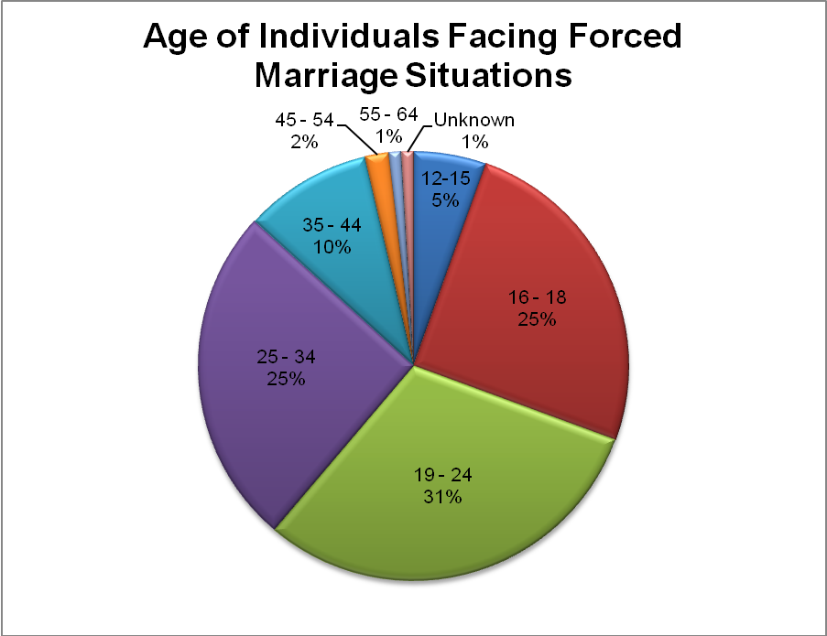

Slide 13
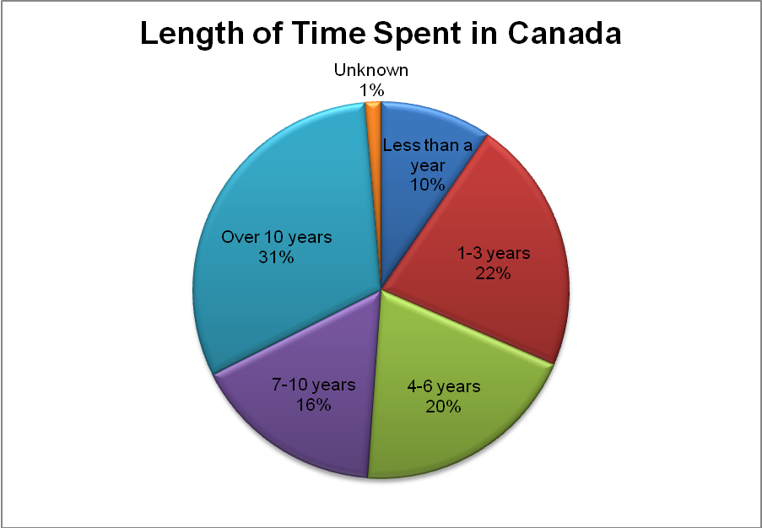

Slide 14
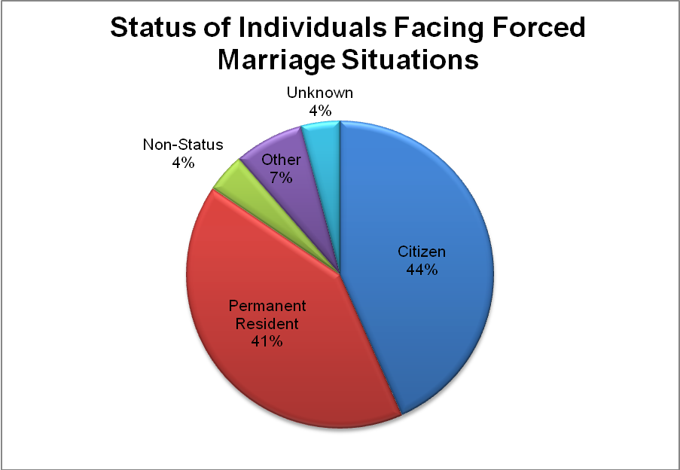

Slide 15

Limitations in access to help

Slide 16
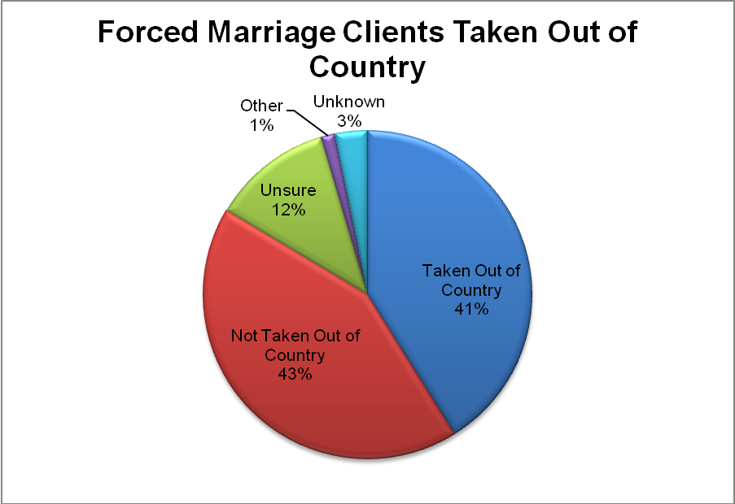

Slide 17
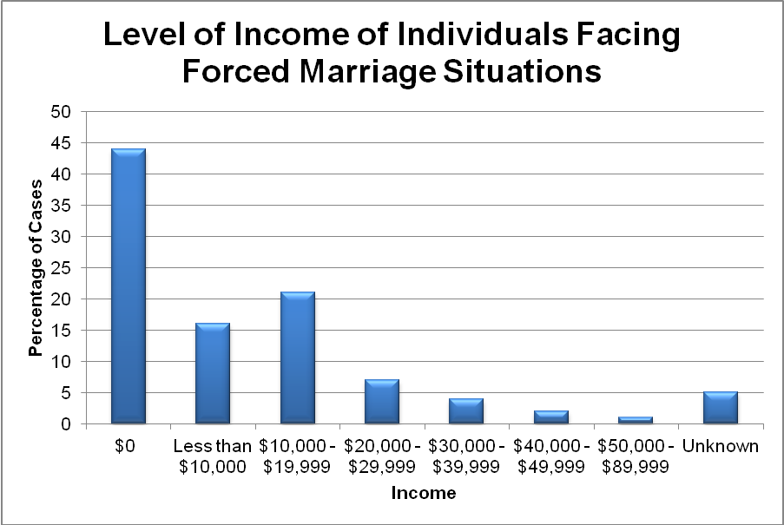

Slide 18
Perpetrators
From the data collected on perpetrators, it was found that most of the individuals facing FM had more than one perpetrator pressuring them.
Reasons
A number of reasons for forcing marriage were reported including religious and cultural beliefs, economic status, immigration status, community pressure, marriage as a cure for mental health issues, and emotional manipulation related to the death of a parent.
Violence
All the individuals forced into the marriage experience violence. 75% of survey respondents reported “Mental or social pressure” as a form of violence experience by the FM client.

Slide 19
Recommendations
Internationally, several jurisdictions have centralized services and resources for FM victims. Canada can learn from that international example.
Centralizing FM including a centralized and national education and awareness campaign,
A multisectoral uniform national training,
Uniform consular services for FM victims,
A centralized database of FM resources.

Slide 20
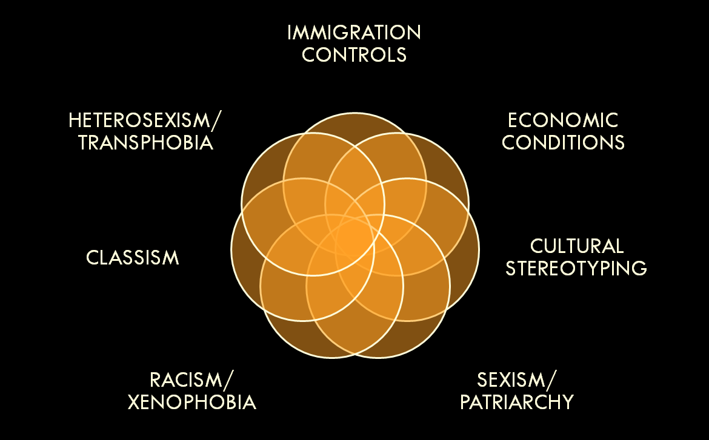
Contextualising the practice of forced marriage in Canada
Notes:
There are no excuses or valid justifications for the practice of forced marriage. It must, however, be noted that individuals arranging forced marriages are often themselves victimized by complex interacting factors. These factors may include:
20

Slide 21
Addressing Forced Marriage
Taking an anti-racist/ anti-oppressive approach
Institutional commitment to fighting violence/ abuse of human rights
Building public and community accountability
Creating safe spaces that encourage open and inclusive dialogue
Prevention-focused initiatives across communities
Engaging with both youth and parents/ caregivers/family members
Ensuring service to both men and women; of all sexual orientations

Slide 22
FM remains a complex issue in Canada. SALCO’s survey on the incidence of FM have made clear that FM is an issue that exists in Canada, that its impact can be devastating on the life of the FM victim, and that Canada has not done enough to protect victims of FM to date.

Slide 23
Thank you.

