Slide 1
Обзор «Международной системы прав человека»
Программа УВКПЧ по укреплению потенциала в области взаимодействия с договорными органами по правам человека
Notes:
Introduction
First view a short 8 minute film on the UN human rights system, which will be followed by a short multiple-choice quiz and then we will go through the answers together
You will have time to ask questions at the end, and the hand-out of the slide will be given to you electronically

Slide 2
Основные механизмы ООН по правам человека
Генеральная Ассамблея
Cекретариат
УВКПЧ *
УВКПЧ поддерживает работу КПЧ и механизмов
Принимает
Создает
Договоры о правах человека
Совет по правам человека
Договорные органы
(Комитеты)
Универсальный периодический обзор
Специальные процедуры
Notes:
GA adopts treaties. This treaties establish each a treaty body (committee). So, treaty-based bodies are set up as a result of legally binding human rights treaties
Charter-based bodies are set up as a result of resolutions and decisions of the UN system. This is the case of the Human Rights Council which was created by a resolution adopted by the GA.
Charter bodies are those which have been created using the authority of the UN Charter. They are political bodies, meaning that either members of the body represent their governments or individuals are appointed to their role by governments. Charter-based bodies can address issues in any country, but it is important to keep in mind that their political nature also has an impact on their effectiveness.
In contrast, treaty-based bodies get their authority from UN human rights treaties (legal agreements between states). Treaty bodies can be considered more effective than Charter bodies, as they come from legal instruments. However, they can only address issues in states that have accepted the treaty.

Slide 3
Обзор международных договоров по правам человека
Специфические явления
Конкретные группы
Всеобщая декларация прав человека
Международная конвенция о ликвидации всех форм расовой дискриминации
Международная конвенция о ликвидации всех форм дискриминации в отношении женщин
Международный пакт о гражданских и политических правах
Конвенция против пыток и других бесчеловечных, унижающих достоинство видов обращения и наказания
Конвенция о правах ребенка
Международный пакт об экономических, социальных и культурных правах
Конвенция о правах трудящихся-мигрантов и членов их семей
Международная конвенция для защиты всех лиц от насильственных исчезновений
Конвенция о правах инвалидов
Notes:
Recap/overview of the core international human rights treaties
The Universal Declaration of Human Rights (10 December 1948) forms the basis of the two covenants—The International Covenant on Economic, Social and Cultural Rights, and the International Covenant on Civil and Political Rights
The process of drafting a legally-binding instrument enshrining the rights of the UDHR had started immediately after the declaration’s adoption in 1948. Initially a single Covenant encompassing all human rights was envisaged. However, after long discussion, the GA requested the CHR two elaborate two separate Covenants, which were ultimately adopted by the GA in December 1966 and entered into force in 1966. The two Covenants have a similar structure and, is some articles, adopt the same or a very similar wording.
Treaties addressing specific phenomena (ICERD, CAT and CED) vs. specific groups (CEDAW, CRC, ICRMW and CRPD)
Legally binding treaties negotiated and adopted by States within the framework of the United Nations General Assembly
Obligations undertaken voluntarily by States
Once ratified/acceded to, treaty obligations are not optional: legally binding obligations

Slide 4
Два пакта, охватывающие гражданские, политические, социальные и культурные права
Международный Пакт о гражданских и политических правах (МПГПП), 1966 год
Первый Факультативный протокол (индивидуальные жалобы), 1966 год
Второй Факультативный протокол (отмена смертной казни), 1989 год
Международный Пакт об экономических, социальных и культурных правах (МПЭСКП), 1966 год
Факультативный протокол (индивидуальные жалобы), 2008 год
Notes:
Many of the treaties are complemented by an Optional Protocol which can address substantive or procedural issues.

Slide 5
Договоры о правах человека, касающиеся конкретных явлений
Международная конвенция о ликвидации всех форм расовой дискриминации (МКЛРД), 1965 год
Конвенция против пыток и других жестоких, бесчеловечных или унижающих достоинство видов обращения и наказания (КПП), 1984 год
Факультативный протокол к КПП (учреждение Подкомитета по предупреждению пыток и других жестоких, бесчеловечных или унижающих достоинство видов обращения → инспекции мест содержания под стражей)
Международная Конвенция для защиты всех лиц от насильственных исчезновений (МККНП), 2006 год

Slide 6
Договоры о правах человека, защищающие конкретные группы
Конвенция о ликвидации всех форм дискриминации в отношении женщин (КЛДЖ), 1979 год
Факультативный протокол (рассмотрение жалоб)
Конвенция о правах ребёнка (КПР), 1989 год
ФП касающийся торговли детей, детской проституции и детской порнографии
ФП касающийся участия детей в вооруженных конфликтах
ФП касающийся процедуры сообщений
Международная конвенция о защите прав всех трудящихся-мигрантов и членов их семей (КТМ), 1990 г.
Конвенция о правах инвалидов (КПИ), 2006 год
Факультативный протокол (рассмотрение жалоб)

Slide 7
Договоры по правам человека
Юридически обязывающие договоры, согласованные и принятые государствами в рамках Генеральной Ассамблеи Организации Объединенных Наций
Обязательства, добровольно принятые государствами
После ратификации/присоединения договорные обязательства не являются факультативными: юридически обязательные обязательства
Обязательства влекут за собой тройную ответственность:
Уважать (воздерживаться от нарушения права ...)
Защищать (предотвращать нарушения права ...)
Выполнять (принять меры для обеспечения реализации права ...)
Notes:
E.g. right to adequate food
Respect: requires States not to take any measures that would result in preventing individuals from having access to adequate food (eg deliberate starvation of its people)
Protect: requires measures by the State to ensure that third parties (individuals, armed groups, enterprises, etc.) do not deprive right-holders of their access to adequate food
Fulfill: adopt measures aimed at improving right-holders’ access to and utilisation of resources and means to ensure their livelihood

Slide 8
Статус ратификации основных международных договоров по правам человека:
ICCPR: 172 OP I 116 OP II 87
ICESCR: 169 OP 24
ICERD: 180
CEDAW: 189 OP 112
CAT: 166 OP 89
CRC: 196 OPAC 168 OPSC 176 OPIC 44
ICMW: 54
CRPD: 177 OP 94
ICCPED: 59
*По состоянию на май 2019 года

Slide 9
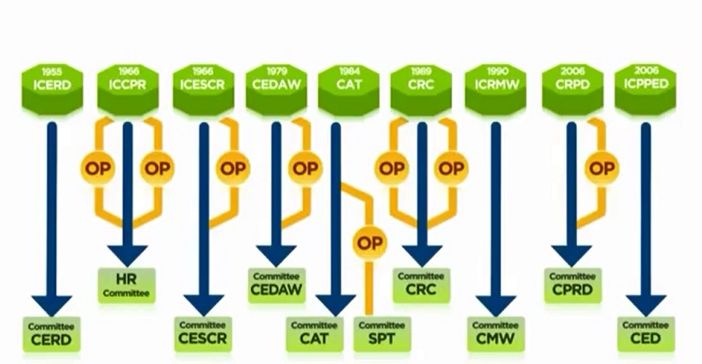

Договорная система ООН по правам человека
Notes:
Each of the HRs treaties provides for the establishment of a Committee of independent expert = a treaty body. In addition, the OPCAT creates as well a treaty body. Therefore → 10 Treaty bodies.
1. Committee on the Elimination of Racial Discrimination (CERD)
2. Human Rights Committee (HRCttee)
3. Committee on Economic, Social and Cultural Rights (CESCR)
4. Committee on the Elimination of Discrimination against Women
(CEDAW)
5. Committee against Torture (CAT)
6. Committee on the Rights of the Child (CRC)
7. Committee on Migrant Workers (CMW)
8. Committee on the Rights of Persons with Disabilities (CRPD)
9. Committee on Enforced Disappearances (CED)
10. Subcommittee on Prevention of Torture (SPT)

Slide 10
Договорные органы
Мандат: проводить мониторинг выполнения соответствующего договора государствами-участниками
Состоят из независимых экспертов, выдвинутых и избранных государствами-участниками на фиксированных, возобновляемых раз в четыре года условиях
Членство: 10-25 членов в зависимости от Комитета
Всего: 172 члена (10 ДО)
Критерии: экспертиза, справедливое географическое распределение, представление основных правовых систем и различных форм цивилизаций и сбалансированное гендерное представительство
Не получают вознаграждение и служат исключительно в личном качестве
Встречаются на 1-4-недельной сессии, проводимой 2-3 раза в год в Женеве
Notes:
Treaty bodies:
Established under each treaty
Composed of independent experts, nominated and elected by States parties for fixed, renewable terms of four years
Membership: 10-25 members depending the Committee
Currently 172 members in total (10 TBs)
Criteria: Expertise, equitable geographical distribution, representation of principal legal systems and different forms of civilization and balanced gender representation
Non-remunerated, and serve solely in their personal capacity

Slide 11
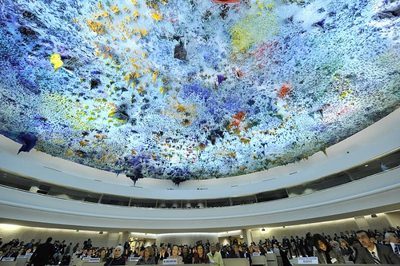
Совет по правам человека
Межправительственный орган
В состав входят 47 членов
УВКПЧ является Секретариатом
Рассматривает ситуации, связанные с нарушением прав человека
Реагирует на чрезвычайные ситуации
Международный форум для диалога по правам человека
Рекомендует усовершенствования законодательства в сфере прав человека
Периодически анализирует ситуации в странах (Универсальный Периодический Обзор)
Notes:
Questions 4, 5 and 6
HRC is an intergovernmental body composed of 47 member states
Main mechanisms established under the HRC: UPR and Special Procedures (quick overview)
HUMAN RIGHTS COUNCIL
-Created by the General Assembly in 2006
-Members elected directly by the General Assembly
-Guided by the principles of universality, impartiality, objectivity and non-selectivity
-Universal Periodic Review
-Ability to convene special sessions to respond promptly to human rights crises
-OHCHR provides support for the meetings of the Council and a follow-up to deliberations
The Human Rights Council, which meets in Geneva 10 weeks a year, was created by the General Assembly in 2006 to replace the Human Rights Commission. It is composed of 47 elected United Nations Member States who serve for an initial period of 3 years, and cannot be elected for more than two consecutive terms. The Human Rights Council is a forum where all Member States can discuss human rights issues, but also promote and make human rights a priority issue.
The expanded mandate of the Council includes making recommendations to the General Assembly for further development to international human rights law and undertaking a Universal Periodic Review of the fulfillment of each State of its human rights obligations and commitments. The Human Rights Council also has the ability to react quickly to human rights emergencies in countries. OHCHR provides support for the meetings of the Human Rights Council, and follow-up to the Council’s deliberations.
QUESTIONS AND ANSWERS ON THE HUMAN RIGHTS COUNCIL
1. How many members the Human Rights Council has?
The Council consists of 47 members, as compared to the 53-member Commission on Human Rights.
2. How are members elected?
Membership to the Council is open to all Member States of the United Nations. Members are elected by the General Assembly through individual and direct votes by absolute majority (96 votes). The distribution of seats is in accordance with equitable geographical representation (13 from the African Group; 13 from the Asian Group; 6 from the Eastern European Group; 8 from the Latin American and Caribbean Group; and 7 from the Western European and Other States Group).
3. How is this election procedure for Council membership different from the Commission on Human Rights?
The election procedure calls for an absolute majority of the entire membership of the General Assembly. Election to the Commission on Human Rights was by the 54 member Economic and Social Council through a majority of those present and voting.
4. What are the expectations of the members to the Council?
When voting for members of the Council, member states will take into consideration a candidates' contribution to the promotion and protection of human rights. Upon election, new members commit themselves to cooperating with the Council and to upholding the highest standards in the promotion and protection of human rights. Candidates to the Council also submit voluntary pledges and commitments with regard to the promotion and protection of human rights. These expectations did not exist for the Commission on Human Rights.
5. How the Council ensure that its members abide by these human rights standards?
Members of the Council undergo the Council's new universal review mechanism during their term of membership. The Universal Periodic Review (UPR) is a unique process which involves a review of the human rights records of all 192 UN Member States once every four years. The UPR is a State-driven process, under the auspices of the Human Rights Council, which provides the opportunity for each State to declare what actions they have taken to improve the human rights situations in their countries and to fulfil their human rights obligations. As one of the main features of the Council, the UPR is designed to ensure equal treatment for every country when their human rights situations are assessed.
6. Could a Member have its rights and privileges suspended in the Council?
The General Assembly would have the right to suspend the rights and privileges of any Council Member that it decides has persistently committed gross and systematic violations of human rights during its term of membership. This process of suspension would require a two-thirds majority vote by the General Assembly.
7. How long are the terms of membership?
Members will be elected for three year terms. They would not be eligible for immediate re-election after serving two consecutive terms.
8. Where does the Human Rights Council fit in within the United Nations system?
The Human Rights Council is a subsidiary body of the General Assembly. This makes it directly accountable to the full membership of the United Nations.
9. Where and how often does the Council meet?
The Human Rights Council is based in Geneva and holds no fewer than three sessions per year (including a main session) for a total period of no less than ten weeks. The Commission met in one annual six-week session. The Council is also able to convene to deal with urgent situations, and to hold special sessions when necessary through a request by a Member of the Council with the support of one-third of the membership of the Council.
10. Do non-governmental organizations and other observers participate in the proceedings of the Council as they did with the Commission on Human Rights?
Observers, including non-governmental organizations, intergovernmental organizations, national human rights institutions and specialized agencies, participate in the Council through the same arrangements and practices that applied to the Commission.
11. How is the work of the special mechanisms of the Commission on Human Rights – independent experts, treaty bodies, and special rapporteurs –affected by the establishment of the Council?
The Council carried over all the Commission's mandates and responsibilities to ensure that there was not a protection gap in the transition. The Council continues to work closely with the UN Special Procedures established by the former Commission on Human Rights and assumed by the Council. In 2007 the Council adopted its “Institution-building package” providing elements to guide it in its future work. Among the elements is the Universal Periodic Review mechanism which will assess the human rights situations in all 192 UN Member States. Other features include a new Advisory Committee which serves as the Council’s “think tank” providing it with expertise and advice on thematic human rights issues and the revised Complaints Procedure mechanism which allows individuals and organizations to bring complaints about human rights violations to the attention of the Council.
12. What is the relationship be between the United Nations High Commissioner for Human Rights and the Human Rights Council?
The Council assumes the role and responsibilities of the Commission on Human Rights relating to the work of the Office of the High Commissioner.
13. How can the main objectives of the Human Rights Council be summarized?
The Council serves as the main United Nations forum for dialogue and cooperation on human rights. Its focus is to help member states meet their human rights obligations through dialogue, capacity building, and technical assistance. The Council also makes recommendations to the General Assembly for further development of international law in the field of human rights.

Slide 12
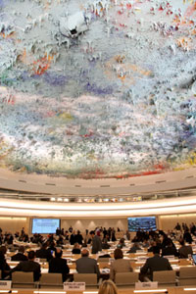
Механизмы CПЧ: Универсальный периодический обзор (УПО)
Межправительственная экспертная оценка
Обзор//рассмотрение каждого государства в 4,5-летнем цикле
Обзоры на основе:
Национальных докладов государств, находящихся на рассмотрении
Свода информации, включающего информацию от экспертов и органов ООН
Свода информации, включающего резюме сообщений от других заинтересованных сторон (НПО, НПЗУ)
CПЧ издает доклад с рекомендациями и обязательствами рассматриваемого государства
Notes:
What is the Universal Periodic Review?
The Universal Periodic Review (UPR) is a unique process which involves a review of the human rights records of all 193 UN Member States once every 4,5 years. The UPR is a significant innovation of the Human Rights Council which is based on equal treatment for all countries. It provides an opportunity for all States to declare what actions they have taken to improve the human rights situations in their countries and to overcome challenges to the enjoyment of human rights. The UPR also includes a sharing of best human rights practices around the globe. Currently, no other mechanism of this kind exists.
How was the UPR established?
The UPR was established when the Human Rights Council was created on 15 March 2006 by the UN General Assembly in resolution 60/251. This mandated the Council to "undertake a universal periodic review, based on objective and reliable information, of the fulfilment by each State of its human rights obligations and commitments in a manner which ensures universality of coverage and equal treatment with respect to all States”. On 18 June 2007, one year after its first meeting, members of the new Council agreed to its institution-building package (A/HRC/RES/5/1) providing a road map guiding the future work of the Council. One of the key elements of this package was the new Universal Periodic Review.
What is the goal of the UPR?
The ultimate goal of UPR is the improvement of the human rights situation in every country with significant consequences for people around the globe. The UPR is designed to prompt, support, and expand the promotion and protection of human rights on the ground. To achieve this, the UPR involves assessing States’ human rights records and addressing human rights violations wherever they occur. The UPR also aims to provide technical assistance to States and enhance their capacity to deal effectively with human rights challenges and to share best practices in the field of human rights among States and other stakeholders.
Who conducts the review?
The reviews are conducted by the UPR Working Group which consists of the 47 members of the Council; however any UN Member State can take part in the discussion/dialogue with the reviewed States. Each State review is assisted by groups of three States, known as “troikas”, who serve as rapporteurs. The selection of the troikas for each State review is done through a drawing of lots prior for each Working Group session.
What are the reviews based on?
The documents on which the reviews are based are: 1) information provided by the State under review, which can take the form of a “national report”; 2) information contained in the reports of independent human rights experts and groups, known as the Special Procedures, human rights treaty bodies, and other UN entities; 3) information from other stakeholders including non-governmental organizations and national human rights institutions.
How are the reviews conducted?
Reviews take place through an interactive discussion between the State under review and other UN Member States. This takes place during a meeting of the UPR Working Group. During this discussion any UN Member State can pose questions, comments and/or make recommendations to the States under review. The troikas may group issues or questions to be shared with the State under review to ensure that the interactive dialogue takes place in a smooth and orderly manner. The duration of the review will be three hours for each country in the Working Group.
Can non-governmental organizations (NGOs) participate in the UPR process?
Yes. NGOs can submit information which can be added to the “other stakeholders” report which is considered during the review. Information they provide can be referred to by any of the States taking part in the interactive discussion during the review at the Working Group meeting. NGOs can attend the UPR Working Group sessions and can make statements at the regular session of the Human Rights Council when the outcome of the State reviews are considered. OHCHR has released "Technical guidelines for the submission of stakeholders”.
What human rights obligations are addressed?
The UPR will assess the extent to which States respect their human rights obligations set out in: (1) the UN Charter; (2) the Universal Declaration of Human Rights; (3) human rights instruments to which the State is party (human rights treaties ratified by the State concerned); (4) voluntary pledges and commitments made by the State (e.g. national human rights policies and/or programmes implemented); and, (5) applicable international humanitarian law.
What is the outcome of the review?
Following the State review by the Working Group a report is prepared by the troika with the involvement of the State under review and assistance from the OHCHR. This report, referred to as the “outcome report”, provides a summary of the actual discussion. It therefore consists of the questions, comments and recommendations made by States to the country under review, as well as the responses by the reviewed State.
How is the review adopted?
During the Working Group session half an hour is allocated to adopt each of the “outcome reports” for the States reviewed that session. These take place no sooner than 48 hours after the country review. The reviewed State has the opportunity to make preliminary comments on the recommendations choosing to either accept or reject them. Both accepted and refused recommendations are included in the report. After the report has been adopted, editorial modifications can be made to the report by States on their own statements, within the following two weeks. The report then has to be adopted at a plenary session of the Human Rights Council. During the plenary session, the State under review can reply to questions and issues that were not sufficiently addressed during the Working Group and respond to recommendations that were raised by States during the review. Time is also allotted to member and observer States who may wish to express their opinion on the outcome of the review and for NGOs and other stakeholders to make general comments.
What steps are taken as follow up to the review?
The State has the primary responsibility to implement the recommendations contained in the final outcome. The UPR ensures that all countries are accountable for progress or failure in implementing these recommendations. When it comes time for the second review of a State they must provide information on what they have been doing to implement the recommendations made during the 1st review four year’s earlier. The international community will assist in implementing the recommendations and conclusions regarding capacity-building and technical assistance, in consultation with the country concerned. If necessary, the Council will address cases where States are not cooperating.
What happens if a State is not cooperating with the UPR?
The Human Rights Council will decide on the measures it would need to take in case of persistent non-cooperation by a State with the UPR.

Slide 13
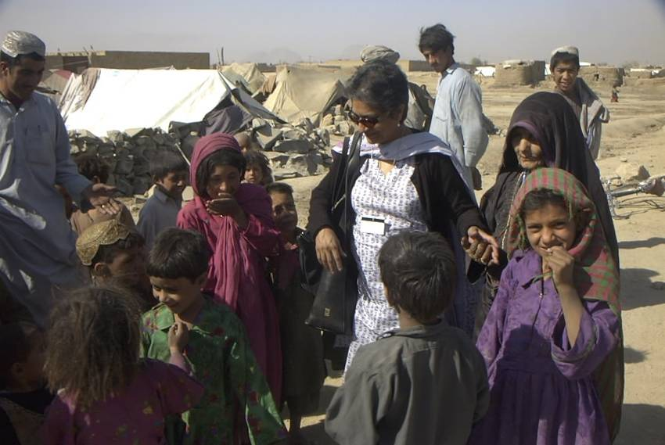
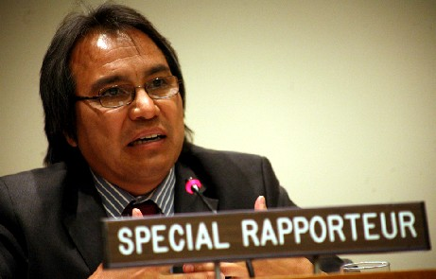
Механизмы CПЧ: специальные процедуры
Специальные процедуры*
44 тематических мандата
10 мандатов, касающихся стран или территорий
Назначаются Советом по правам человека
Мониторинг прав человека в разных странах или конкретных проблем
Исследование проблем(ы)
Посещения стран
Получение и рассмотрение прямых жалоб
Обращение к правительствам
Ответные меры на чрезвычайные ситуации
Доклад Совету по правам человека
* по состоянию на май 2019 года
Notes:
SPECIAL PROCEDURES
Mechanisms established by the Human Rights Council to address:
- Specific country situations
- Thematic issues in all parts of the world
Who are the Special Procedures Mandate Holders and how do they work?
- Special procedures commonly are either an individual, called a special rapporteur or representative or an independent expert, or a group of individuals, called a working group.
- Special Procedures mandate holders are independent: fully free from governmental or non-governmental pressure, they report to the Council on their findings and recommendations.
-Work on a voluntary basis
-Appointed by the Human Rights Council
-14 country mandates (Belarus, Cambodia, Central African Republic, Côte d’Ivoire, DPRK, Eritrea, Haiti, the Islamic Republic of Iran, Mali, Myanmar, the Palestinian territories, Somalia, Sudan and Syria), as of 27 March 2015.
-41 Thematic Mandates, as of 27 March 2015.
-Report to the Human Rights Council.
-Conduct research, country visits, receive complaints, and engage governments
-Thematic mandate periods will be of three years. Country mandate periods will be of one year. Mandate-holders may not exceeded a six‑year term limit.
- Special Rapporteurs are sometimes the only mechanism that will alert the international community on certain human rights issues.
OHCHR provides personnel and logistical support to mandate holders
Special procedures:
The special procedures are considered the most effective, flexible and responsive mechanisms within the UN human rights system. The Council’s review of these procedures aims to strengthen the system and to ensure greater synergy with other human rights mechanisms within the UN system.
The Council agreed to criteria and established a process for the continuing review, rationalization and improvement of all special procedure mandates was established by the Council;
Any decision to streamline, merge or eventually discontinue mandates will be guided by the need for improvement of the enjoyment and protection of human rights;
The Council’s existing thirty-eight country and thematic special procedures will be reviewed in accordance with a schedule to be agreed upon by the Council;
An agreed process and general criteria for the selection of special procedure mandate-holders will ensure that individuals with the highest standards of expertise, experience, independence and impartiality are selected;
A “Code of Conduct” for mandate-holders aimed at strengthening the effectiveness of the system and the capacity of mandate-holders to exercise their functions was also adopted by the Council. It will enhance their moral authority and credibility and requires supportive action by other stakeholders, in particular by States.

Slide 14
РЕЗЮМЕ: Различные функции МПР
 | Тип | Мандат | Функции
УПО | Межправительст-венный | Совет по правам человека | - Рассмотрение докладов
СП | Независимые эксперты | Совет по правам человека | Посещения Индивидуальные жалобы
ДО | Независимые эксперты | Международные договоры по правам человека | Рассмотрение докладов Индивидуальные жалобы Посещения (1 ДО-ППП)
 | ВСЕ ТРИ МЕХАНИЗМА ДАЮТ РЕКОМЕНДАЦИИ
Notes:
Explain all HRMs and their functions and that during this workshop focus will be given to engagement with HRM regarding reporting. Mention that the reporting cycle is going to be explained in the next session as well as the perioridicity of reporting.

