Slide 1
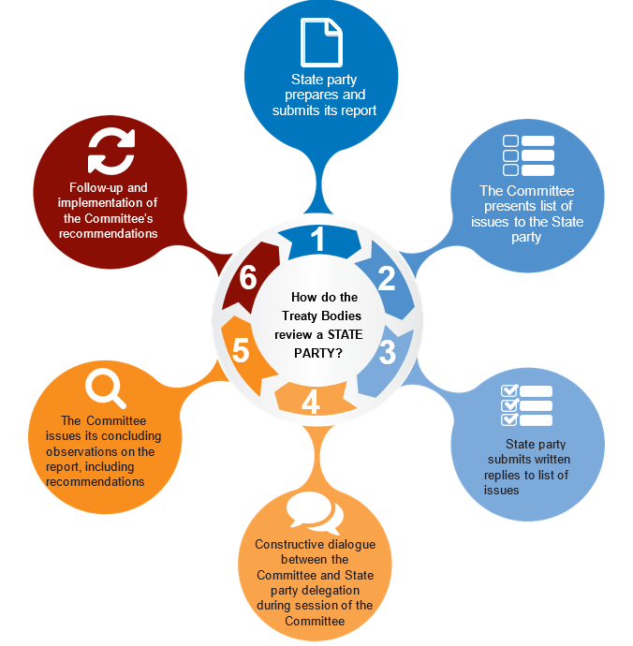
Reporting cycle

Slide 2
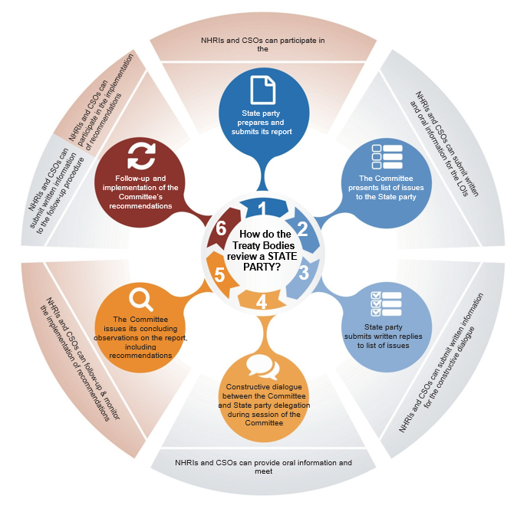
Reporting cycle with stakeholders

Slide 3
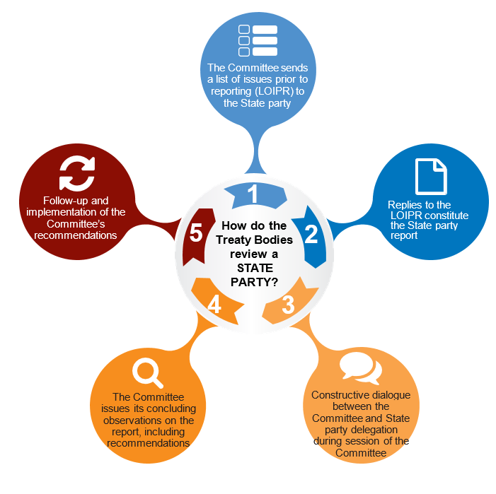
The simplified reporting procedure

