Slide 1
United Nations Human Rights Council
Open-Ended Working Group on the Right to Development, 2 May, 2019
Sub-item 3: Discussion of the Content and Scope of a Legally Binding Instrument on the Right to Development
Dr. Mihir Kanade
Academic Director, and
Head of the Department of International Law
University for Peace – Established by the UN General Assembly

Slide 2
Observations Concerning
a) the formulation of the right to development
b) the nature of obligations of States parties to a legally binding instrument on the right to development.

Slide 3
Article 1(1) DRTD
The right to development is an inalienable human right by virtue of which every human person and all peoples are entitled to participate in, contribute to, and enjoy economic, social, cultural and political development, in which all human rights and fundamental freedoms can be fully realized.

Slide 4
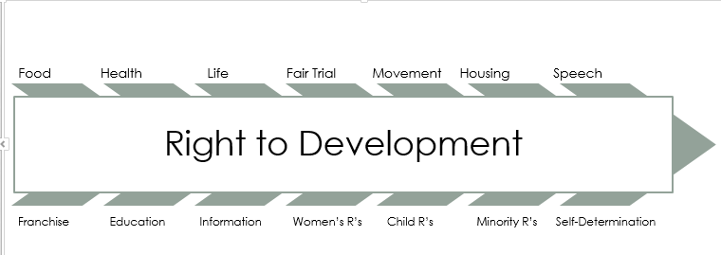
Vector Model of Arjun Sengupta, First Independent Expert on RtD
This is a representation of Sengupta’s Vector Model as expressed diagrammatically by Dr. Mihir Kanade

Slide 5
Article 1(1) DRTD
The right to development is an inalienable human right by virtue of which every human person and all peoples are entitled to participate in, contribute to, and enjoy economic, social, cultural and political development, in which all human rights and fundamental freedoms can be fully realized.

Slide 6
Article 1(1) DRTD
The right to development is an inalienable human right by virtue of which every human person and all peoples are entitled to participate in, contribute to, and enjoy economic, social, cultural and political development, in which all human rights and fundamental freedoms can be fully realized.

Slide 7
Article 1(1) DRTD
The right to development is an inalienable human right by virtue of which every human person and all peoples are entitled to participate in, contribute to, and enjoy economic, social, cultural and political development, in which all human rights and fundamental freedoms can be fully realized.

Slide 8
Article 1(2) DRTD
The human right to development also implies the full realization of the right of peoples to self-determination, which includes, subject to the relevant provisions of both International Covenants on Human Rights, the exercise of their inalienable right to full sovereignty over all their natural wealth and resources

Slide 9
Article 1(1) DRTD
The right to development is an inalienable human right by virtue of which every human person and all peoples are entitled to participate in, contribute to, and enjoy economic, social, cultural and political development, in which all human rights and fundamental freedoms can be fully realized.

Slide 10
Suggested Reformulation of Article 1(1) in a legally binding instrument
1. Every human person and all peoples have the right to development by virtue of which they are entitled to participate in, contribute to, and enjoy economic, social, cultural, civil, and political development that is consistent with all other human rights and fundamental freedoms.

Slide 11
Article 2 DRTD
1. The human person is the central subject of development and should be the active participant and beneficiary of the right to development.
3. States have the right and the duty to formulate appropriate national development policies that aim at the constant improvement of the well-being of the entire population and of all individuals, on the basis of their active, free and meaningful participation in development and in the fair distribution of the benefits resulting therefrom.

Slide 12
Suggested Reformulation in a legally binding instrument
States, on behalf of their peoples, have the right, as well as the duty, to formulate appropriate national development policies […]

Slide 13
DRTD Provisions on Duties of States Related to National and International Action
Article
3(1)
States have the primary responsibility for the creation of national and international conditions favourable to the realization of the right to development.
Article
4(1)
States have the duty to take steps, individually and collectively, to formulate international development policies with a view to facilitating the full realization of the right to development.
Article
3(3)
States have the duty to co-operate with each other in ensuring development and eliminating obstacles to development.

Slide 14
Three Levels of Obligations on States Related to the Right to Development
1. Obligations of States acting individually as they formulate national development policies and programmes affecting persons within their jurisdiction;
2. Obligations of States acting individually as they adopt and implement policies that affect persons not strictly within their jurisdiction, and;
3. Obligations of States acting collectively in global and regional partnerships.

Slide 15



Nature of RtD Obligations of States Parties | Individual State Obligations Internally | Individual State Obligations Externally | State Obligations Collectively
Obligation to Respect (Do no harm)
Obligation to Protect (against third party violations)
Obligation to Fulfill (Measures to improve, eliminate obstacles, and facilitate realization)

