Slide 1
A civil society perspective on the potential of trade for achieving sustainable development
Sanya Reid Smith
30/4/2019

Slide 2
Some current trade and investment negotiations
WTO including:
WTO accession. Acceding countries: https://www.wto.org/english/thewto_e/acc_e/acc_e.htm
FTAs including:
EUFTAs, eg EU’s proposal to Indonesia: Authorisation for Exploration and Production of Energy Goods [Hydrocarbons; Electricity], Raw Materials [Ores and Concentrates] and Forestry Goods: ‘Each Party may require an entity which has been granted an authorisation to pay a financial contribution or a contribution in kind. The contribution shall be fixed in such a manner so as not to interfere with the management and the decision-making process of the entity which has been granted an authorisation.’
EFTA FTAs
RCEP
BITs

Slide 3
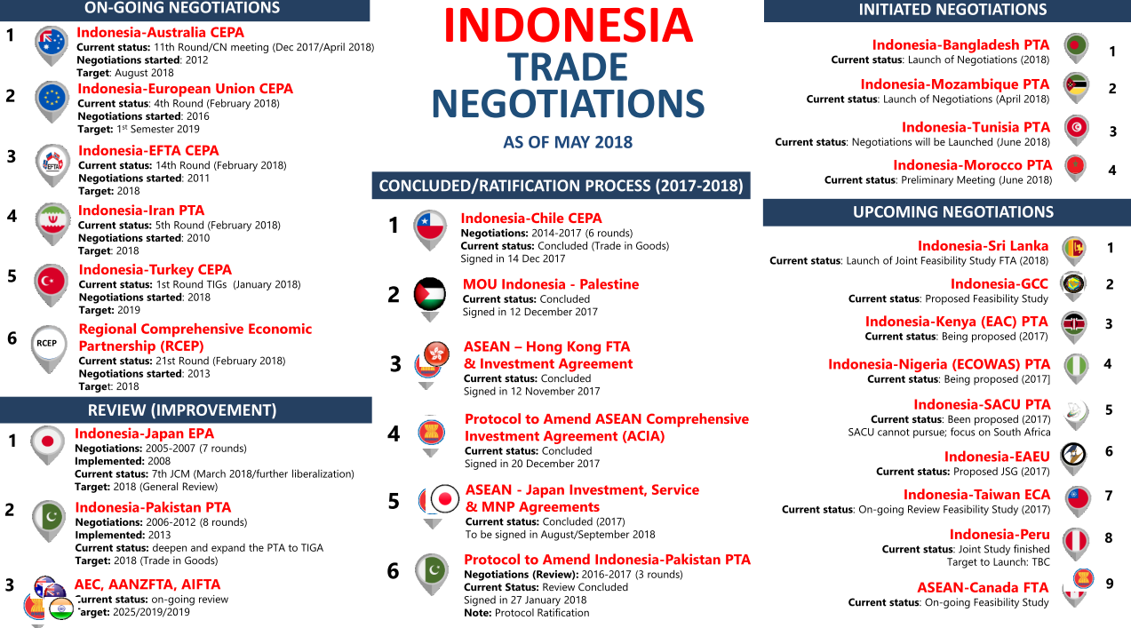
An example of one country’s trade negotiations
From http://ditjenppi.kemendag.go.id/assets/files/publikasi/doc_20180511_ongoing-and-upcoming-negotiations4.pdf

Slide 4
Some current WTO negotiations/discussions
Fisheries subsidies
Services domestic regulation disciplines
WTO reform including: US proposal: ‘the following categories of Members will not avail themselves of special and differential treatment in current and future WTO negotiations:
i. A WTO Member that is a Member of the Organization for Economic Cooperation and Development (OECD), or a WTO Member that has begun the accession process to the OECD;
ii. A WTO Member that is a member of the Group of 20 (G20);
iii. A WTO Member that is classified as a "high income" country by the World Bank; or
iv. A WTO Member that accounts for no less than 0.5 per cent of global merchandise trade (imports and exports).’ WT/GC/W/764

Slide 5
Some current WTO negotiations/discussions continued
Plurilaterals:
Ecommerce
Gender
MSMEs
Investment facilitation

Slide 6
Some further information
WTO proposals: https://docs.wto.org/dol2fe/Pages/FE_Search/FE_S_S001.aspx
WTO reform proposals include:
https://ustr.gov/about-us/policy-offices/press-office/press-releases/2018/september/joint-statement-trilateral
trade.ec.europa.eu/doclib/docs/2018/september/tradoc_157331.pdf
EUFTA proposals: http://trade.ec.europa.eu/doclib/press/index.cfm?id=1395
EFTA FTAs: https://www.efta.int/free-trade
RCEP leaked texts: http://bilaterals.org/?-mega-regional-ftas-
BITs: https://investmentpolicyhubold.unctad.org/IIA/IiasByCountry#iiaInnerMenu
221 women’s rights groups call for rejection of WTO’s gender declaration: https://apwld.org/press-release-164-womens-rights-groups-call-on-governments-to-reject-the-wto-declaration-on-womens-economic-empowerment/
Some analyses of WTO ecommerce and domestic regulation disciplines communications: https://www.twn.my/briefings_MC11.htm

Slide 7
Thank you
sanya@twnetwork.org

