Slide 1
Foundations – Promoting the Rights of Persons with Disabilities through the Sustainable Development Goals
A Resource Package
Online Training Module – Session 1
Presenter's name
Event or meeting title
Platform, (Date)
© United Nations, 2022 – These presentation slides form part of the OHCHR Promoting the Rights of Persons with Disabilities through the Sustainable Development Goals: A Resource Package.

Slide 2
Teams tech help slides
(Templates by Training for Change)

Slide 3
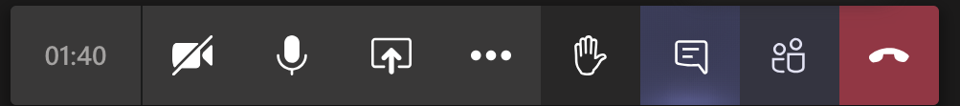
Set-up
Click Unmute and Start Video to say hello
Raise your hand
Click Participants
and Chat

Slide 4
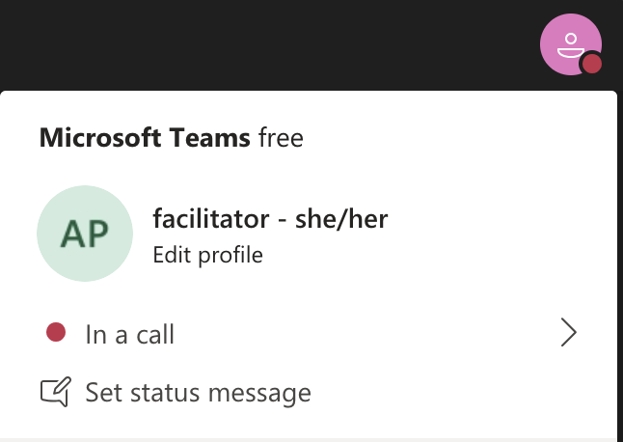
Rename yourself: Click the icon on the top right corner, click “Edit profile” to change your name and add your pronouns. Click “Set status message” to write your organization and location.

Slide 5
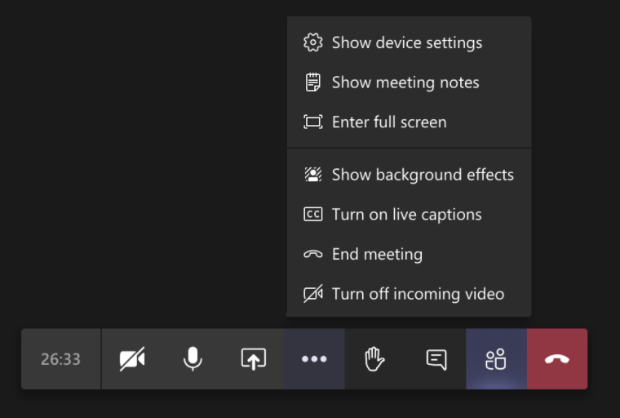
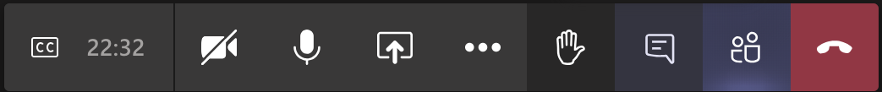
Closed Captions

Slide 6
Zoom tech help slides
(Templates by Training for Change)

Slide 7
Set-up
Click Unmute and Start Video to say hello
Click Participants
and Chat

Slide 8
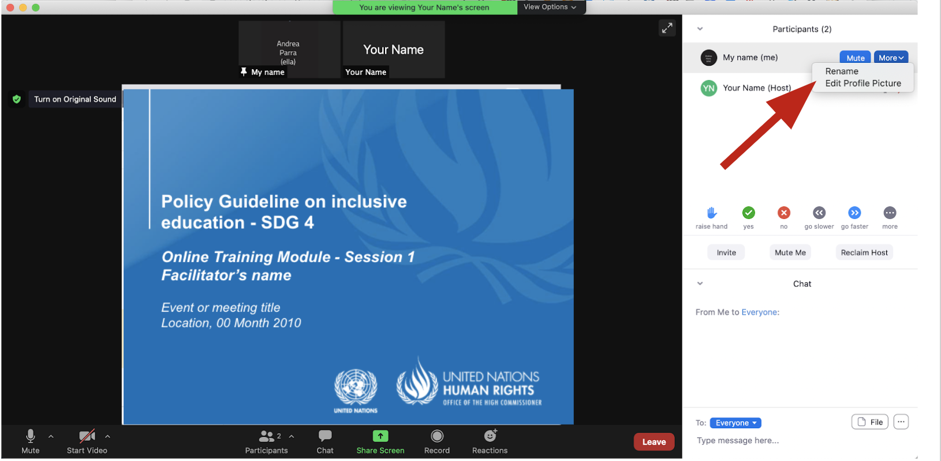
Rename yourself: Find your name at the top of the Participants list, click “More” then “Rename”. Add your pronouns & location.

Slide 9
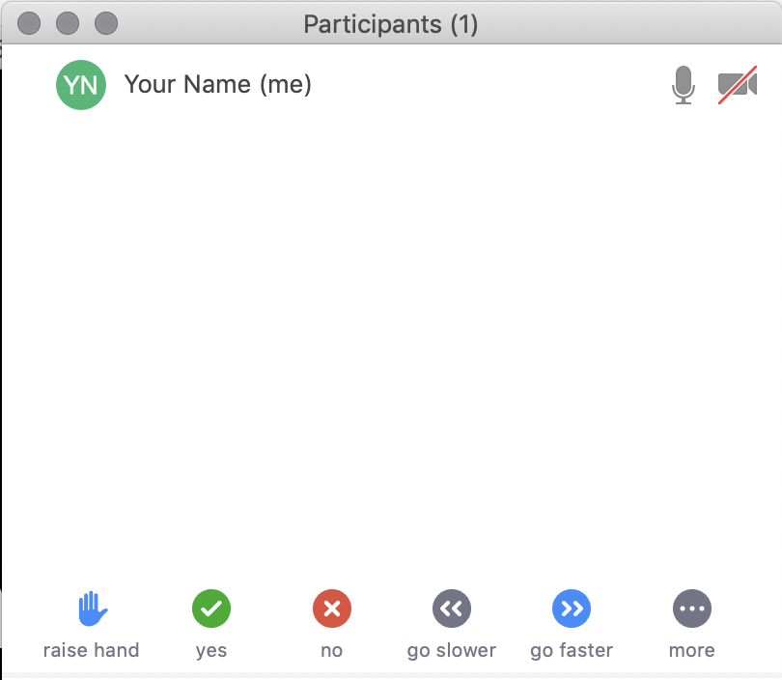
Raise your hand
Use the participants
menu tool
--or--
Type * in chat
*9 on phone
Alt+Y on keyboard

Slide 10
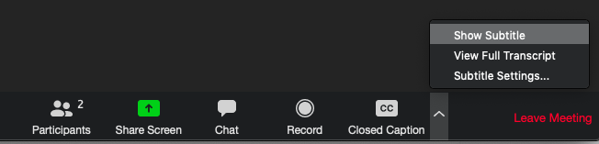
Closed Captioning
Click arrow next to “Closed Caption” and click “Show Subtitle”
Notes:
Template by Training for Change • www.trainingforchange.org
Visual guide for how to turn on closed captioning is very important when you have a live captioner in your online meeting. It is recommended to also paste in chat:
==========
Live closed captioning available. Click “Closed Caption” in the toolbar and “Show Subtitle” to view the captions. Click “Subtitle Settings…” for more options.
==========

Slide 12
Be present
Remove distractions
Get a beverage
Get note-taking materials
Center yourself

Slide 13
Welcome!
Name
Name
Name
Name
Share your name, affiliation and one way in which you contribute to the diversity of this group
Name
Name
Name
Name
Name
Name
Name
Template by Training for Change
Notes:
Template by Training for Change • www.trainingforchange.org

Slide 14
Objectives of the module
Become familiar with the various components of the Office of the United Nations High Commissioner for Human Rights’ Resource Package on Promoting the Rights of Persons with Disabilities through the Sustainable Development Goals
Gain an understanding of key human rights concepts that underpin a rights-based approach to disability-inclusive development.
Gain an understanding of the structural requirements that enable the implementation of all the Sustainable Development Goals with a disability rights lens.
Identify concrete steps that policymakers can take to implement general requirements and foundations for the inclusion of persons with disabilities.

Slide 15
What’s in the Resource Package?
Policy Guidance
Human Rights Indicators for the Convention on the Rights of Persons with Disabilities
Data Sources Guidance
Training Materials
Videos

Slide 16
Agenda
Start time: 00:00
Models of disability
Human rights model of disability
Ableism – Ability privilege road
Closing time:

Slide 17
Disability and Ableism:
What did you think about disability when you were 8-12 years old?

Slide 18
Understanding Ableism and Disability

Slide 19
Understanding Ableism and Disability

Slide 20
Models of disability
Charity Model of Disability
People with impairments perceived as objects of benevolence who cannot take care of themselves.
Conditions participation to receiving “help” or charity.
Having impairments is seen as a curse or punishment.
Medical Model of Disability
People with impairments seen throughout history as persons who are sick or subjects of rehabilitation.
Reduces persons to their impairment and conditions participation to being rehabilitated or “fixed” to meet societal norms and to fit back into society.

Slide 21
Break! Come back at :00

Slide 22
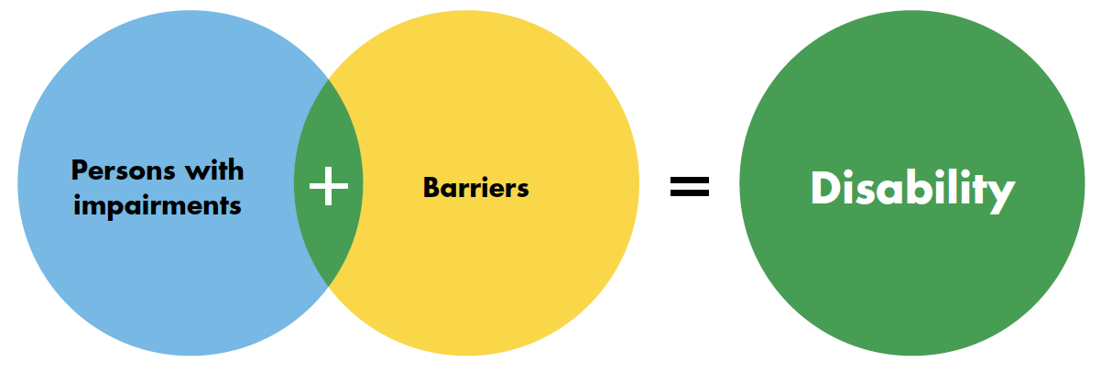
Human Rights Model of Disability

Slide 23
Breakout Groups
In trios think about your specific contexts and areas of work.
What barriers do people with disabilities in your context face that relate to your area of work?

Slide 24
Barriers

Slide 25
Privilege Road
  In your groups, go through
    Autistic Hoya’s Abled Privilege Checklist; and
    Melissa Graham’s “The Invisible Backpack of Able-Bodied Privilege Checklist”
  Each person marks some of the statements which is true for themselves.
  Discuss: What surprised you? What hadn’t you thought about before? What are you curious about?

Slide 26
Ableism
“[A] value system that considers certain typical characteristics of body and mind as essential for living a life of value. Based on strict standards of appearance, functioning and behaviour, ableist ways of thinking consider the disability experience as a misfortune that leads to suffering and disadvantage and invariably devalues human life”.
Special Rapporteur on the rights of persons with disabilities, Report on the impact of ableism in medical and scientific practice, A/HRC/43/41, 2019

Slide 27
Wrap-up and Next Steps
(Add dates of next trainings and any follow-up information here)
(Contact information for questions)

Slide 28
Closing
Raise your hand and share one thing you would like to do to become more aware of ableism in your daily life.

Slide 29
Closing
Name
Name
Name
Name
Name one thing you would like to do to become more aware of ableism in your daily life.
Name
Name
Name
Name
Name
Name
Name
Template by Training for Change
Notes:
Template by Training for Change • www.trainingforchange.org

Slide 30
Resources
Resource package link
  Policy Guidance
  Human Rights Indicators
  Data Sources Guidance
  Training Materials
  Videos
(Add other relevant resources)

Slide 31
Thank you!
For further information, please contact:

