Slide 1
Policy Guidance on Decent Work and Economic Growth – Sustainable Development Goal 8: Promoting the Rights of Persons with Disabilities through the Sustainable Development Goals
A Resource Package
Online Training Module – Session 2
Presenter's name
Event or meeting title
Platform, (Date)
© United Nations, 2022 – These presentation slides form part of the OHCHR Promoting the Rights of Persons with Disabilities through the Sustainable Development Goals: A Resource Package.

Slide 2
Teams tech help slides
(Templates by Training for Change)

Slide 3

Set-up
Click Unmute and Start Video to say hello
Raise your hand
Click Participants
and Chat

Slide 4
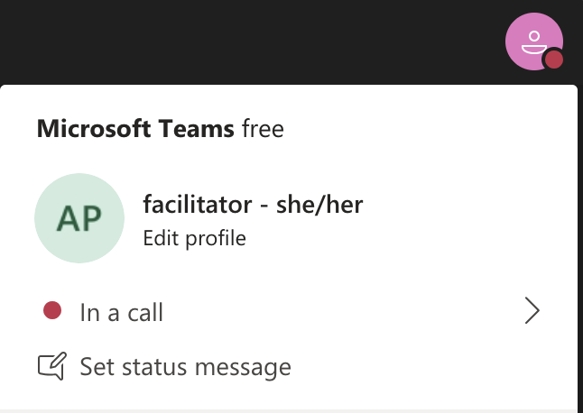
Rename yourself: Click the icon on the top right corner, click “Edit profile” to change your name and add your pronouns. Click “Set status message” to write your organization and location.

Slide 5
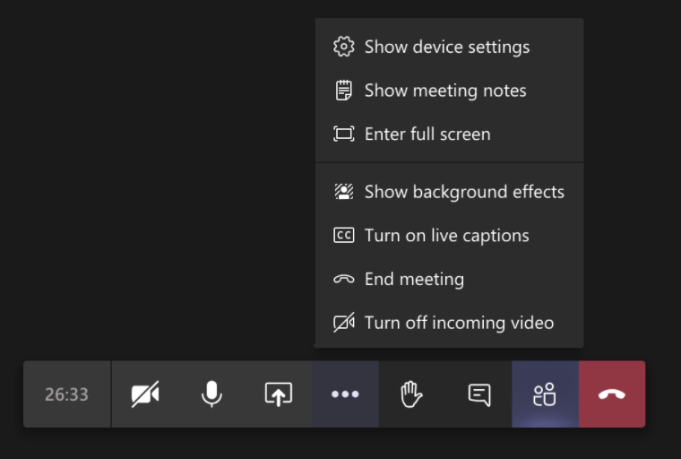
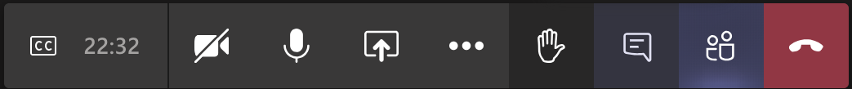
Closed Captions

Slide 6
Zoom tech help slides
(Templates by Training for Change)

Slide 7
Set-up
Click Unmute and Start Video to say hello
Click Participants
and Chat

Slide 8
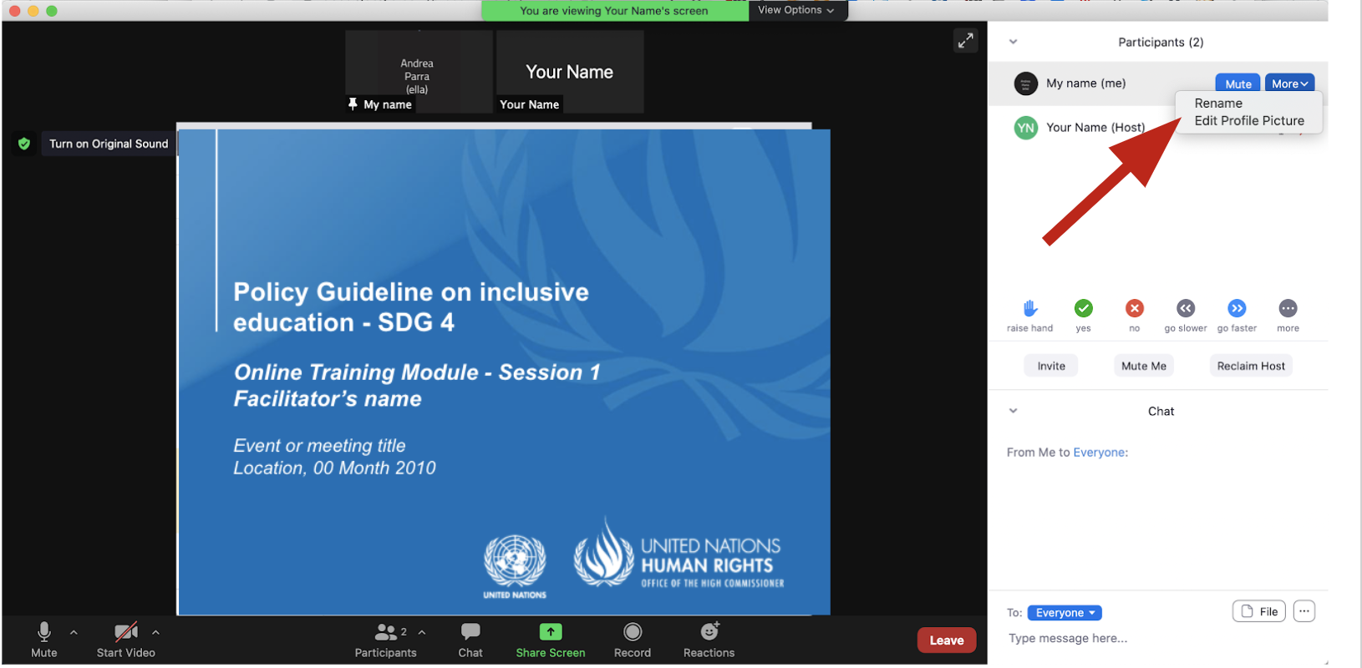
Rename yourself: Find your name at the top of the Participants list, click “More” then “Rename”. Add your pronouns & location.

Slide 9
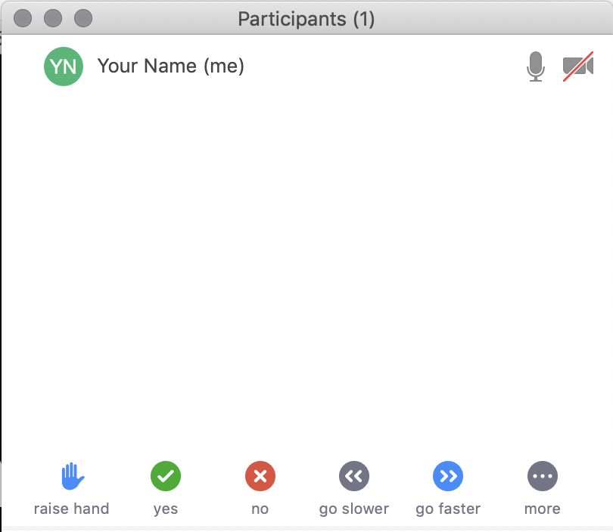
Raise your hand
Use the participants
menu tool
--or--
Type * in chat
*9 on phone
Alt+Y on keyboard

Slide 10
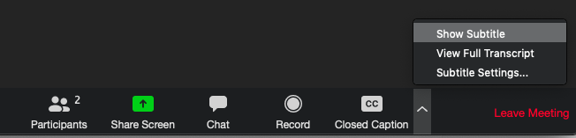
Closed Captioning
Click arrow next to “Closed Caption” and click “Show Subtitle”
Notes:
Template by Training for Change • www.trainingforchange.org
Visual guide for how to turn on closed captioning is very important when you have a live captioner in your online meeting. It is recommended to also paste in chat:
==========
Live closed captioning available. Click “Closed Caption” in the toolbar and “Show Subtitle” to view the captions. Click “Subtitle Settings…” for more options.
==========

Slide 12
Be present
Remove distractions
Get a beverage
Get note-taking materials
Center yourself

Slide 13
Welcome!
Please share in chat one thing that stuck with you from last session.
Notes:
Template by Training for Change • www.trainingforchange.org

Slide 14
Objectives of the module
Become familiar with the various components of the Office of the United Nations High Commissioner for Human Rights’ Resource Package on Promoting the Rights of Persons with Disabilities through the Sustainable Development Goals.
Gain a better understanding of the situation of persons with disabilities with regards to employment.
Identify concrete actions that policymakers can take to implement Sustainable Development Goal 8 in their own contexts.
Learn how to obtain additional information for supporting the process of implementation of Sustainable Development Goal 8.

Slide 15
Teamwork: Employment Barriers
Clara
Raj
Noah
Ana
Visit each station, read through the character card and write down specific barriers they and the actors in charge of making decisions might face.

Slide 16
Employment Barriers – Stations
CLARA
Dependent Employment
Actors
Actors
Pre-Hire
Clara
Hired

Slide 17
Employment Barriers – Stations
RAJID
Dependent Employment
Actors
Actors
Pre-Hire
Rajid
Hired

Slide 18
Employment Barriers – Stations
ANA
Dependent Employment
Actors
Actors
Pre-Hire
Ana
Hired

Slide 19
Employment Barriers – Stations
NOAH
Dependent Employment
Actors
Actors
Pre-Hire
Noah
Hired

Slide 20
Maximize employment
What helps to have a good working experience?

Slide 21
Maximize employment

Slide 22

Maximize employment
Full and productive employment of persons with disabilities
8.5 By 2030, achieve full and productive employment and decent work for all women and men, including for young people and persons with disabilities, and equal pay for work of equal value
Include the rights of persons with disabilities in labour law, including the prohibition of discrimination, the provision of reasonable accommodation and the right to return to work | Adopt an action plan/strategy for the promotion of employment of persons with disabilities in both the private and public sector | Carry out awareness-raising campaigns on the labour rights of persons with disabilities | Measure and reduce the disability pay gap
Related CRPD indicators:5.7, 5.11, 5.12, 13.14, 27.1, 27.4, 27.13, 27.16, 27.25

Slide 23
Maximize employment
Self-employment of persons with disabilities
8.3 Promote development-oriented policies that support productive activities, decent job creation, entrepreneurship, creativity and innovation, and encourage the formalization and growth of micro-, small- and medium-sized enterprises, including through access to financial services 8.10 Strengthen the capacity of domestic financial institutions to encourage and expand access to banking, insurance and financial services for all
Ensure that mainstream vocational and entrepreneurship training are inclusive of persons with disabilities and that supportive targeted training is available to them | Adopt legal and regulatory measures to ensure the equal participation of persons with disabilities in business organizations and equal access to financial services, including micro-finance and credit schemes | Make business development services available for persons with disabilities
Related CRPD indicators: 9.3, 9.4, 12.1, 12.2, 12.15, 19.12, 19.13, 19.26, 24.5, 24.20, 24.27, 27.1, 27.4, 27.12, 27.15, 27.19, 28.3, 28.4, 28.5, 28.14

Slide 24
Maximize employment
Protection of labour rights of persons with disabilities
8.8 Protect labour rights and promote safe and secure working environments for all workers, including migrant workers, in particular women migrants, and those in precarious employment 8.7 Take immediate and effective measures to eradicate forced labour, end modern slavery and human trafficking and secure the prohibition and elimination of the worst forms of child labour, including recruitment and use of child soldiers, and by 2025 end child labour in all its forms
Ensure freedom of association to persons with disabilities to create and participate in trade unions | Ensure that occupational health assessments do not prevent access to employment, based on impairments | Incorporate accessibility in all its dimensions as a key element of occupational health and safety | Adopt disability inclusive strategies against forced labour, including measures to end forced begging and other forms of exploitation
Related CRPD indicators:16.1, 16.3, 16.13, 27.1, 27.2, 27.5, 27.7, 29.9, 29.11, 29.23

Slide 25
Break! Come back at :00

Slide 26
Let’s Go On A Work Journey – Pre-Hire (Clara)

Slide 27
Let’s Go On A Work Journey – Hire (Rajid)

Slide 28
Let’s Go On A Work Journey – Retirement (Ana)

Slide 29
Let’s Go On A Work Journey – Self-Employment (Noah)

Slide 30
Closing
Name
Name
Name
Name
What is one thing I commit to do in the next three months to advance inclusive employment in my context?
Name
Name
Name
Name
Name
Name
Name
Template by Training for Change
Notes:
Template by Training for Change • www.trainingforchange.org

Slide 31
Resources
Resource package link
  Policy Guidance
  Human Rights Indicators
  Data Sources Guidance
  Training Materials
  Videos
(Add other relevant resources)

Slide 32
Thank you!
For further information, please contact:

