Slide 1


MODULE 1
Introduction to the course and to international migration
Session 2: An introduction to international migration

Slide 2

Session overview
Migration: causes and factors
Understanding the terminology
Complexities of migration
Stereotypes – myths – realities
Common policy responses

Slide 3
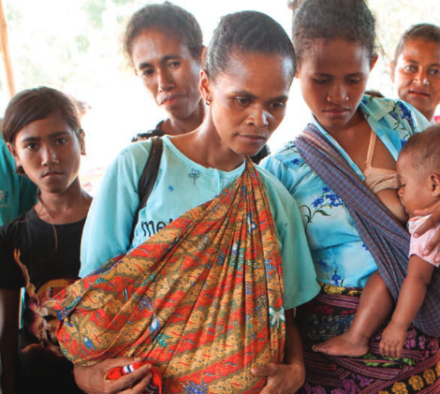
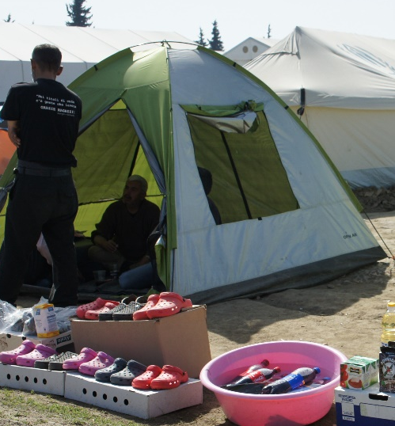
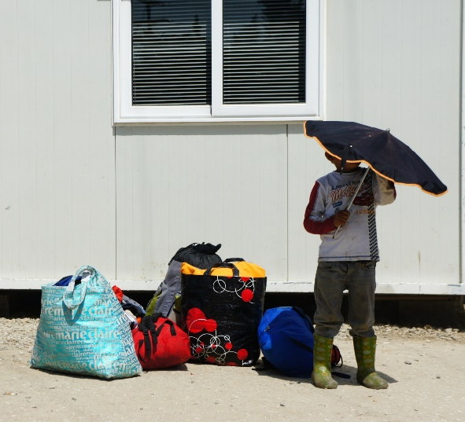
Why do people move? Reasons include...
281 million international migrants
48% women
52% men
15% under 20 years of age

Slide 4
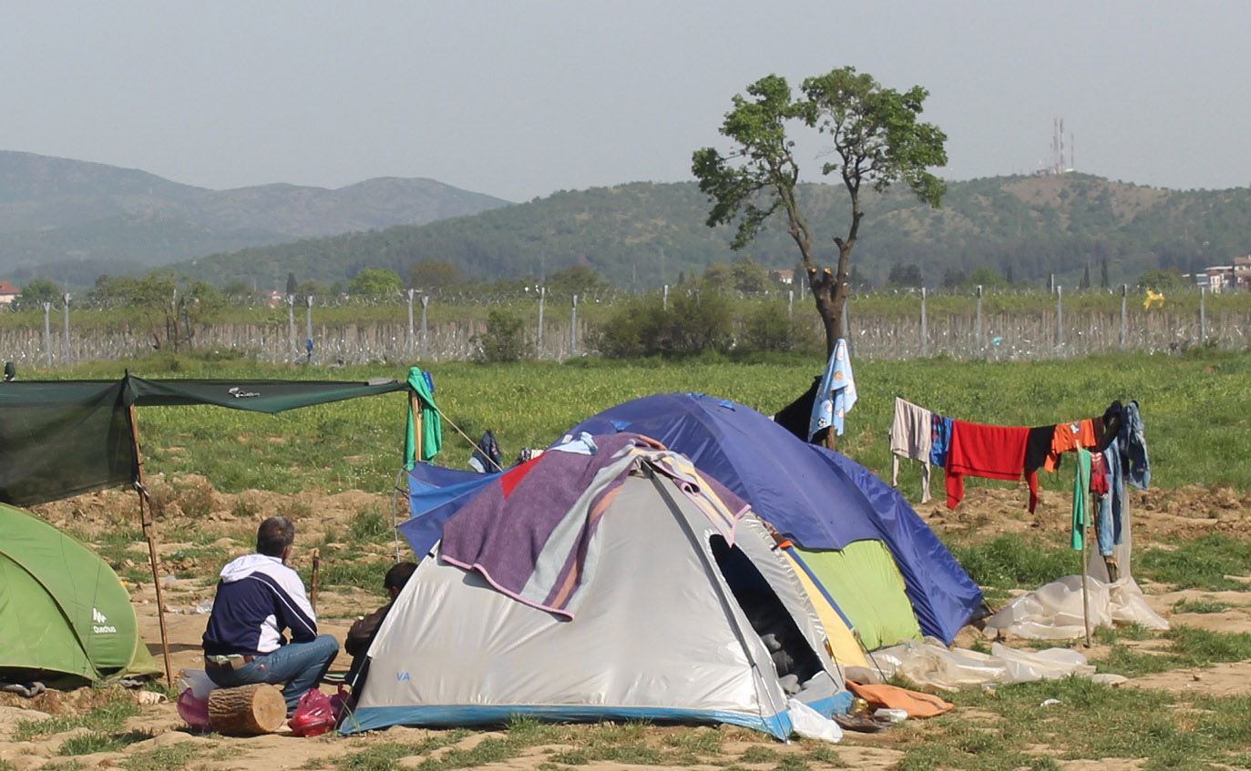
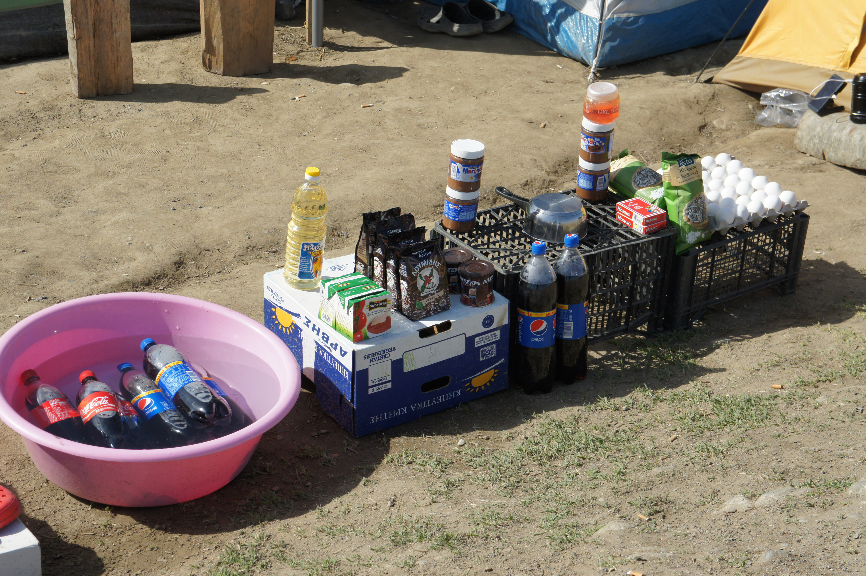
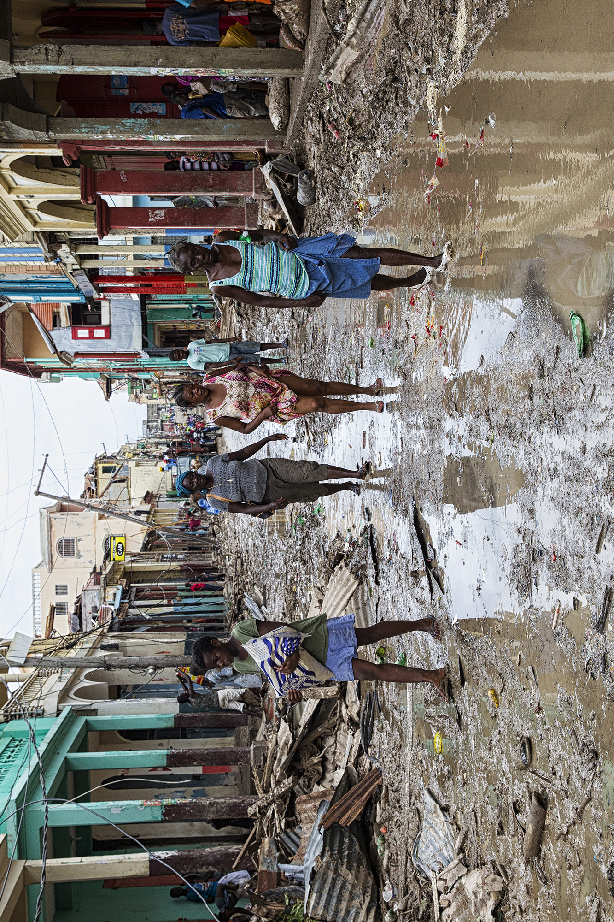
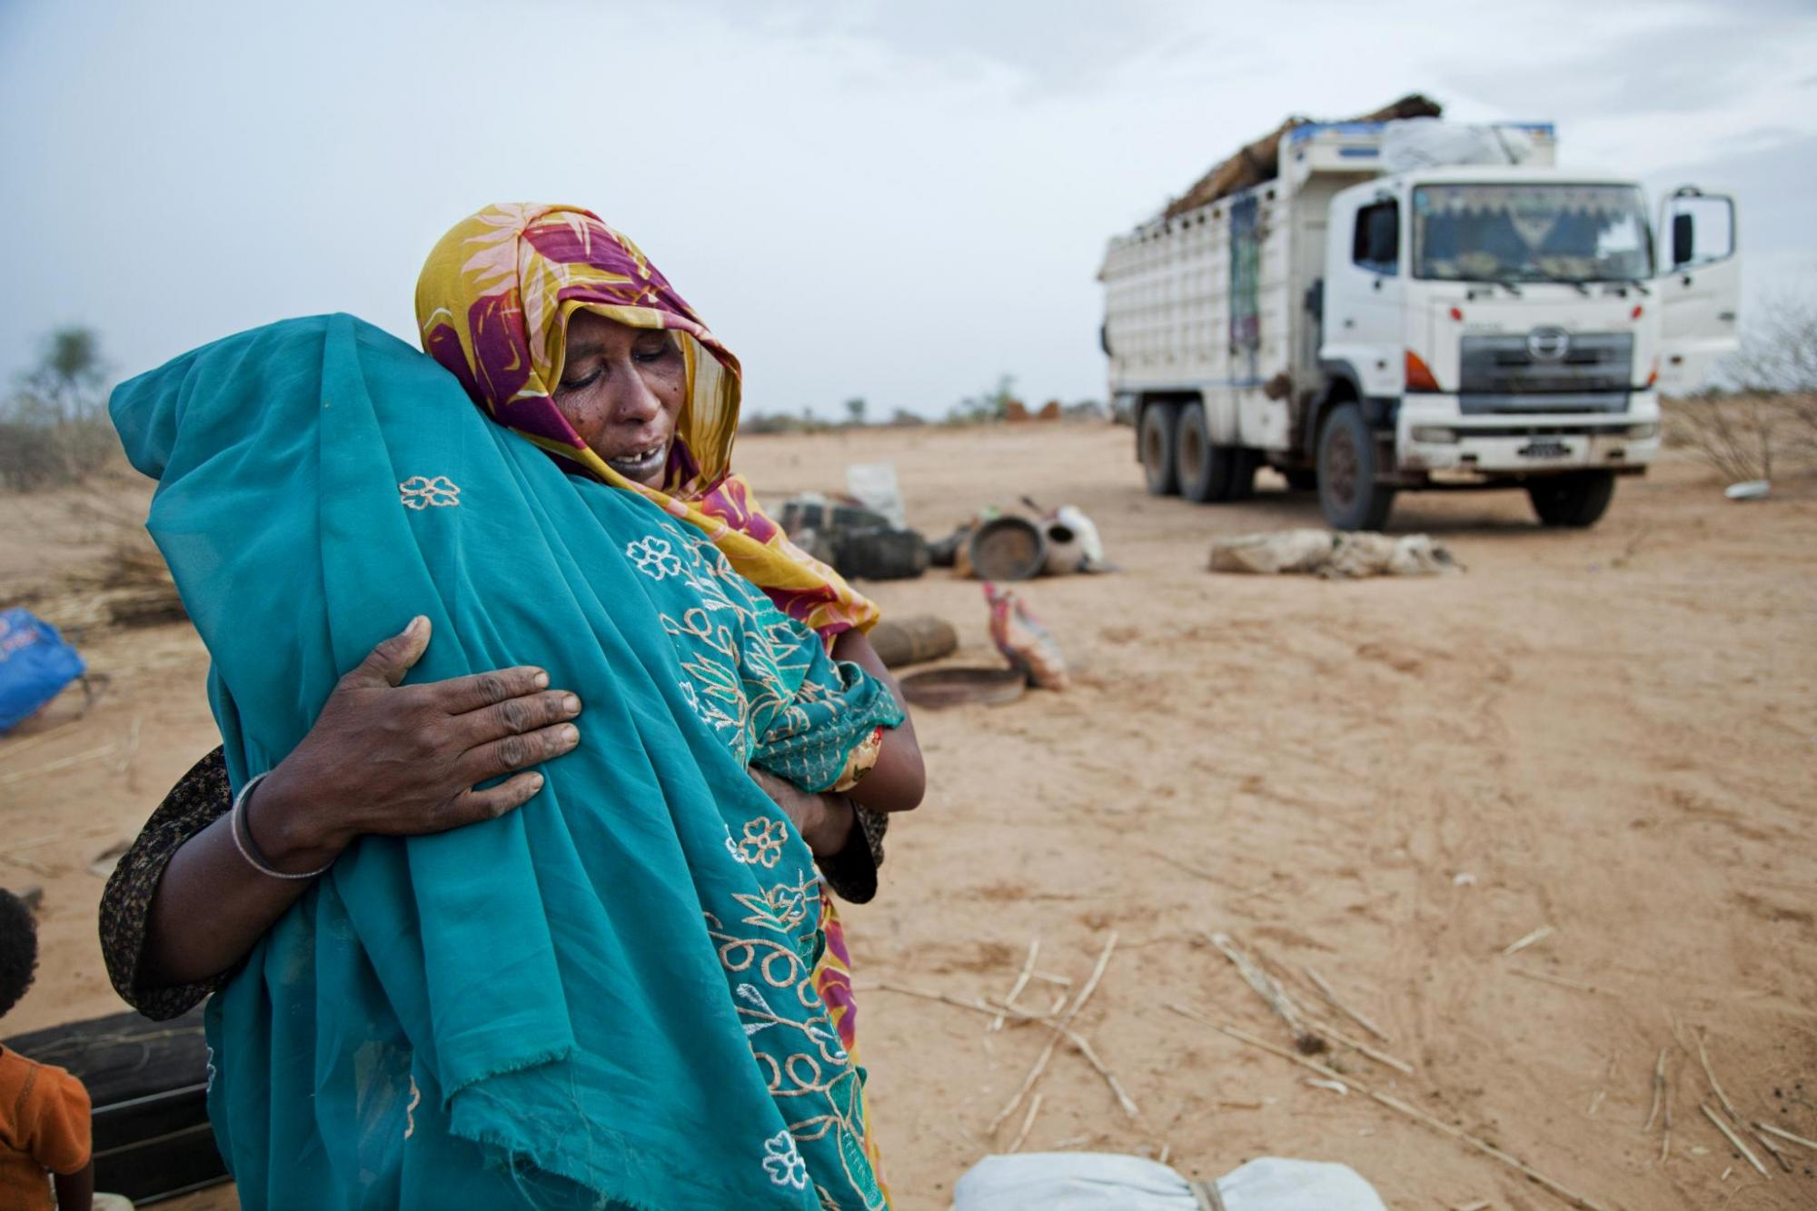
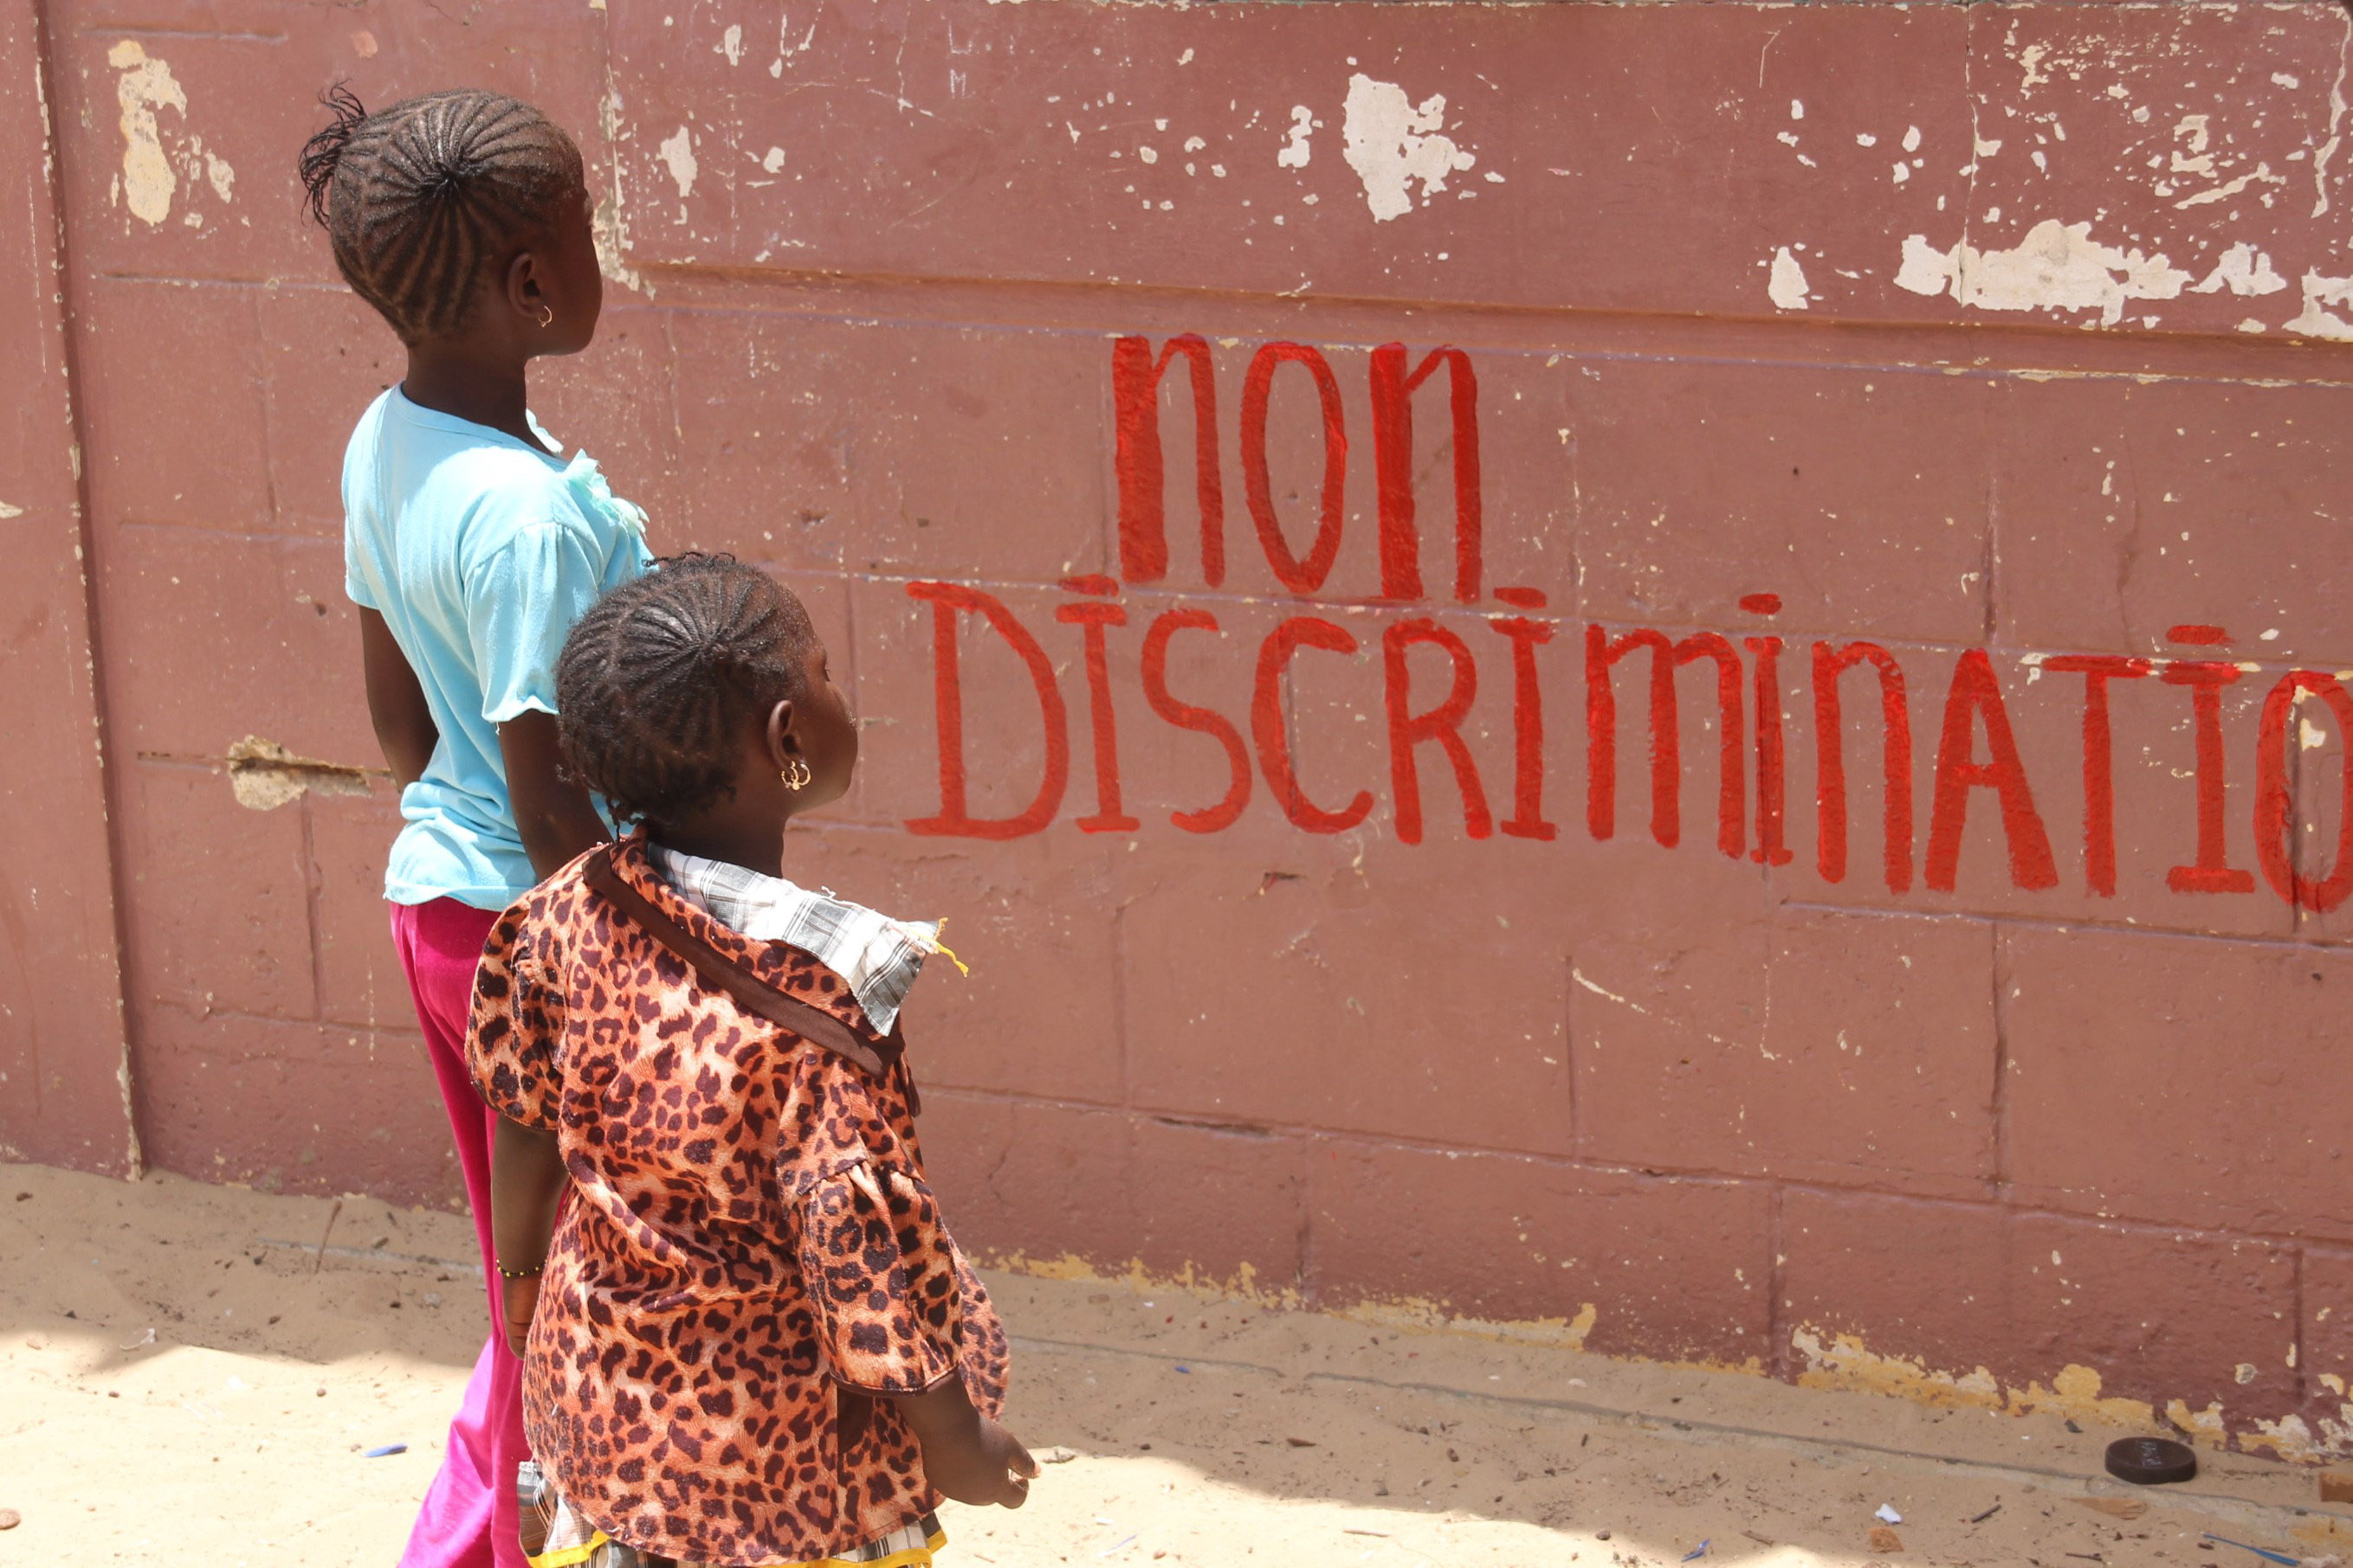
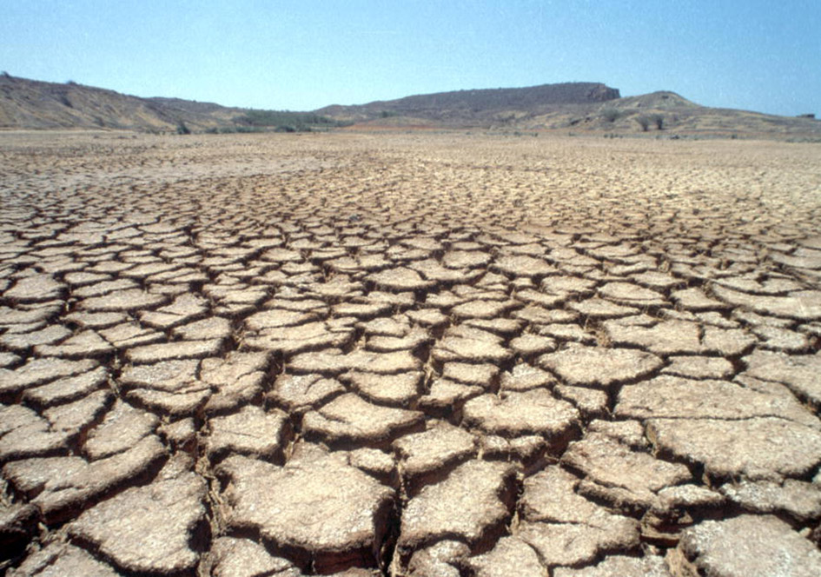
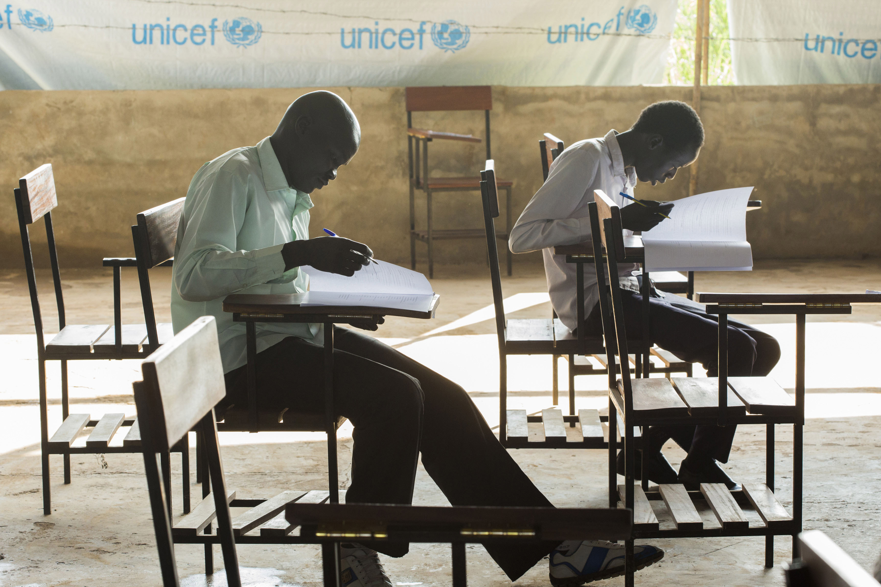
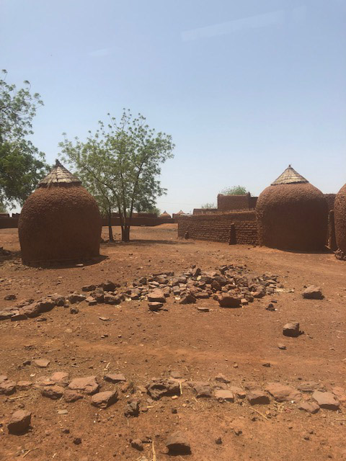
Why do people move? Reasons include...
Livelihood, decent work
Adequate housing, forced evictions
Violence, including gender-based violence exploitation
War, conflict, persecution, generalized violence
Poverty, food/water insecurity
Discrim-ination, stigma, prejudice
Climate change, natural disasters
Family reunification
Access to healthcare, including sexual and reproductive health
Access to education

Slide 5
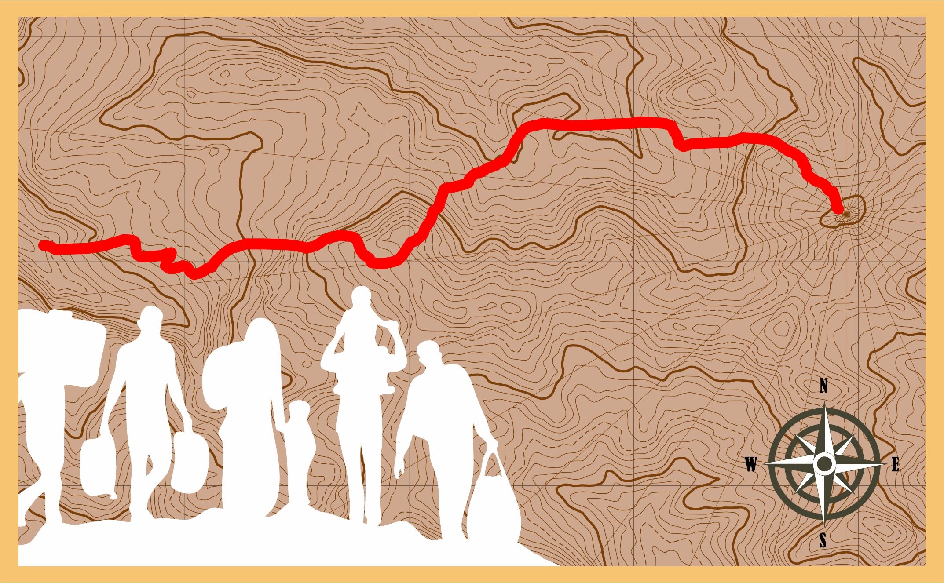
Challenges along the journey
Exit bans
Exit visa requirements
Law enforcement
Walls/fences
Dangerous interception practices
Criminalization of irregular migration
Mandatory detention policies
Dangerous return practices

Slide 6
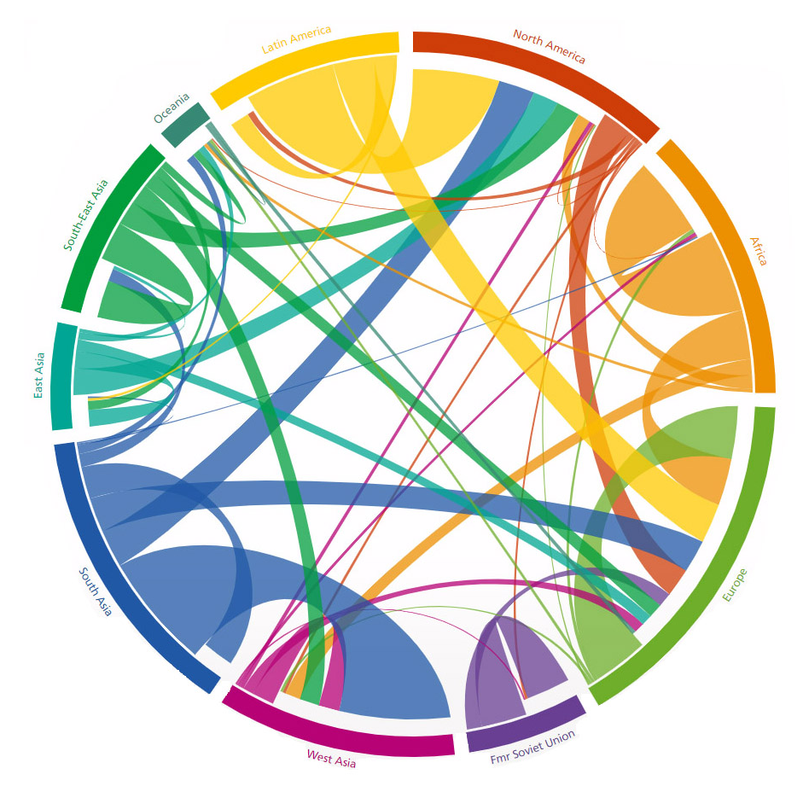
Where do people move?

Slide 7
Activity: Human experiences
Read your migrant’s story
What does the story tell you?
Who is this person?
What issues does she or he face?
Note your answers in the left column
5 minutes
Read the definitions
Which categories apply to your migrant story?
Are there gaps?
Note your answers in the right column. Align them with the issues you put in the left column
10 minutes

Slide 8

Yusuf, 17 years old
I have been here in this detention centre for two weeks. There is no work in our village back home. All the young men have to leave to be able to support their families, and the security situation is getting worse. It took me one year to get to Europe, walking across mountains that were strewn with dead bodies, and working along the way to finally reach where I am now. In Türkiye I worked in a restaurant where the hours were long and the work was very tiring and occasionally dangerous (I have been burned by the fires of the oven several times). My passport was retained by the restaurant owner for “safe keeping”, so I have no documents with me.
I have told the guards here that I am 17 but they laugh at me and tell me that I look much older. There is no telephone in the centre to contact my family, and my mobile phone was taken away from me. I share a cell with four adult men, and am not allowed outside for more than 10 minutes a day. I sometimes feel that I am more scared here than crossing those dangerous mountains.

Slide 9
Amodita, 20 years old
I left my home when I was 14 years old because my father was desperately ill and I needed to work to pay for his medical treatment. Both my parents are elderly and they rely on the money that my sister and I can earn. A friend of the family knew an agent who arranged documents, a place for me to work and someone to accompany me on the journey. My parents put all their savings into paying the agent and took out extortionate loans.
I lived with a rich family, where I cleaned, cooked and took care of the two children. Even though I worked very hard, my employers were never happy and abused me. One day they both subjected me to vicious sexual violence and I knew I had to escape. I am now in a shelter and am receiving medical treatment but I am in constant fear of deportation. I do not want to return home as I have not been able to achieve my goal to send money home. How can I face my parents when all I have done is spend their money?

Slide 10
Ichanga, 25 years old
My village has been affected by drought since before I was born and my family had to leave for the city in search of a livelihood because my father could no longer farm his land. We lived in a shanty town for a few years but were still unable to make a living. My parents then took me and my brother to Libya. The Libyans did not treat us well and when conflict erupted it became very dangerous.
I was working in Libya but my employers refused to pay me, telling me I had to work or else be killed. They had taken my passport and I had no choice but to leave by crossing the Mediterranean. I don’t know what has happened to the rest of my family – I have not been able to reach them. I don’t know how long it will take for me to get a passport. I think this is why I am in prison here in Italy. I don’t know what will happen to me. Maybe they will send me back to my country. I have not lived in my country for 20 years and have no family left there.

Slide 11
Yasmine, 20 years old
Our community has lived in the region for over a century, but we are not of the same religion as the majority of the population, which has led to problems so serious that last year a mob came and burnt down our entire village. Those who survived fled to a refugee camp from which the Government does not allow them to leave. I stayed there for a few months but could not bear the squalid conditions and misery. There was nothing worth living for.
I managed to find a man who was willing to help me get me out of the country. I didn’t have anything of value, so he agreed to let me pay him back once I got a job. After my journey at sea, the people on the boat took me and half of the group to a camp in the jungle where we were treated like slaves and sexually abused. I was lucky enough to escape but have not seen a doctor even though I am worried that I may be pregnant. I am too afraid I’ll be detained and deported. A woman that I met recently gave me some medicine, but now I have a high fever. I don’t know what to do.

Slide 12
José and cousin, 15 years old
My cousin and I (both 15 years old) left together because our families wanted us to receive a better education and they feared that we would be pressured to join a gang. In our community the men are supposed to be out on the streets, not reading books in school; that’s for girls. My father moved to live irregularly in the US two years ago, and after my mother was killed in a shoot-out we decided to try and join him. We travelled north on buses and on foot, trying to avoid the “la bestia” train because we heard how the Mexican authorities were stopping many people, arresting them and sending them back across the border.
We are waiting here at the US border to earn enough money to pay a “coyote” to smuggle us across the border because it is too risky to take your chances on your own. We hear stories of other travellers who have been kidnapped by the coyotes for ransom. I have been working long hours at whatever jobs I can find. We are living in a run-down part of the border town, in an abandoned building without access to sanitation.

Slide 13
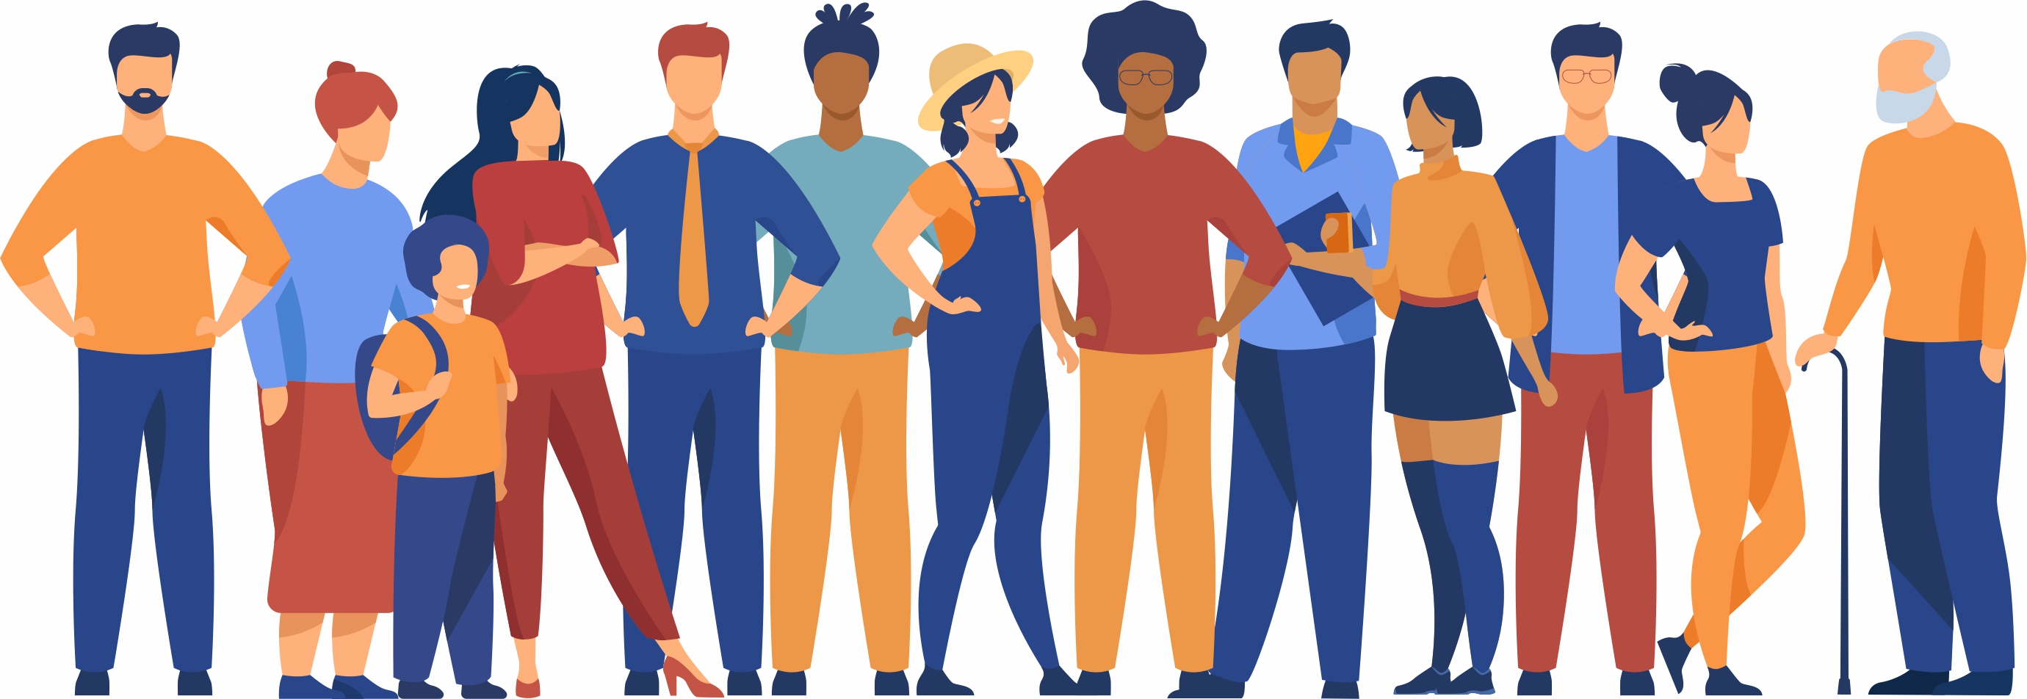
Definitions and categories
MIGRANT
Forced?
Voluntary?
Trafficked person
Refugee
Irregular migrant
Internally displaced person
Smuggled person
Unaccompanied child
Asylum seeker
Migrant worker

Slide 14

The challenge of terminology
[T]here is growing recognition that proliferation [of migration categories] obscures rather than illuminates the processes underlying the decision to move, with potentially harmful effects on policy-making.
UNDP Human Development Report (2009)

Slide 15
Migrants in vulnerable situations are
migrants who are unable effectively to enjoy their human rights, are at increased risk of violations and abuse and who, accordingly, are entitled to call on a duty bearer’s heightened duty of care.
OHCHR/Global Migration Group, Principles and Guidelines (Geneva, 2017)
It is important to identify individuals in vulnerable situations in order to understand what specific protections they are entitled to and refer them to the appropriate services.
Even in vulnerable situations migrants exercise autonomy and make their own decisions.

Slide 16
Migration is…
WHOSE BUSINESS?

Slide 17
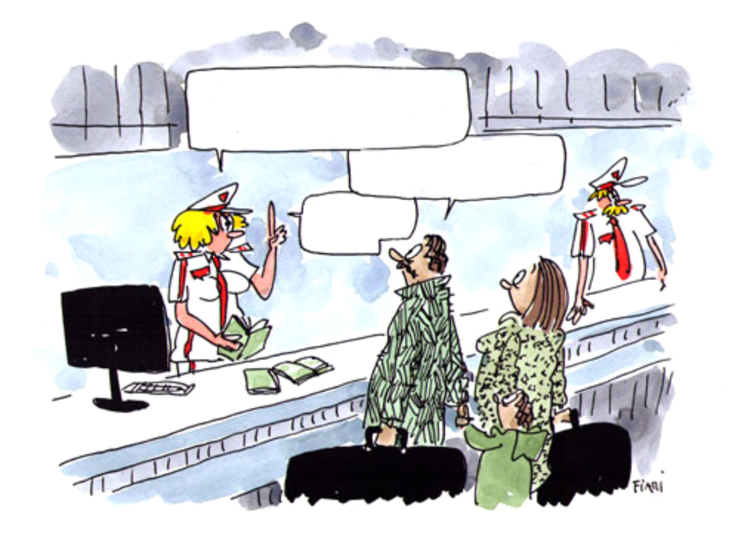
Stereotypes – myths – reality?
IN THIS COUNTRY, MIGRANTS HAVE A DUTY TO PAY TAXES AND SOCIAL SECURITY CONTRIBUTIONS!
SO WE CAN ALSO BENEFIT FROM THEM?
LET’ NOT EXAGGERATE!

Slide 18

Yes or No?
Should irregular migration – i.e., crossing borders or staying in countries without proper permission – be a crime?

Slide 19
Yes or No?
Do irregular migrants pay taxes?

Slide 20
Yes or No?
Are expats and migrants different?

Slide 21
Yes or No?
Regularization programmes are a means of addressing irregular migration

Slide 22
How to respond to prejudice and inaccurate perceptions.
Consider and acknowledge the views of others we disagree with. Why do they feel that way?
Facts
Balanced arguments
Framing
Human rights apply to everyone – regardless of their circumstances
Balanced and evidence-based arguments!
BUT… be careful with statistics…

Slide 23
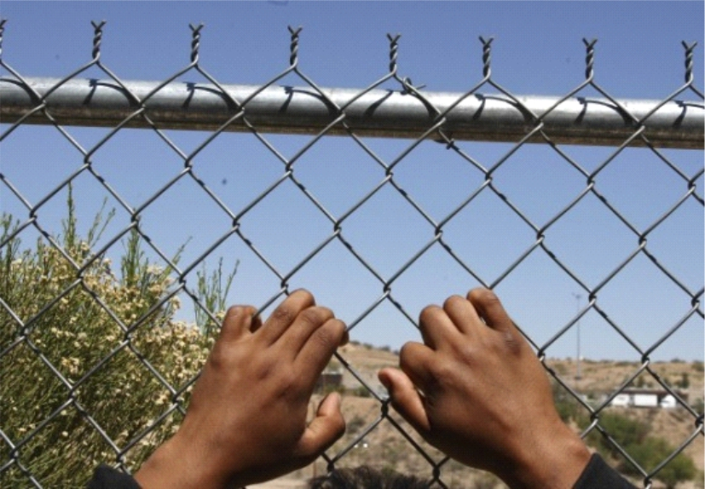
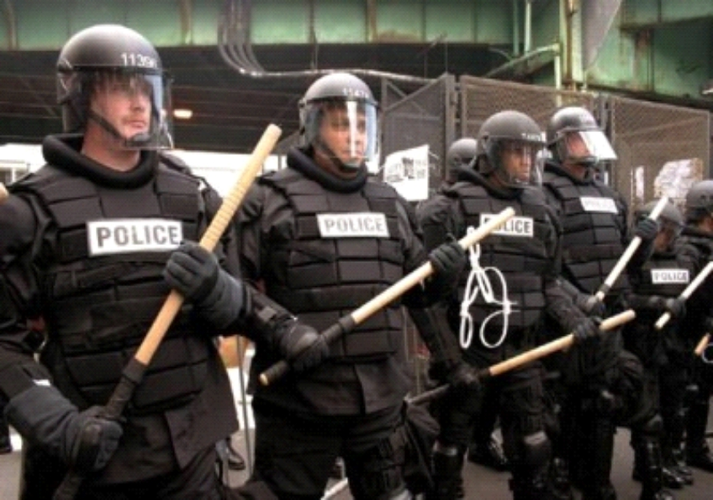
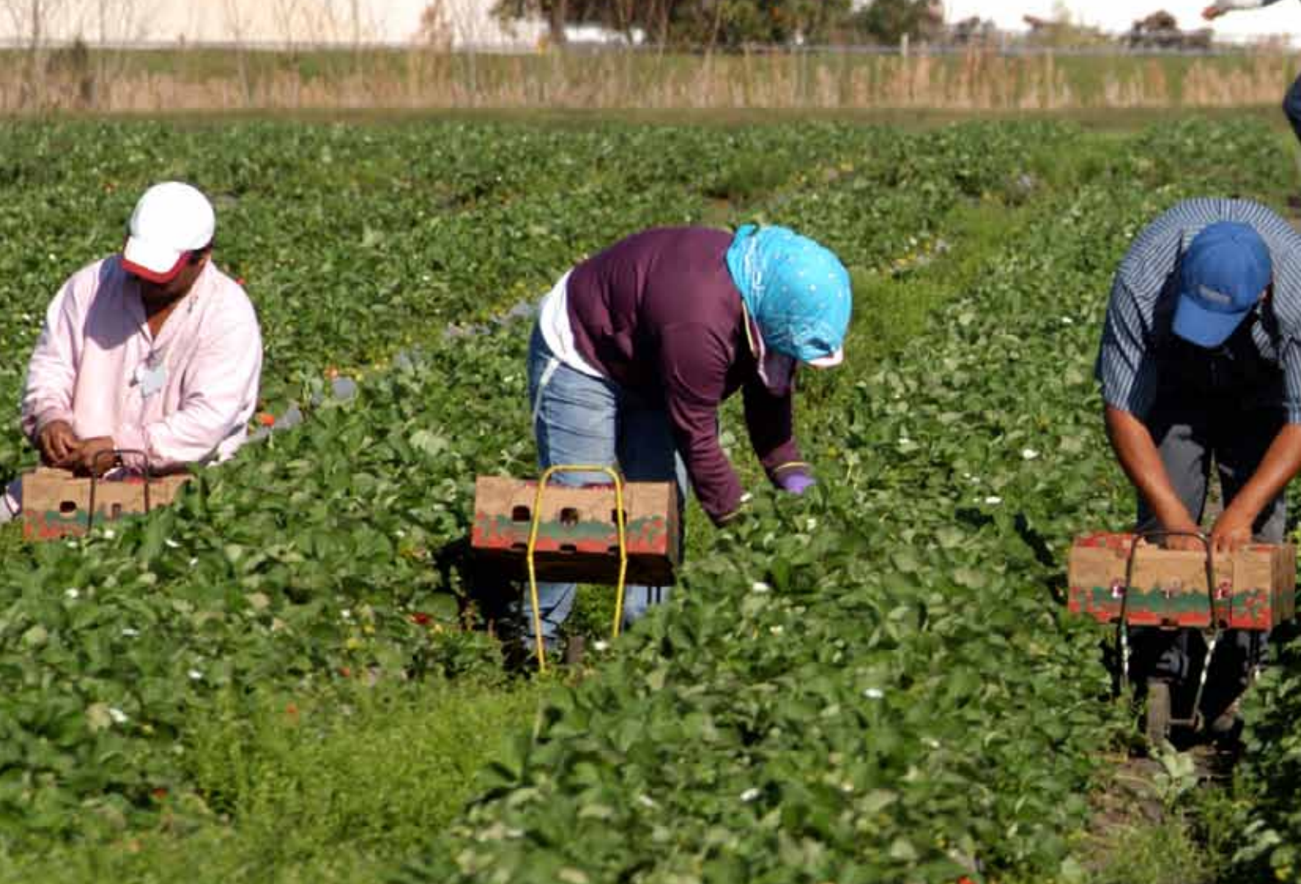

Policy responses to migration
State sovereignty
Migration discourse
Populism/ nationalism
Security
Economic interest

Slide 24
Why are these approaches problematic?
Populism / nationalism encourages hostile and xenophobic responses to migrants
Security imposes harsh or discriminatory law enforcement responses and criminalizes irregular migrants
Economic interest treats migrants as commodities or units of labour
Lack of a human rights perspective = Inadequate migration policies

Slide 25

Summary and key messages
Migration is as old as humankind. It occurs in and between all regions of the world. Almost every country is a country of origin, transit or destination, and an increasing number are all three.
All migrants, regardless of their motives for migrating or their legal status, are entitled to their human rights.
It is important to challenge beliefs about and attitudes to migrants that are based on stereotypes and myths rather than reality.
Migration is a complex, multi-faceted phenomenon with important economic, social and political dimensions. However, at its heart are human beings with human rights, who should be at the centre of analysis and policy interventions on migration.

Slide 26
To sum up…
Migration is the story of humanity. At its best, it tells the stories of teachers, doctors, care and construction workers, actors and artists who have found success and enriched their adopted lands… the only effective approach to migration must be grounded in the human rights of the people concerned, focusing on root causes and long-term solutions.
Zeid Ra’ad Al Hussein,
Former UN High Commissioner for Human Rights

Slide 27

Useful resources
OHCHR and Global Migration Group, Principles and Guidelines, supported by practical guidance, on the human rights protection on migrants in vulnerable situations, 2018
OHCHR, Report on the promotion and protection of the human rights of migrants in the context of large movements, 2016
OHCHR, Study on the Situation of Migrants in Transit, 2015
OHCHR, Migration and Human Rights: Improving human rights-based governance of international migration, 2012
Global Migration Group, International Migration and Human Rights: Challenges and opportunities on the threshold of the 60th anniversary of the Universal Declaration for Human Rights, 2008
PANOS and UNOAC, Media Friendly Glossary on Migration, 2014
OHCHR, Informal summary of the Roundtable on confronting hate in our societies and reshaping narratives on migration, 2019

Slide 28
Amplifying migrant voices
The OHCHR documentary short film I Am Not Here follows three women migrant domestic workers
OHCHR’s animated video series Stand Up For Migrants tells 15 stories of migrants from across the world

Slide 29
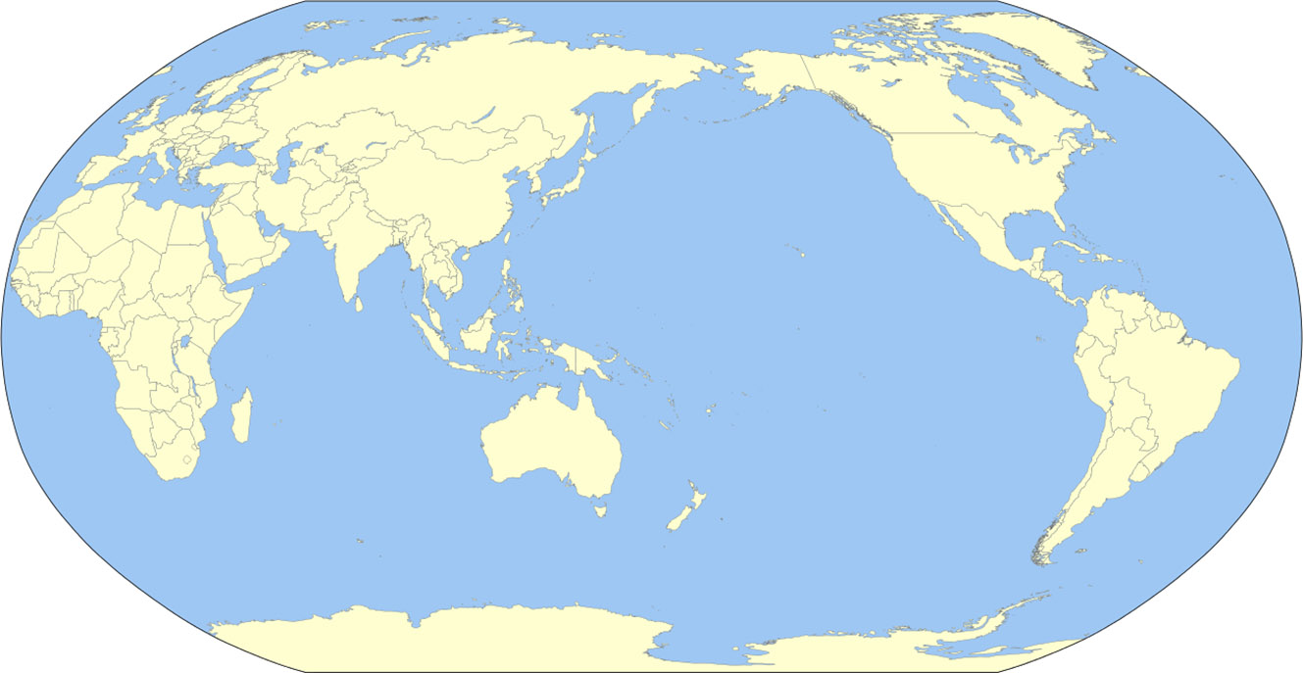
Migration map
https://www.iom.int/world-migration

Slide 30
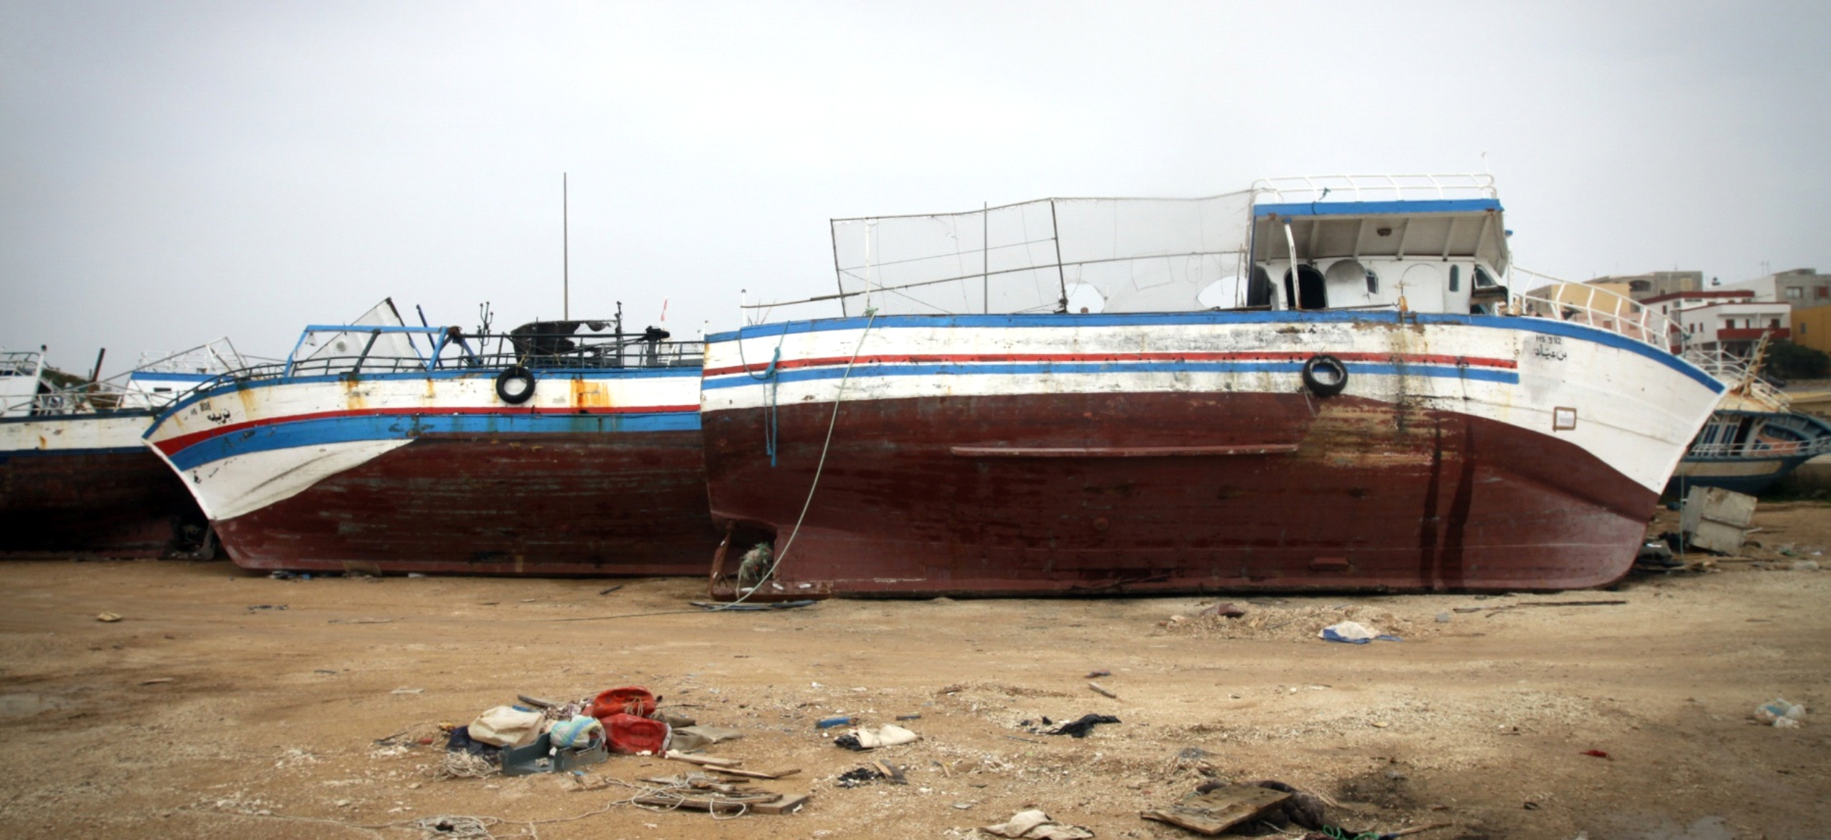
Could you make it into “Fortress Europe”?
http://www.theguardian.com/global-development/ng-interactive/2014/jan/refugee-choices-interactive

Slide 31
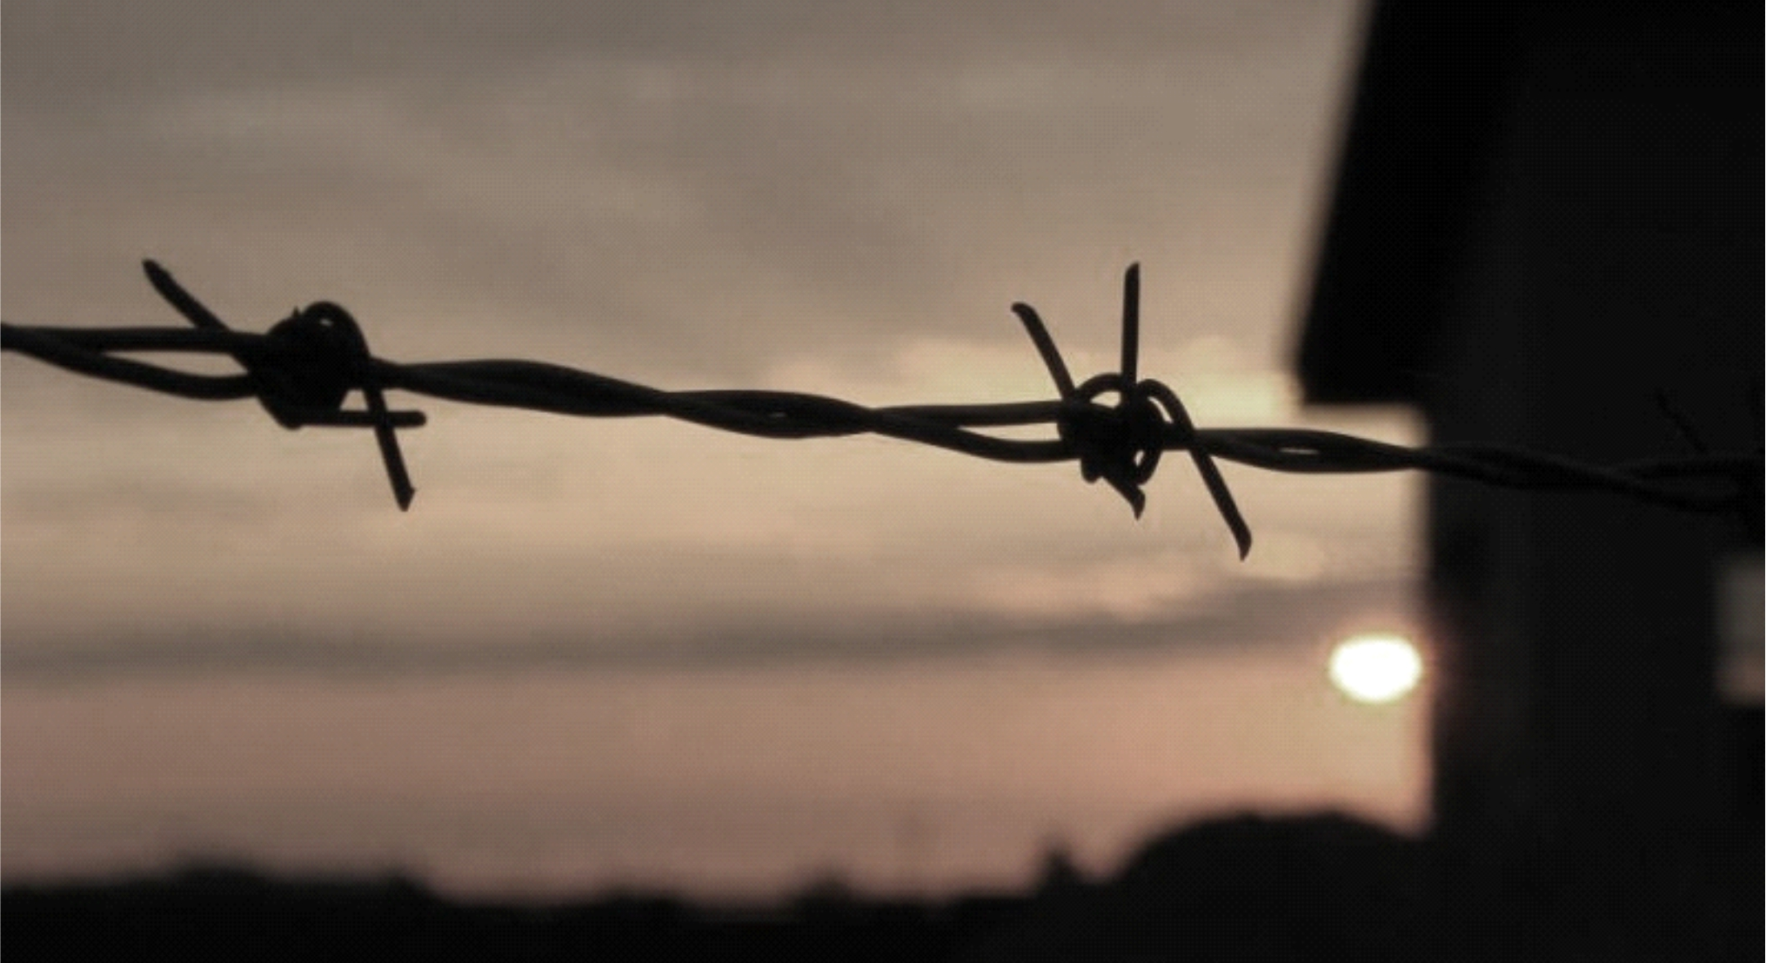
Deaths at borders
http://missingmigrants.iom.int/

