Slide 1


MODULE 2
Understanding migration as a human rights issue
Session 4: The Convention on Migrant Workers

Slide 2

Module overview
Session 3: International human rights and migration
Session 4: The Convention on Migrant Workers
Session 5: The United Nations human rights system

Slide 3

Session overview
The International Convention on the Protection of the Rights of All Migrant Workers and Members of their Families (background and content)
Challenges to ratification and implementation
Identifying migration-related human rights issues by analysing a case study

Slide 4
Draft a convention on the rights of migrant workers
Congratulations! You are the new Special Rapporteur on the human rights of migrants!
Your first task is to support the development of a new convention on the rights of migrant workers.
In your group, brainstorm the question on your flip chart.
After 5 minutes, move to the next flip chart. Discuss its question and the answers given by the previous group(s). Add to the list other rights you can think of.
What rights should be included in this convention?

Slide 5
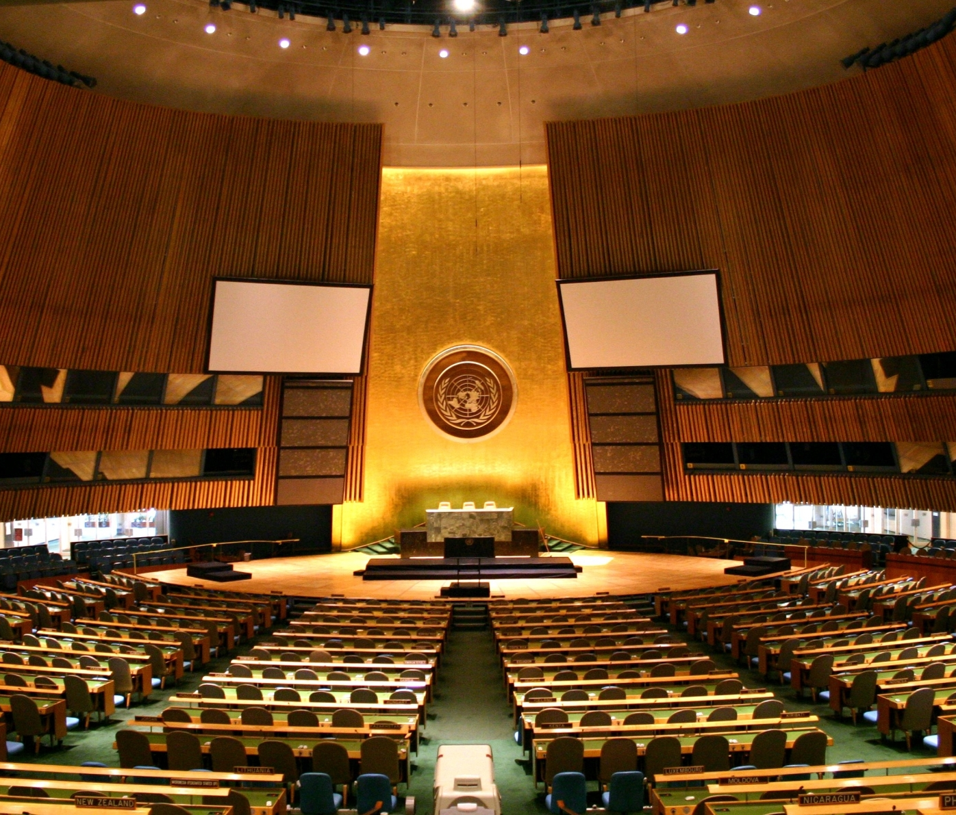
History of the Convention on Migrant Workers
Drafting the convention took ten years.
The General Assembly adopted it on 18 December 1990 without a vote.
It entered into force on 1 July 2003.
It currently has 58 ratifications and 11 signatories.

Slide 6
What does a convention on migrant workers add?
It:
Affirms minimum standards of civil, political, economic, social and cultural rights
Addresses the specific vulnerabilities of migrant workers
Improves their situation by reaffirming existing norms and creating new norms that are relevant to migrants
Prevents and prohibits exploitation in the migration process
Clarifies the obligations and responsibilities of States: rights become legally enforceable in national laws
Harmonizes treatment
Offers an avenue for individual complaints… More?

Slide 7

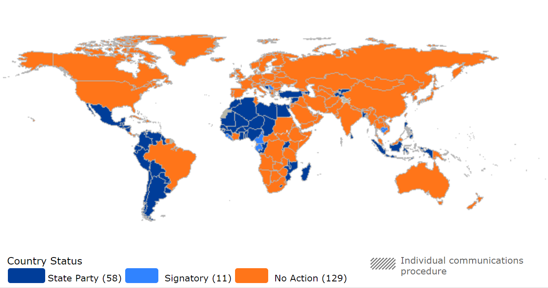
Map of ratifications

Slide 8
Who does the Convention on Migrant Workers protect?
All migrant workers (irregular and regular)
Members of their families
Frontier workers
Seafarers
Seasonal workers
Project-tied workers
Workers on offshore installations
Itinerant workers
Workers in specified employment
Self-employed workers

Slide 9
Who is a migrant worker?
“A person who is to be engaged, is engaged or has been engaged in a remunerated activity in
a State of which s/he is
not a national”
(Article 2(1))
Article 5:
A migrant worker is considered to be either:
Documented / in a regular situation
Undocumented / in an irregular situation

Slide 10

Non-discrimination
Prohibition of:
“A person who is to be engaged, is engaged or has been engaged in a remunerated activity in
a State of which s/he is
not a national”
(Article 2(1))
distinction of any kind such as … sex, race, colour, language, religion or conviction, political or other opinion, national, ethnic or social origin, nationality, age, economic position, property, marital status, birth or other status
(Article 7).

Slide 11
Prohibited grounds of discrimination:
comparing treaties
“A person who is to be engaged, is engaged or has been engaged in a remunerated activity in
a State of which s/he is
not a national”
(Article 2(1))
ICCPR and ICESCR | CMW
Race, colour, sex, language, religion, political or other opinion, national or social origin, property, birth or other status | Sex, race, colour, language, religion or conviction, political or other opinion, national, ethnic or social origin, nationality, age, economic position, property, marital status, birth or other status

Slide 12

Group activity
Part III of the Convention (human rights of all migrant workers)
On a flip chart, identify and match relevant articles with corresponding rights
10 minutes!

Slide 13
Basic rights and freedoms
Non-discrimination (article 7)
Freedom of movement to and from country of origin (article 8)
Right to life (article 9)
Protection against torture (article 10)
Freedom from slavery and forced or compulsory labour (article 11)
Freedom of thought, conscience and religion (article 12)
Freedom of opinion and expression (article 13)
Right to privacy (article 14)
Right to property (article 15)
Right to liberty and security (articles 16, 17)
Right to emergency medical care (article 28)
Right to a name, birth registration and nationality (article 29)
Right to education (article 30)
Right to cultural identity (article 31)
Right to information (article 33)

Slide 14
Procedural rights
Right to a fair trial and equality before the law (article 18)
No punishment without law (article 19)
Prohibition of imprisonment for debt (article 20(1))
Prohibition of expulsion for failure to fulfil employment-related contractual obligations (article 20(2))
Protection from confiscation or destruction of documents (article 21)
Prohibition of collective expulsion and right to individual assessment (article 22)
Right to consular protection (article 23)

Slide 15
Employment rights
Right to fair conditions of work (article 25)
Right to join trade unions and right to association (article 26)
Right to social security (article 27)
Right to transfer earnings and savings on termination of stay in the State of employment (article 32)

Slide 16

Case study exercise
What human rights issues can you identify in the case study of Bea and John’s family?
Link these issues to relevant human rights standards.
You have 20 minutes!

Slide 17
What are some of the challenges to ratification?
The complexity and length of the Convention on Migrant Workers.
Concerns about its scope. Some think, for example, that it interferes with sovereignty or promotes irregular migration.
Lack of political will to protect migrants’ rights.
Contains specific language for policy implementation
Promotes preference for regular migration
Acknowledges that the economic and social benefits of migration can only be achieved if migrants are protected

Slide 18
Why ratify?
To show government commitment (legally and symbolically)
To implement standards in domestic law
To be accountable to the international community
To provide a foundation for policy and programmes
To promote awareness of rights
To facilitate cooperation and coordination between countries of origin and destination
To emphasize a human rights-based approach

Slide 19

Key messages
The Convention…
Establishes the obligations of countries of origin, transit, and employment
Interprets in more precise terms how general rights and obligations apply to the situation of migrant workers
Sets out several rights and protections that are specific to migrant workers
Is a valuable tool to promote and protect the rights of migrants
Is one of nine core international human rights instruments that protect migrants

Slide 20

Useful resources
OHCHR, Fact Sheet No. 24 (Rev. 1), The International Convention on Migrant Workers and its Committee
International Steering Committee for the Campaign for the Ratification of the Migrants Rights Convention, Guide on Ratification – International Convention on the Protection of the Rights of All Migrant Workers and Members of their Families
The Global Compact for Safe, Orderly and Regular Migration

Slide 21
Part III: The rights of all migrant workers.
Basic rights and freedoms
Right to life (article 9)
Protection against torture (article 10)
Protection against slavery and forced or compulsory labour (article 11)
Right to privacy (article 14)
Protection from the arbitrary deprivation of property (article 15)
Right to liberty and security (articles 16, 17)
Equality before the law (article 18)

Slide 22
Part III: The rights of all migrant workers.
Specific rights of migrant workers
Protection from confiscation or destruction of documents
(article 21)
Protection from collective expulsion (article 22)
Right to consular protection (article 23)
Right to recognition as a person before the law (article 24)
Right to fair conditions of work (article 25)
Right to join trade unions
(article 26)
Right to social security (article 27)
Right to emergency medical care (article 28)
Access to birth registration (article 29)
Access to education (article 30)
Right to information (article 33)

Slide 23
Part IV (articles 36-56): The rights of migrant workers in a regular situation
Standards specific to regular migrants include:
Right to freedom of movement (article 39)
Right to form trade unions (article 40)
Right to participate in public affairs (article 41)
Protection of the family and measures to facilitate reunification (article 44)
Equality of treatment with respect to employment protections (article 54)

Slide 24
Part VI (articles 64-71): Promotion of sound, equitable, humane and lawful conditions
States are expected to cooperate internationally to promote humane migration, taking account of the needs of migrant workers
Regulation of recruitment agencies (article 66)
Regularization: take account of length of stay and family situation (article 69)

Slide 25
What does the Convention on Migrant Workers say about irregular migration?
States may take appropriate action to prevent and eliminate clandestine movement, but must protect the fundamental rights of irregular migrants (preamble).
There is no right to regularization (article 35).
States should take measures to ensure irregular situations do not persist, and should consider regularization, taking account of circumstances of entry, duration of stay, and family situation (article 69).
States should cooperate to discourage irregular migration, including by sanctioning employers (article 68).
Part III sets out the fundamental rights of all migrants.

Slide 26
Article 81: the ‘saving clause’
Nothing in the present Convention shall affect more favourable rights or freedoms granted to migrant workers and members of their families by:
The law or practice of a State Party
Any bilateral or multilateral treaty in force that applies to the State Party

